Slide 1
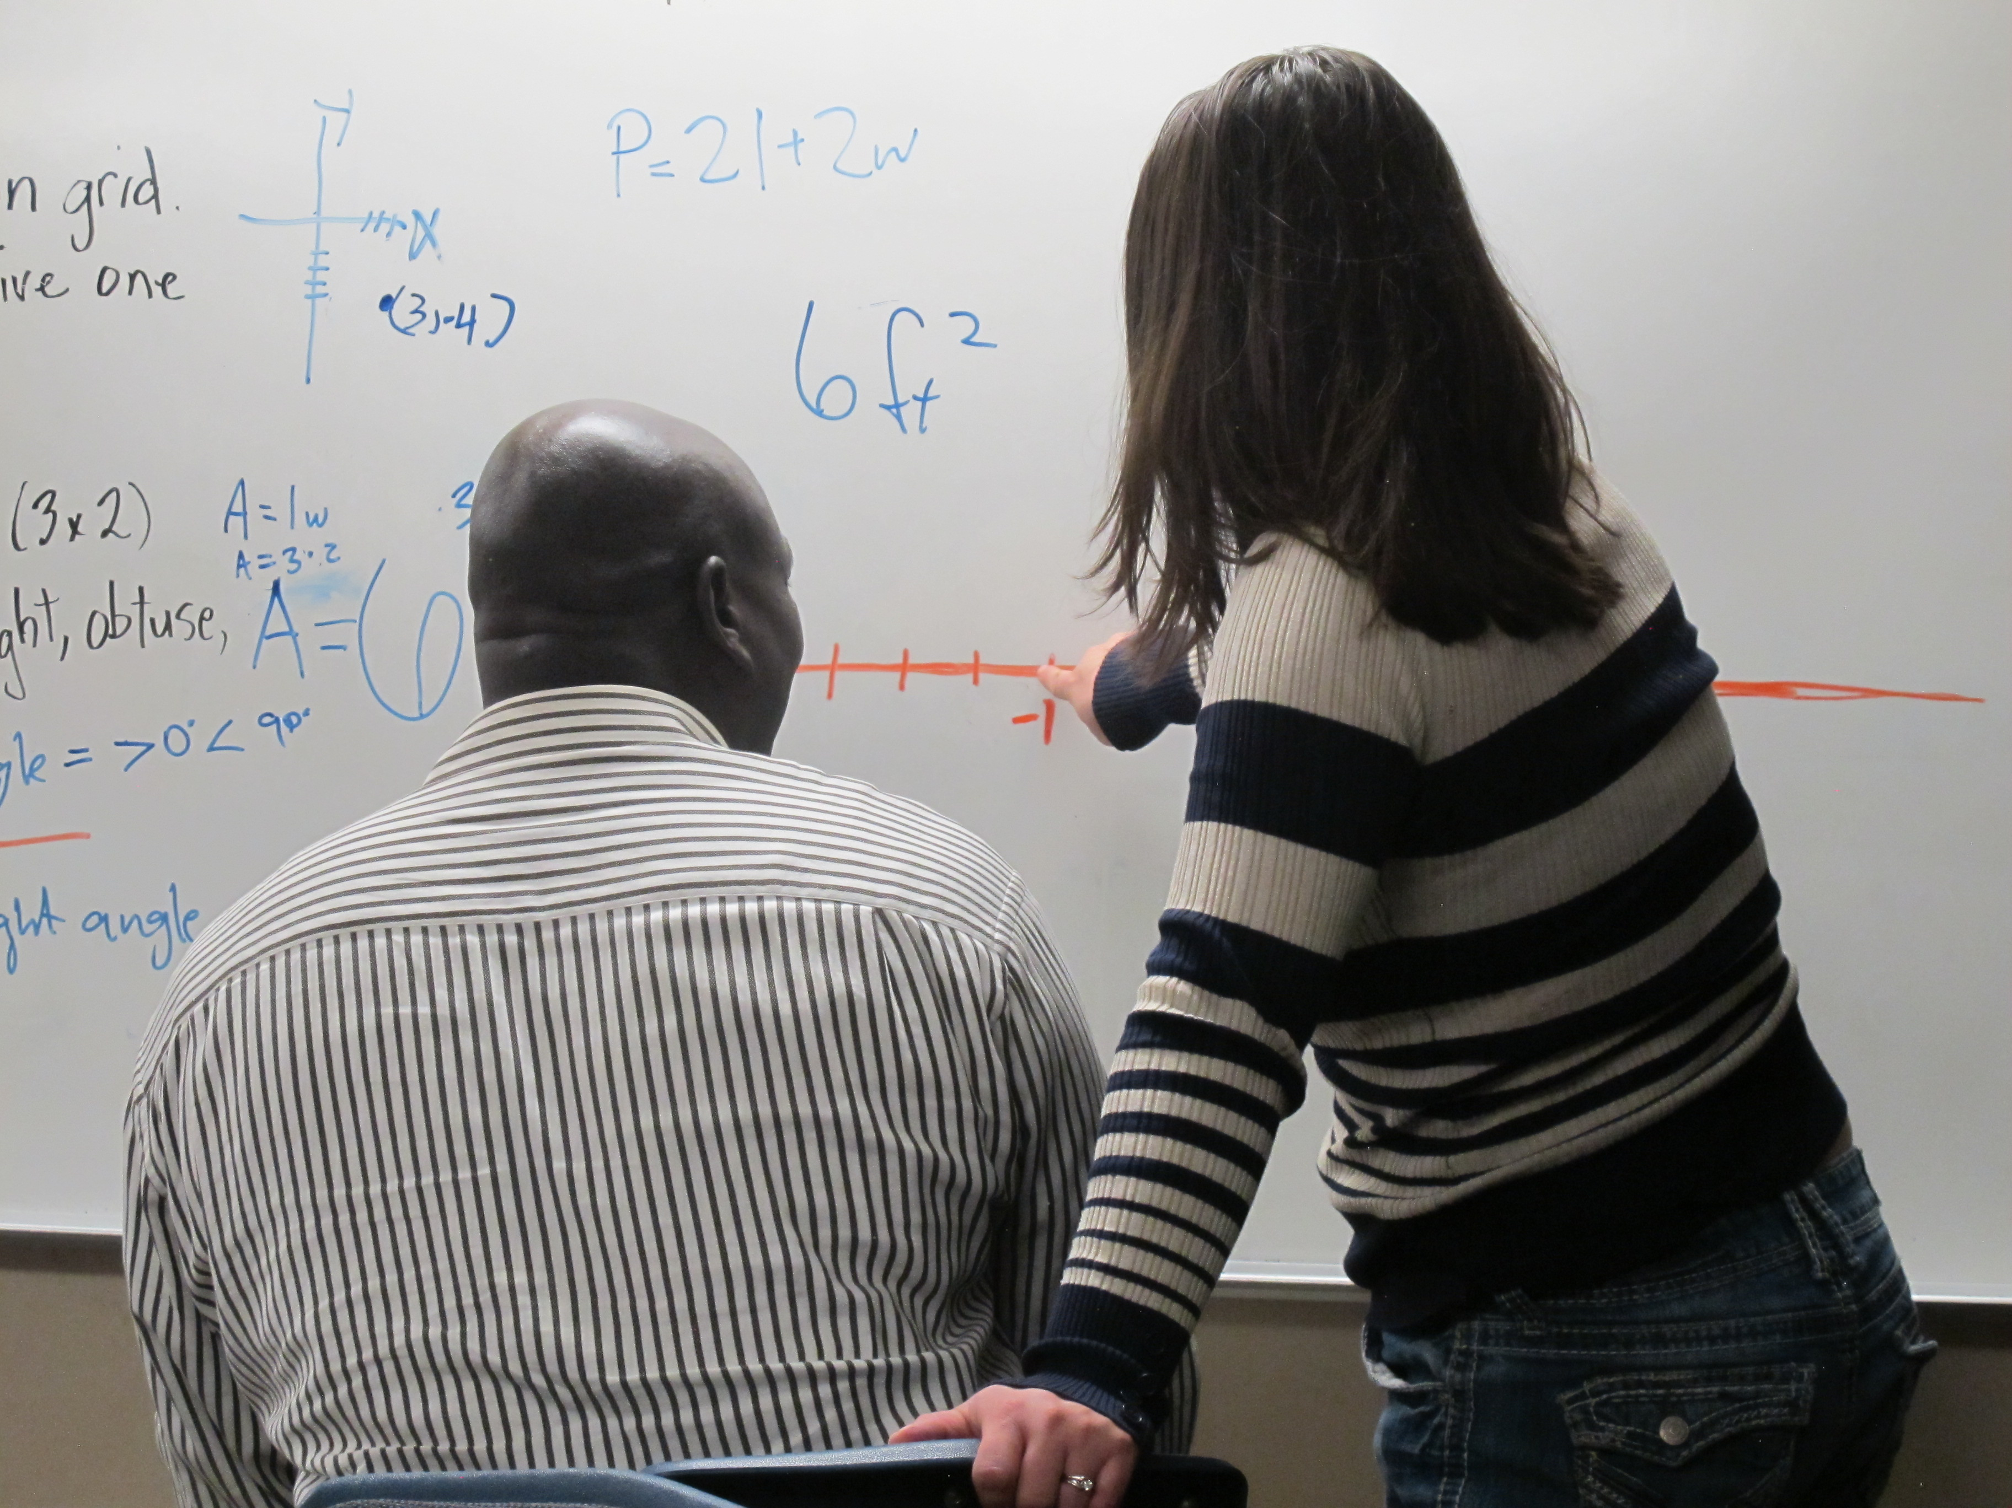
Ask, Don’t Tell
Danny Farris Ray Johnson
John McDonald Ellen Peterson
Deborah Young, Ed.D.
UAACCE/USBE 2018 Conference
Notes:
Slide 1. Introduce us.
John – came to learn writing structure and practice math
Danny – came here to better myself and prepare myself for college
Ray – came here to better myself as a reader and to write stories
Ellen – came here to reach my goals of being a teacher
Deb –been here for xx years; Learning Specialist since 19xx

Slide 2
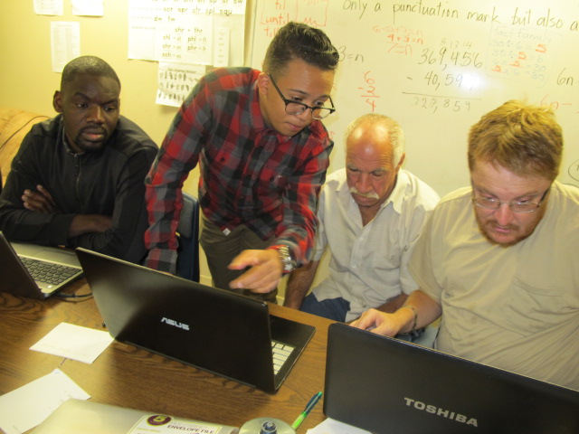
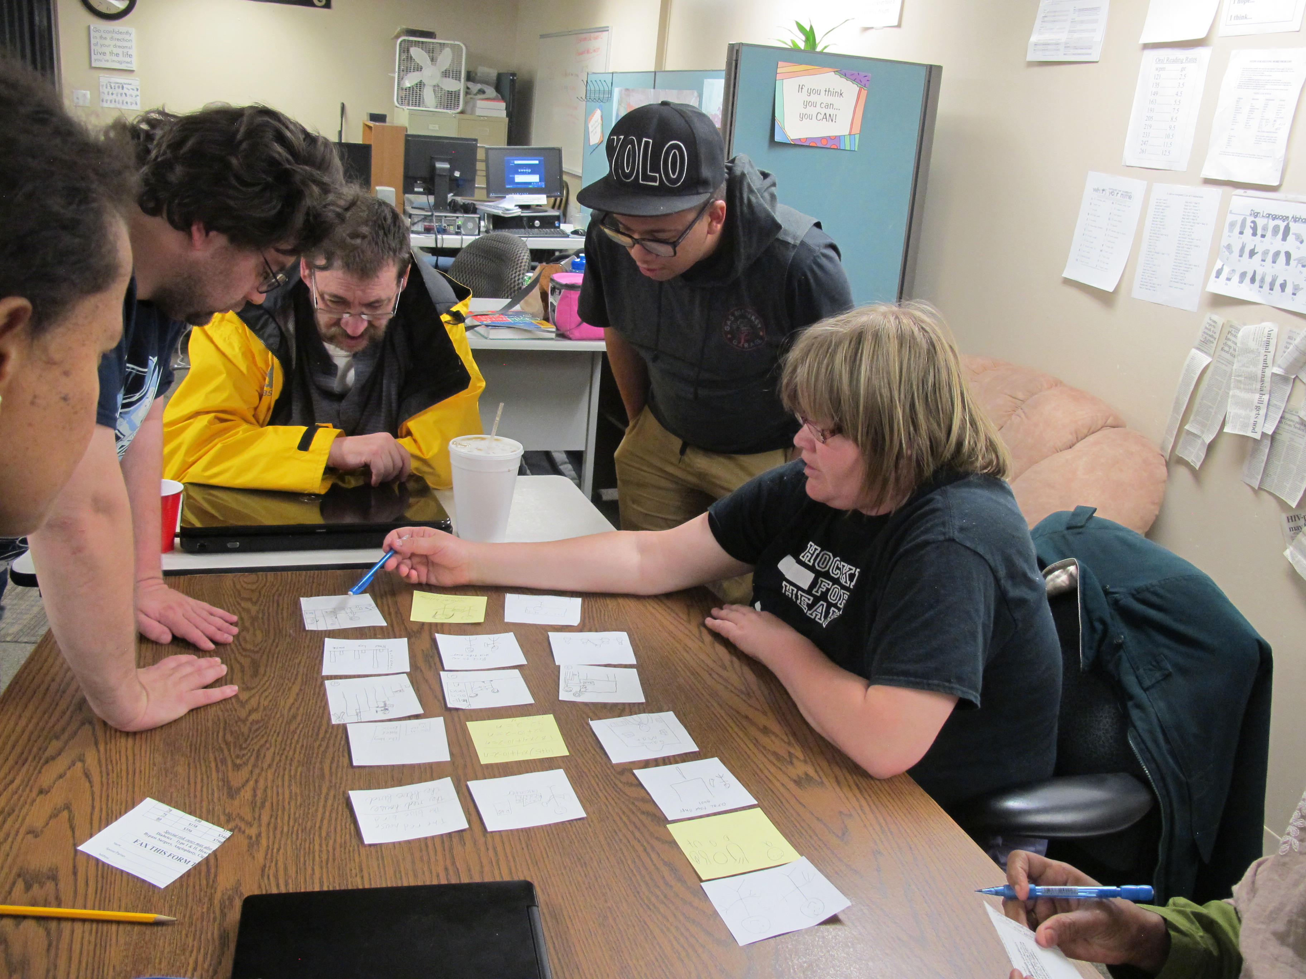
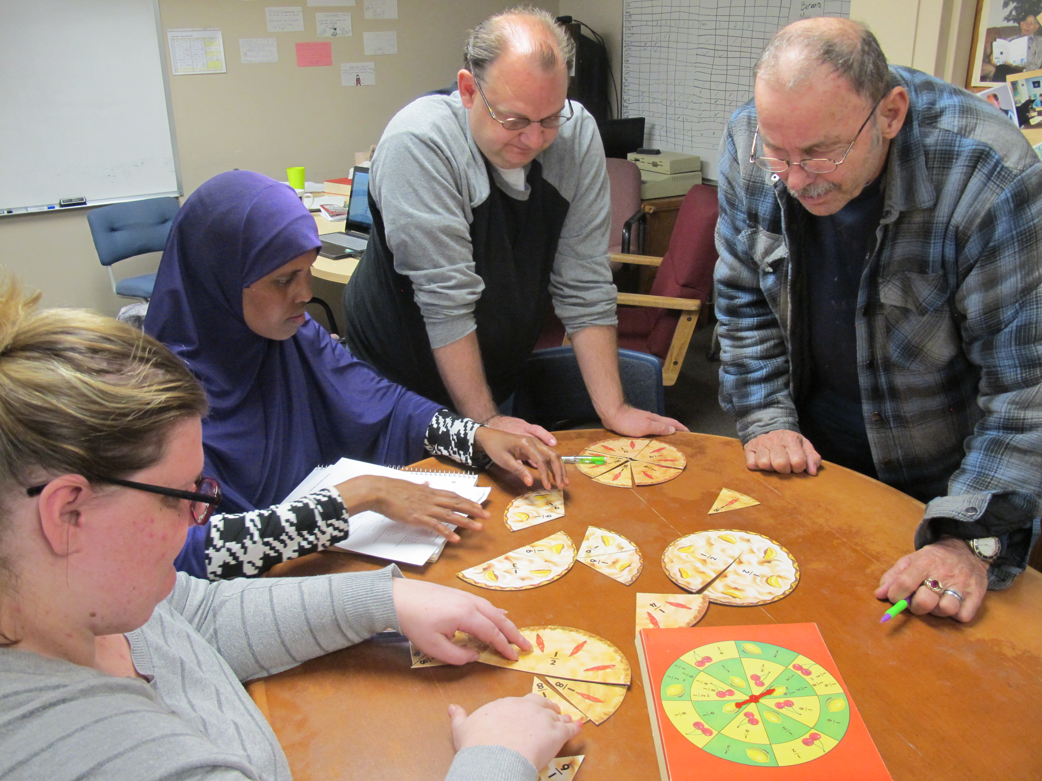
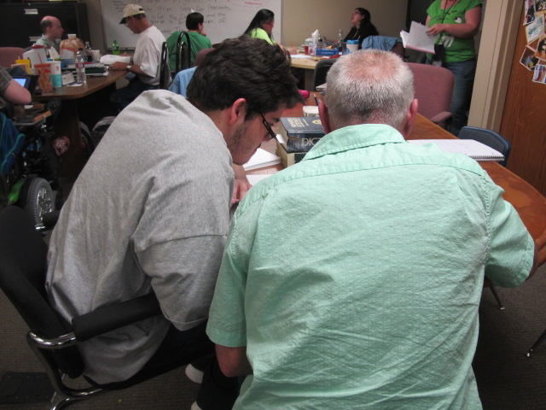
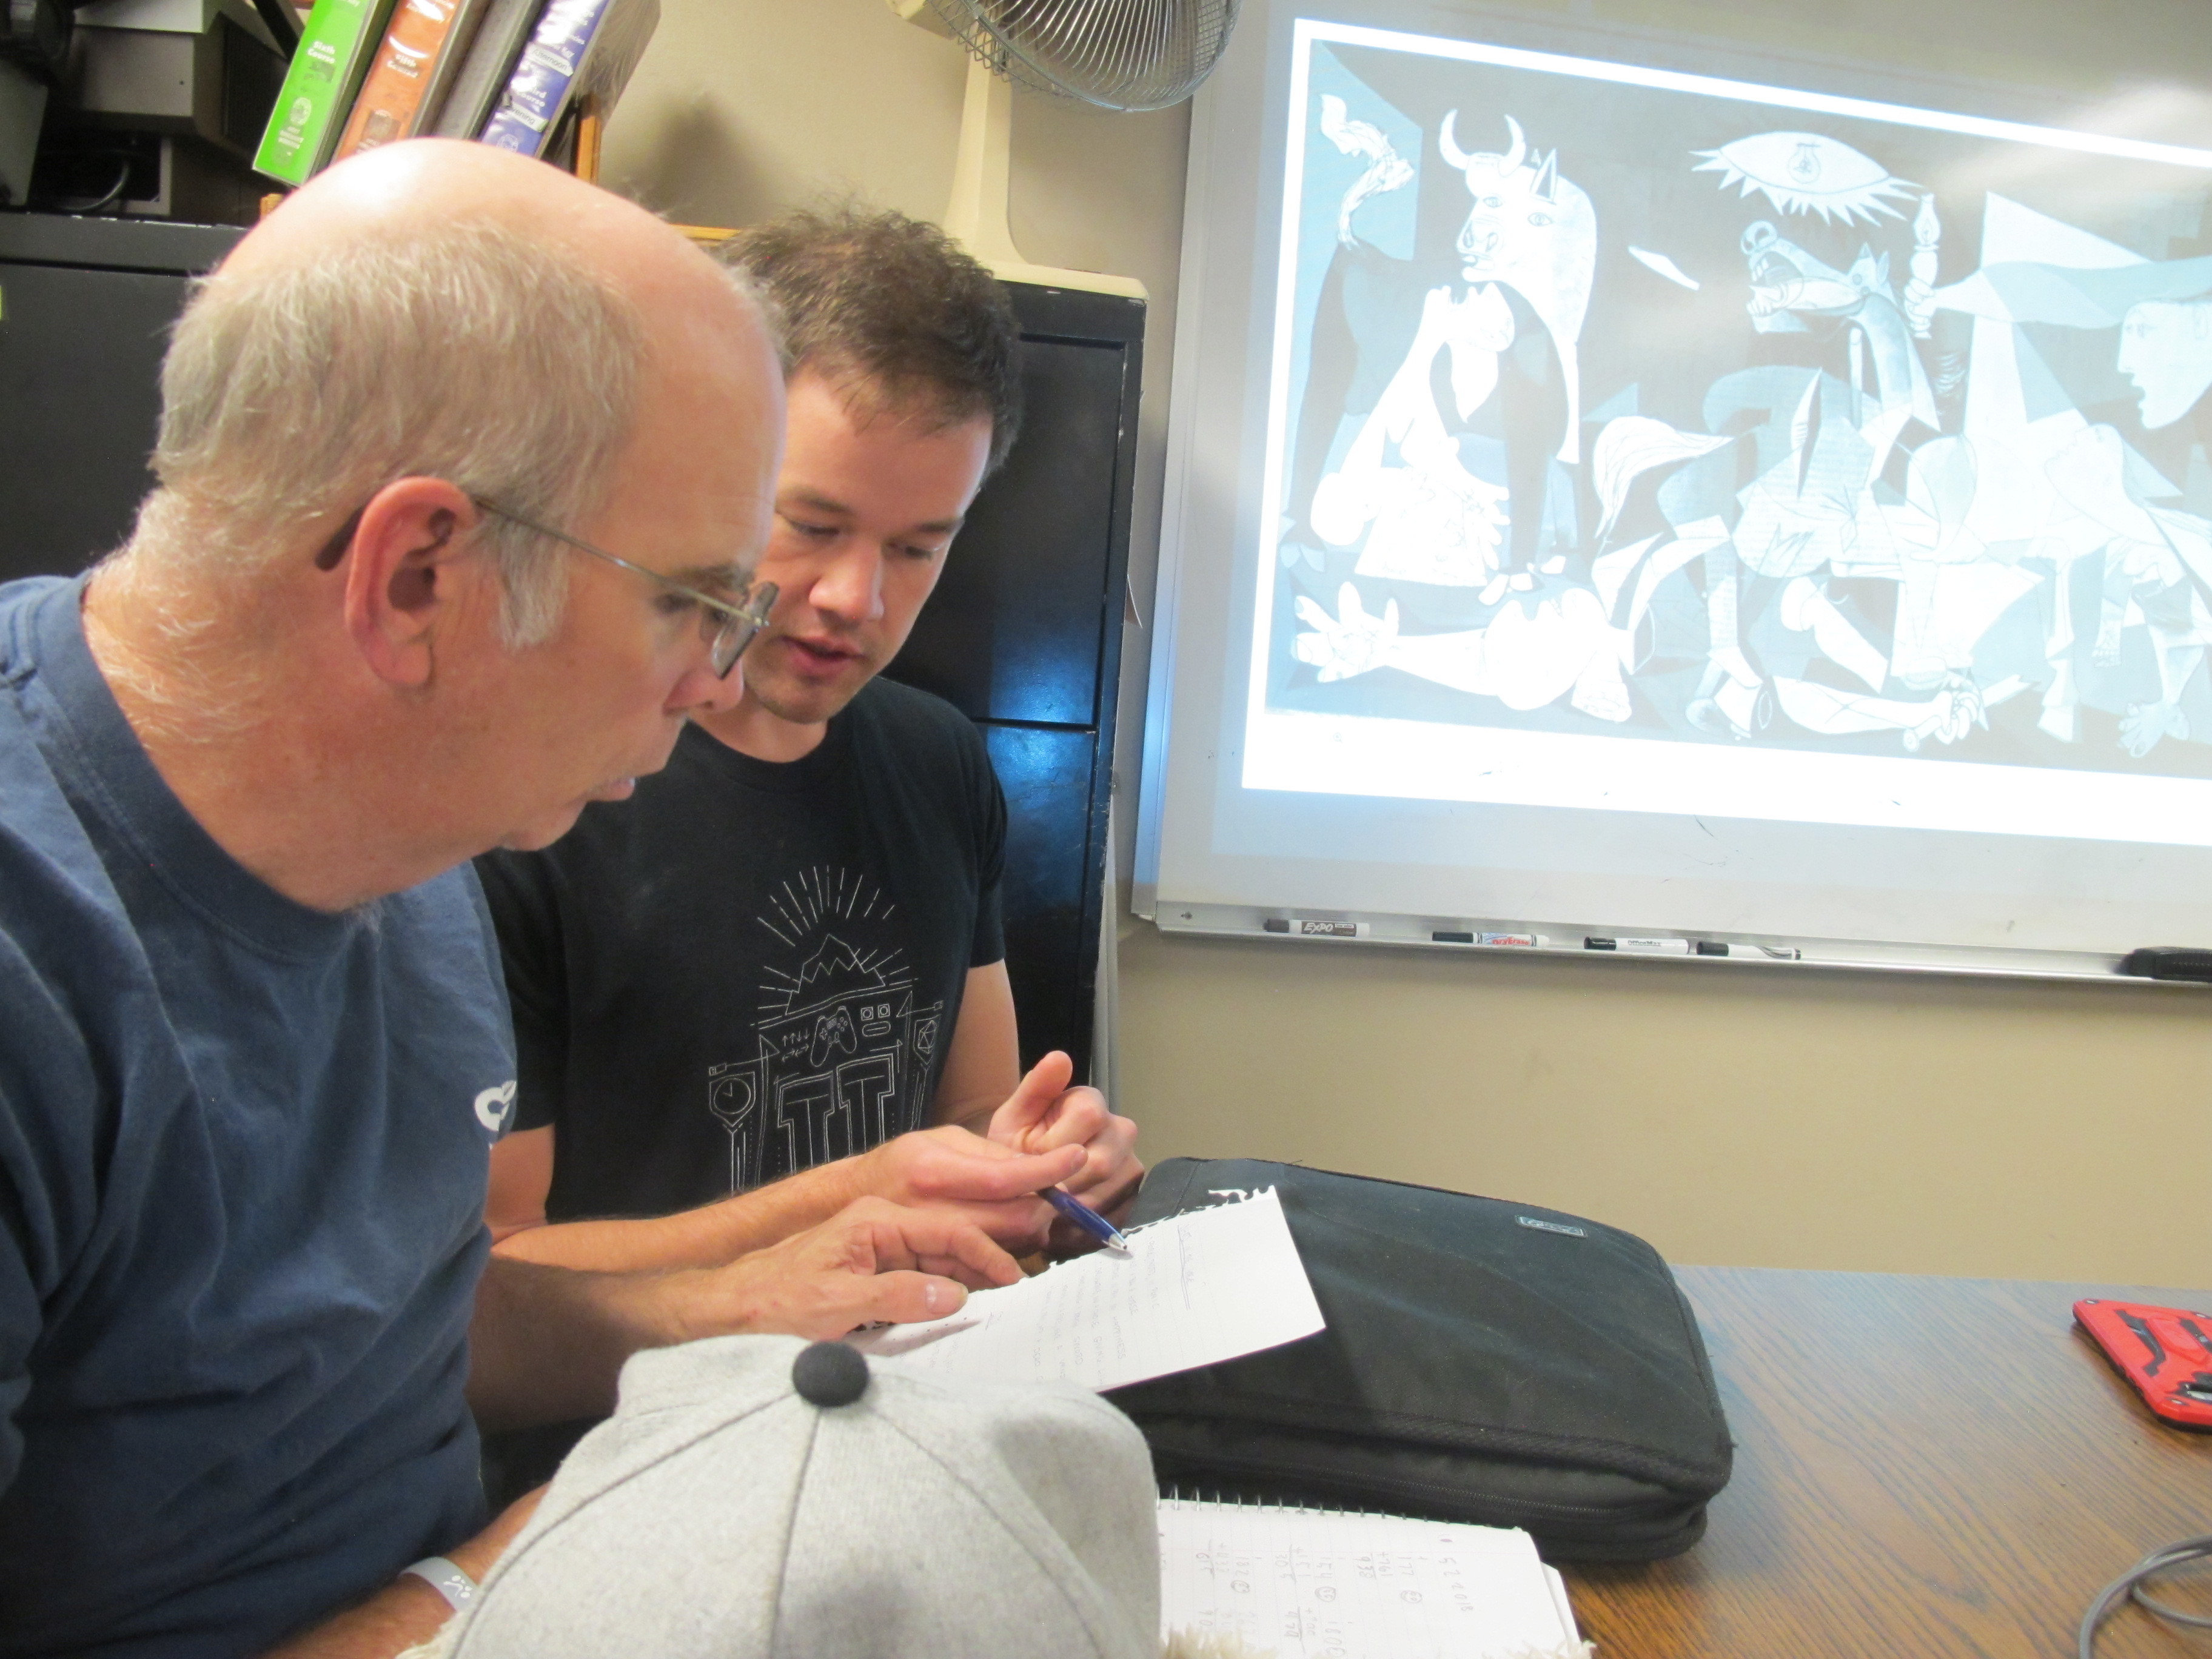
Notes:
Slide 2. Literacy Action Center

Slide 3
What’s your teaching style?
Notes:
Slide 3.

Slide 4
Activity:
Groups of 3
Roles: teacher, learner, observer
Learner comes to teacher with problem.
Observer watches how the teacher handles the problem. 2 minutes
Notes:
Slide 4. Observe for 2 minutes

Slide 5
30 – 24 ÷ 3 ÷ 2² ∙ 2
Notes:
Slide 5.

Slide 6
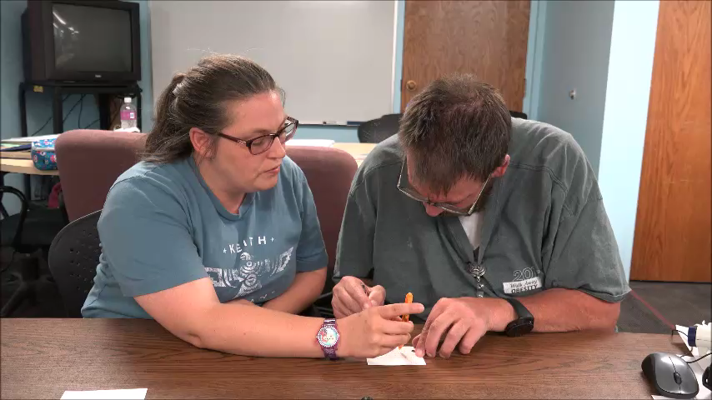
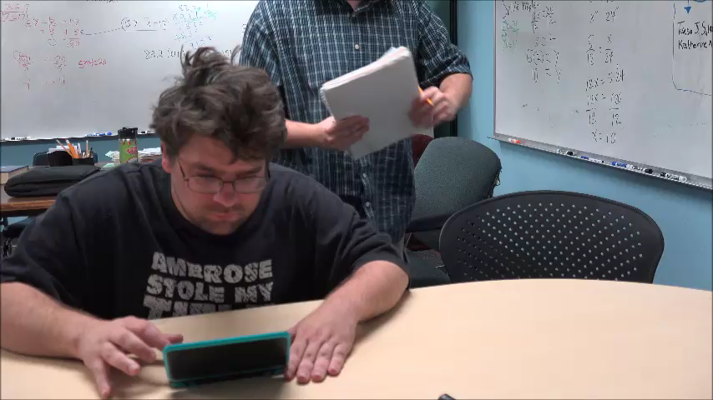
Which style is more like yours?
A
B
Notes:
Slide 6.

Slide 7
Who’s doing the learning?
person doing the work –
talking, writing, or
manipulating the keyboard
Notes:
Slide 7.

Slide 8
Inquiry method:
Open-ended
Reflective thought
Exploration & self-checking
Process and behavior
Learner’s pace & place of understanding
Pinpoints instructional need
Link known to unknown
Notes:
Slide 8.

Slide 9
Note Pages
Go hand-in-hand with inquiry method
Puts learner in charge
Focuses on area of difficulty
Provides tools
Removes teacher from learner’s hip pocket
Notes:
Slide 9.

Slide 10
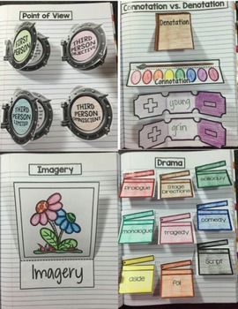
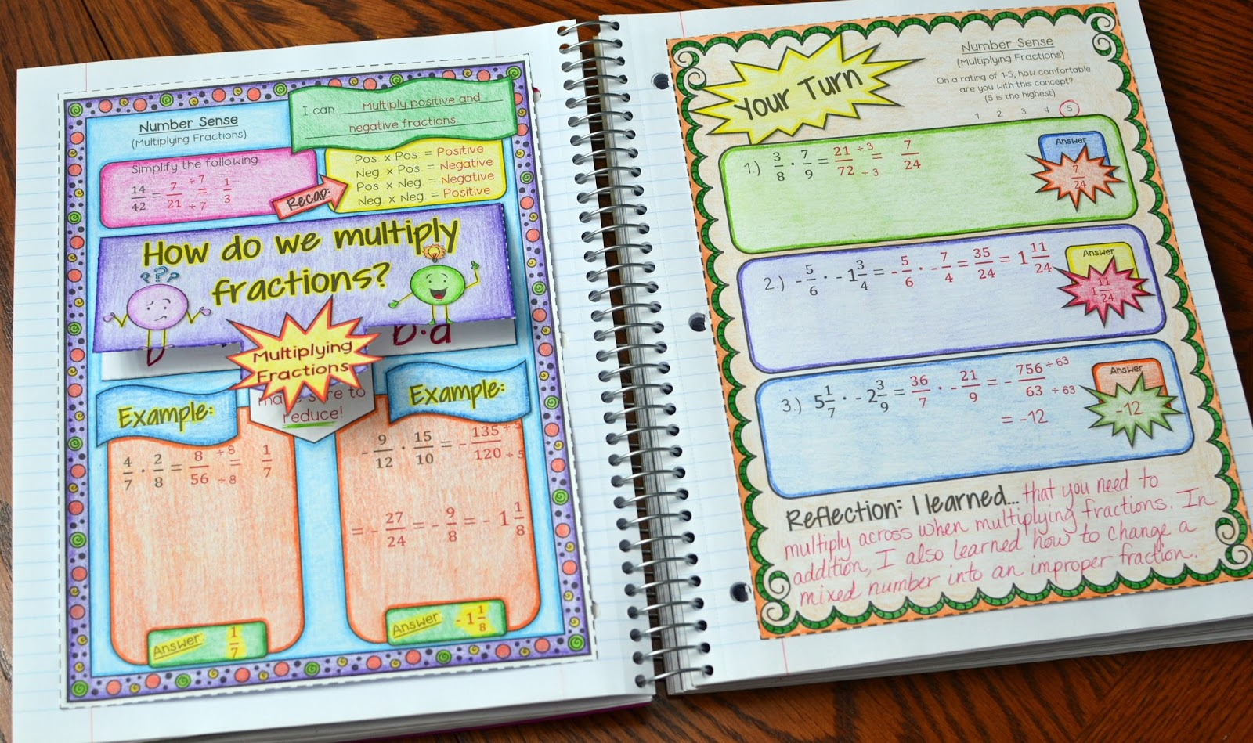
Interactive Note Pages
Notes:
Slide 10

Slide 11
Notes:
Slide 11

Slide 12
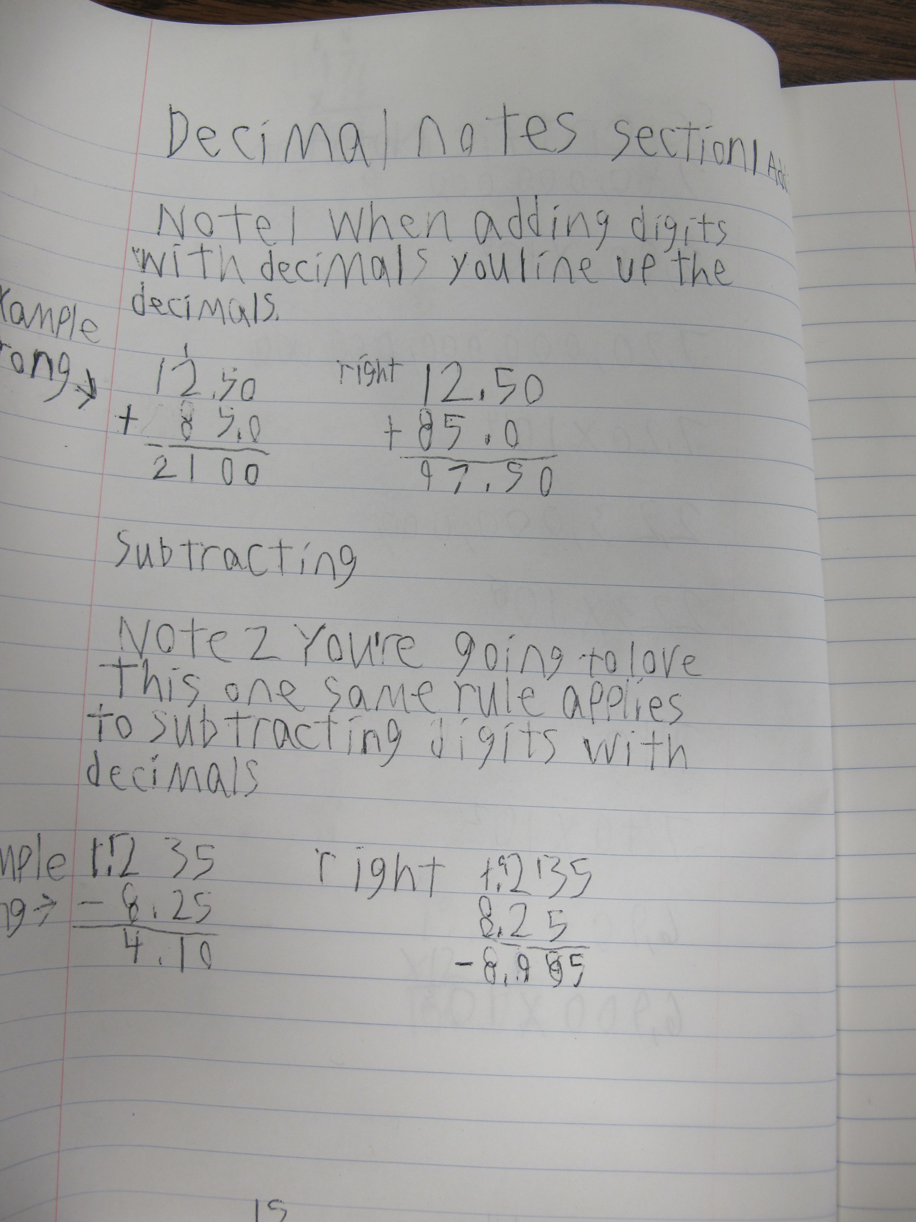
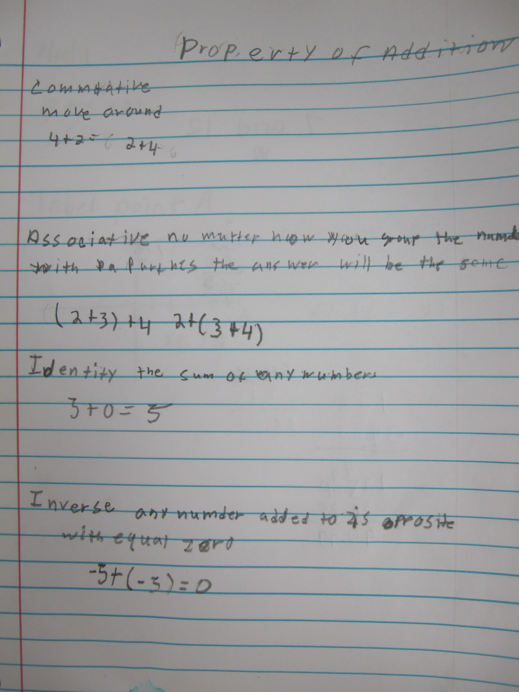
Notes:
Slide 12

Slide 13
Notes:
Slide 13

Slide 14
Key Elements
NOTEBOOK
■ Keep in notebook
■ Number pages
■ Label pages
■ Index pages
Key Elements
PAGES
■ Design depends on content
■ Use color if possible
■ Must include examples
■ May include steps
■ Must use own words

Slide 15
Note Pages
Pros
Works with individual or groups
Supports independence & confidence
Promotes long-term memory growth
Requires engagement in development
Cons
Time consuming
Must direct learners to use notes
May have to recreate same note page multiple times
Must be involved in creation of page to make difference

Slide 16
Inquiry Method
Asking can explore thinking
Asking can direct thinking
Learner talks, I listen
Learner holds pencil, I observe – ask questions
Note Pages
Puts process on paper (concrete)
Illustrates things I forget
Generates my own book of knowledge

Slide 17
What would a note page about this session look like?
Inquiry method
Note pages
In your group, draft a page.

Slide 18
Thank you for sharing.
Danny Farris Ray Johnson
John McDonald Ellen Peterson
Deborah Young, Ed.D.
Questions? Contact us at
lac@LiteracyActionCenter.org

