Slide 1
Creating an Adult Learning Environment And Twelve Steps to Passing the GED
Presented by:
Mark VanVoorhis
and
Jeff Hendricks

Slide 2
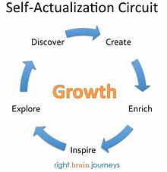
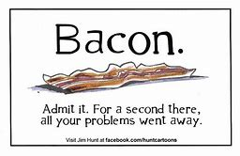
How does it feel?

Slide 3
How does it sound?
As a Teacher, open up dialogues to explore students’ different perceptions of relationships between all things.
As a Learner, look for how anything you are learning relates to everything else…. see how this enriches your perception and experience.
www.onecommunityglobal.org
Studies on music and the brain:
www.edu-cyberpg.com – mice and music
www.additudemag.com – music and ADHD

Slide 4
PERSONALIZED APPROACH Kenny questioned RIGOR, Mark replaced it with VIGOR!!!!
Rigor
Vigor
Strictness
Hardness
Harsh
Extreme Climate
Rigidly Severe
Stern
Stiff
Bitter
Active force
Strength
Energy
Robust
Healthy
Powerful
Endowed with
Full
Unless students (and teachers) are motivated (with vigor), they will reject the rigor of any learning task and abandon it before achieving success.
Disrupting Class Christensen, Horn, Johnson
Notes:
P

Slide 5
Two Reasons for Distracted Learning
Student Does Not Understand Concept Being Taught
Attendance – missed prior scaffolding of concepts.
ADHD
Attention
Disrupted
Hearing
Disorganized
www.understood.org
Boredom of Student
Already know concept
Not presented in life-purpose manner
Not related to interests and goals
No outlet for creativity
Classroom pace
No variety - Project and Problem-Based Learning
www.gettingsmart.com

Slide 6
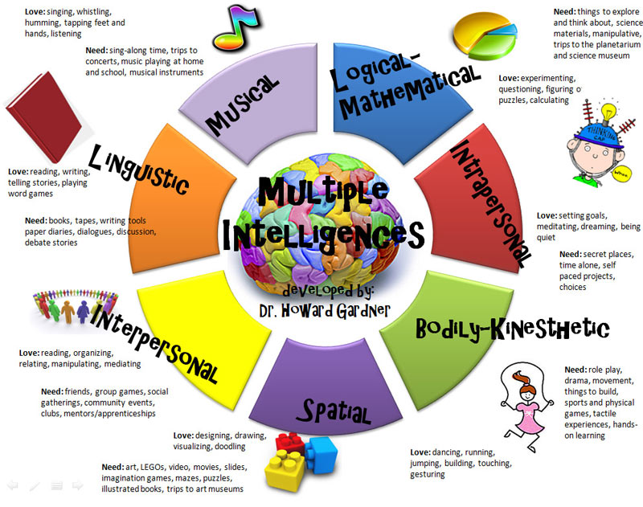
Using Students’ Multiple Intelligences

Slide 7
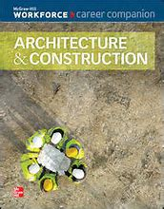
Using Multiple Intelligence for Career Possibilities – Giving Purpose to Education and Student Goals for Their Individual Pathway.
Use UtahFuture.org to identify and explore possible careers to spark interest and gain focus. Use Career Cluster and Interest Survey
Use McGraw-Hill Workforce Career Companions to organize educational and training path.

Slide 8
Focused Learning
Student is an Individual with specific needs and wants
Defined – what is known and what is not known by student
Teacher Guided Student Self-Pacing
Life Purpose Meaning
Boost Confidence
Differentiated Curriculum
World Related Meaning
Explore Niches
Differentiated Instruction
Discover Possible Places
Empowered Life-Long Learning
Leverage student data with instruction, materials and technology to meet student needs. If a student has mastered a concept before the rest of her classmates, there should be no need to wait until the end of the unit to progress, nor should the struggling student simply continue without the time to grasp more important building blocks.

Slide 9
Step 1 for Passing the GED
TABE Test - Use results to gauge where to start and focus individual student:
If student scores AHSC 2 level in all areas, skip to #3.
If student needs a level gain, start with that subject and work through Step 2.

Slide 10
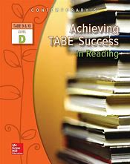
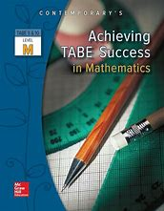
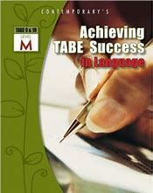
Step 2 for Passing the GED
Start with level gain focus area to build confidence quickly:
Use Achieving TABE Success in McGraw-Hill books.
Pre-Test – front of the book – use composite notebook.
Have student review missed test problems and write a sentence of why they missed it.
From “Pretest Answer Key and Evaluation Chart,” list pages needed for remediation.
Have student start with 3 problems on each page.
If they are correct, move on to next page.
If they are incorrect, review concept with student.
Student does next 3 problems; repeat as needed
Student completes “Check Ups” after each section. Again, have student write a sentence of why they missed whatever problem they missed.
Review and Remediate any problems incorrect.
Post-Test at the back of the books, writing a sentence of why they missed the problem.
Have student revisit and remediate pages of missed problems from the chart.

Slide 11
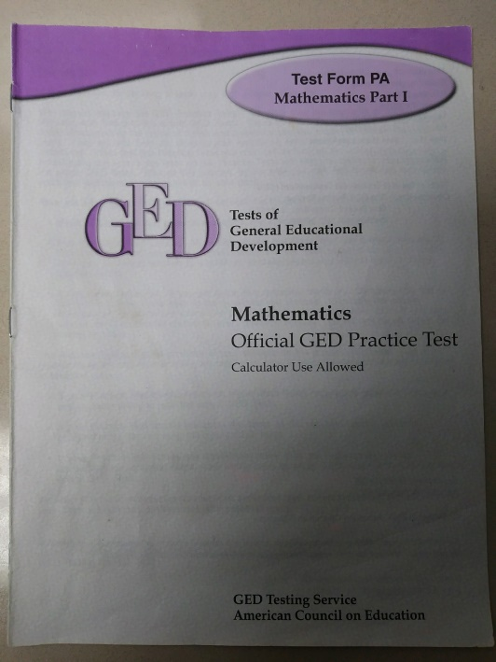
Step 3 for Passing GED
Old Paper and Pencil GED Practice Test – yes, it is outdated, but gives an idea where the student is before spending money for the GED Ready Test.
Take the paper and pencil test.
If they are scoring around 400, the student is on the fence; they may or may not pass it.
If they score below 400, have them remediate and do Step 2 with the related subject. Social Studies and Science will be addressed on Steps 7 and 9.
Have student revisit each problem they missed and determine why they missed it. The more times you can have the student do this, the better. They will start to see how tests are written and will begin to identify things that confuse them and they will make less and less mistakes as they move forward.
Steck-Vaughn
PO Box 26015
Austin, TX 78755
800-531-5015
www.steck-vaughn.com
ISBN 0-7398-5433-X

Slide 12
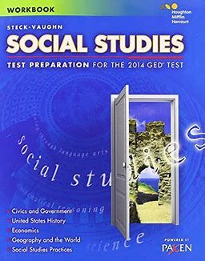
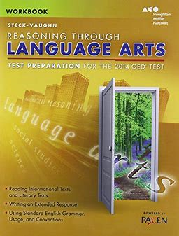
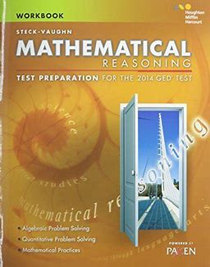
Step 4 for Passing the GED
When a student is close to or above a 400 on the paper and pencil GED test, have them take the GED Ready test in the subject they have been remediating in.
The score gauge at the end of the GED Ready Test will give the student and teacher the likelihood of passing the test.
On GED.com, have the student select study material. The Steck-Vaughn, Workbooks prepare students in a focused, non-confusing manner. It explains each question and gives clear remediation instructions of why the answer is the answer.

Slide 13
Steps 5 and 6 for Passing the GED
Step 5: For the Language portion, as mentioned above, reviewing, preparing, and leveling up to the high AHSC 1 or higher will build a great foundation. Refer to the following for other great insights:
http://www.gedpracticequestions.com/ged-reading-practice-test/
https://highered.mheducation.com/sites/0809222280/student_view0/ged_practice_test_pt_i.html
Step 6: There are many different approaches to the Math portion, but as mentioned, using the TABE practice and review will give a great foundation. To refine skills, using the following resources:
http://www.gedpracticequestions.com/ged-math-practice-test/
https://www.testpreptoolkit.com/ged-math/
https://www.mometrix.com/academy/ged-math-practice-test/

Slide 14
Steps 7 and 8 for Passing the GED
Step 7: For the Science portion, it seems if students have prepared and GED Ready indicates they will pass Math, if they will take the Science GED Ready and review the Student Book by Steck-Vaughn for 3 to 6 hours, they should pass. Here are some helpful sites and information:
https://magoosh.com/ged/ged-study-guide-science-focused/
http://www.dummies.com/test-prep/ged/boosting-your-ged-science-score-on-test-day/
Step 8: Using and having practice time with the TI-30XS calculator, both the real calculator and pop-up used on GED Ready and the test is vital. Pages xii and xiii in all the Steck-Vaughn workbooks have a great review for using the TI. Here are a few websites that give solid tutorials and practice:
https://www.gedtestingservice.com/ged_calc_en_web/
https://www.atomiclearning.com/ti30xs
https://www.youtube.com/watch?v=VoLZLsRXuKE

Slide 15
Steps 9 and 10 for Passing the GED
Step 9: For the Social Studies portion, it seems if students have prepared and GED Ready indicates they will pass Language, if they will take the Social Studies GED Ready and review the Student Book by Steck-Vaughn for 3 to 6 hours, they should pass. Here are some tools to help:
https://study.com/academy/popular/how-to-pass-the-social-studies-ged-test.html
https://www.testpreptoolkit.com/ged-test/
Step 10: For the writing portion of the Language test:
Use GED Practice Essays. They give great insights to the basics and focus of the writing portion.
Having students practice by using the prompts onGEDtestingservice.com
Review written papers with student, not just making corrections, but explaining why other choices, organization, sentence structure, and word uses are better.
Here are some helpful sites:
https://www.passged.com/articles/the-ged-essay-test-understanding-the-essay-improving-the-score
https://magoosh.com/ged/top-tips-ged-writing/
http://www.gedpracticequestions.com/ged-essay-tips/

Slide 16
Steps 11 and 12 for Passing the GED
Step 11: As students practice testing with paper and pencil tests, GED Ready, and other sample tests, review testing strategies with them. Students build confidence as they understand how tests are written, why certain answers are best, the process of elimination, reading questions and answers correctly to get the correct answer and the list goes on. Find some tips here:
http://www.pstcc.edu/counseling/_files/pdf/test-taking-hints2.pdf
https://www.educationcorner.com/test-taking-strategies.html
Step 12: As we know, good sleep, attitude, and nutrition add to great test results. Have your students read these articles to help the students’ approach and boost their scores on the GED tests:
http://www.chicagotribune.com/business/sns-health-nutrition-better-grades-story.html
https://www.acmc.edu/how-students-can-stay-positive-towards-school/
http://time.com/3663796/for-better-grades-let-your-kids-sleep-more/
http://valleysleepcenter.com/score-how-sleep-affects-standardized-testing/

Slide 17
Presenters’ Information
Mark VanVoorhis Jeff Hendricks
mark.vanvoorhis@nebo.edu jeff.hendricks@nebo.edu
801-885-4062 801-358-9131
Thank you
for your attendance!

