Slide 1

Department of Workforce Services: Helping Utahns Become Self-Sufficient

Slide 2

Department of Workforce Services
jobs.utah.gov

Slide 3

Job Search Assistance & Preparation
Workshops
Resume writing
Interviewing
Job searching
LinkedIn
Work Success
Computer lab
Onsite recruitments
Career exploration
And more!

Slide 4
Temporary Assistance
SNAP (formerly known as Food Stamps)
Financial assistance
Child care
Medical

Slide 5
Other Divisions
Office of Rehabilitation
Unemployment Insurance
Eligibility Services
Refugee Services Office
Office of Child Care
Housing and Community Development

Slide 6


WIOA
Develop skills to become more employable
Help make career choices based on personal interests and jobs in demand
Assist customers to gain skills that will help them be successful

Slide 7

Services We Offer
Career planning and job search assistance
Work experience
Training assistance
Basic skills assistance
Supports to overcome
obstacles
And more!

Slide 8


How is someone eligible?
Between the ages of 14-24 for youth program and over the age of 18 for the adult program
Verify citizenship or eligibility to work in the US
Meet the WIOA criteria and income guidelines
Complete a basic skills assessment (For youth program only)

Slide 9
Additional Eligibility Criteria for Youth
In School and…
Have a disability
Currently in foster care or aged out at 18
Attendance issues while completing high school
Attending Adult Ed (funding will be verified through UTOPIA)
Out of school and…
Dropped out of high school
Pregnant or parenting
Homeless
An offender
Suffer from substance or domestic abuse
Native American
Have an incarcerated parent

Slide 10

Program Expectations
Active participation in negotiated activities
Maintain contact with their employment counselor
Attend all appointments
Turn in all needed documents (receipts, grades, etc.)

Slide 11

How to Apply
Application for training services on jobs.utah.gov
Citizenship info and income verification
TABE assessment (for youth program only)

Slide 12
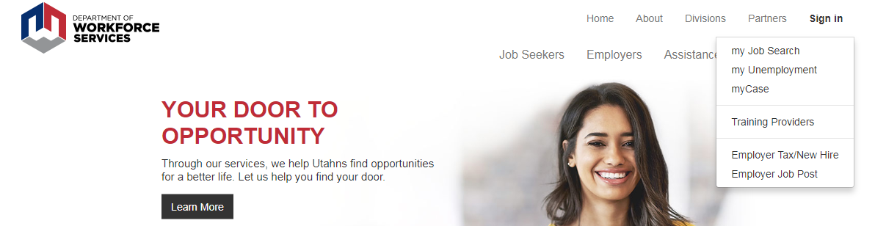
How to Apply

Slide 13


Slide 14
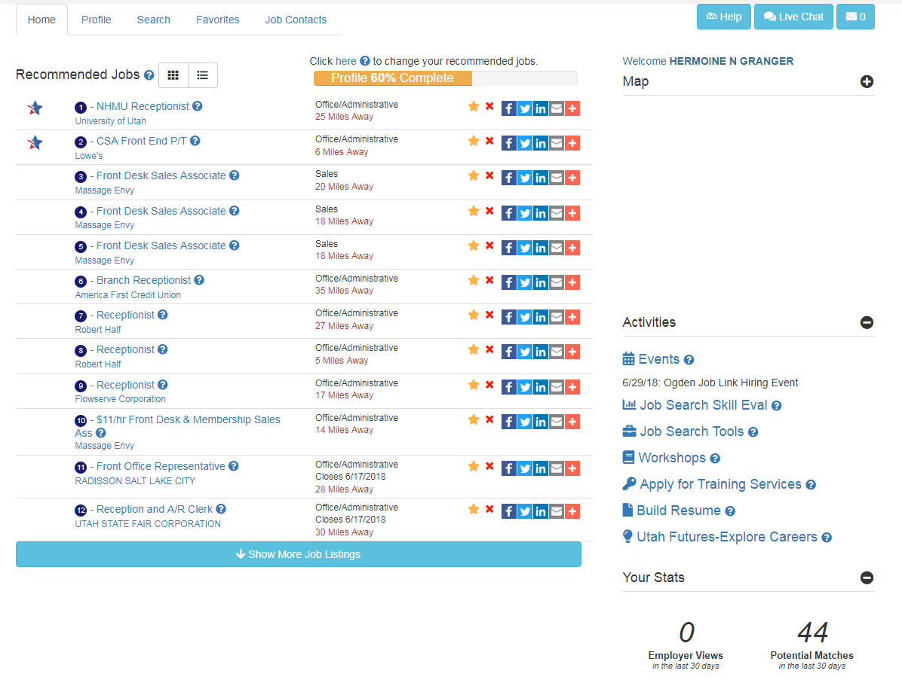

Slide 15
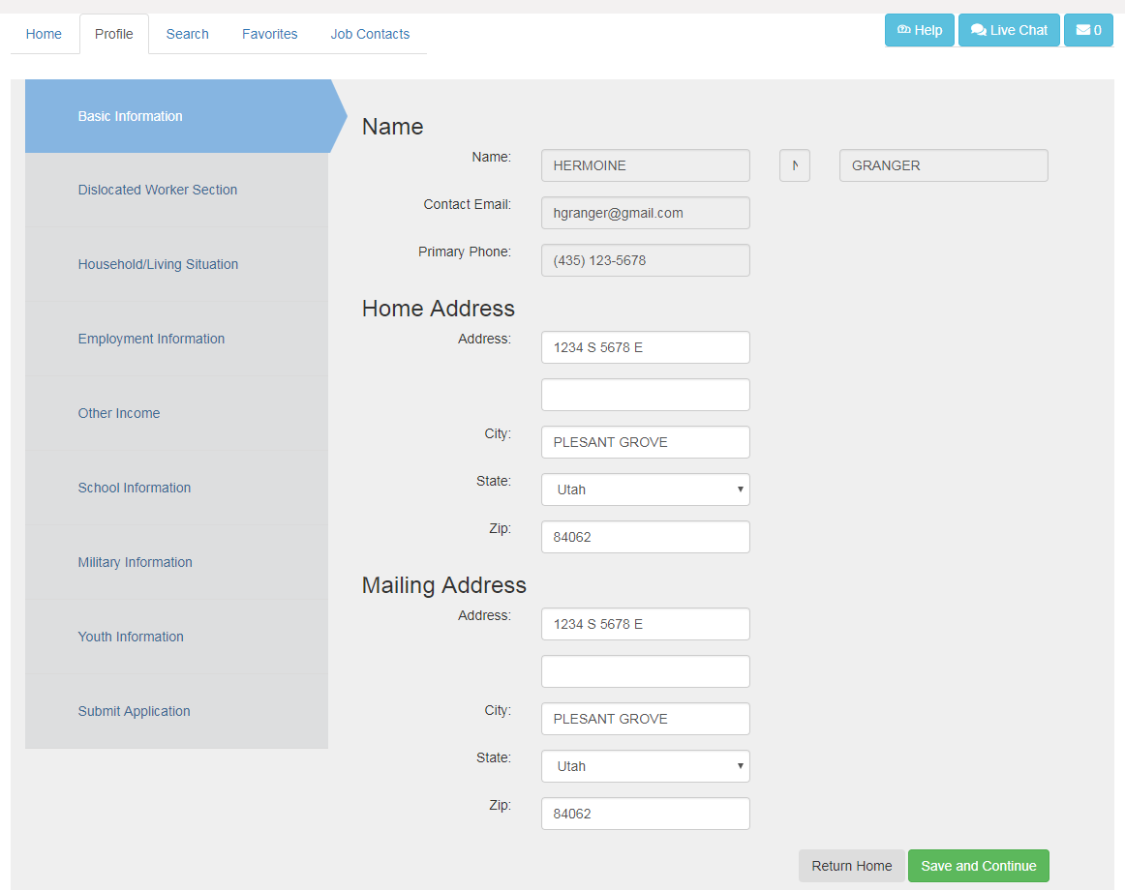

Slide 16
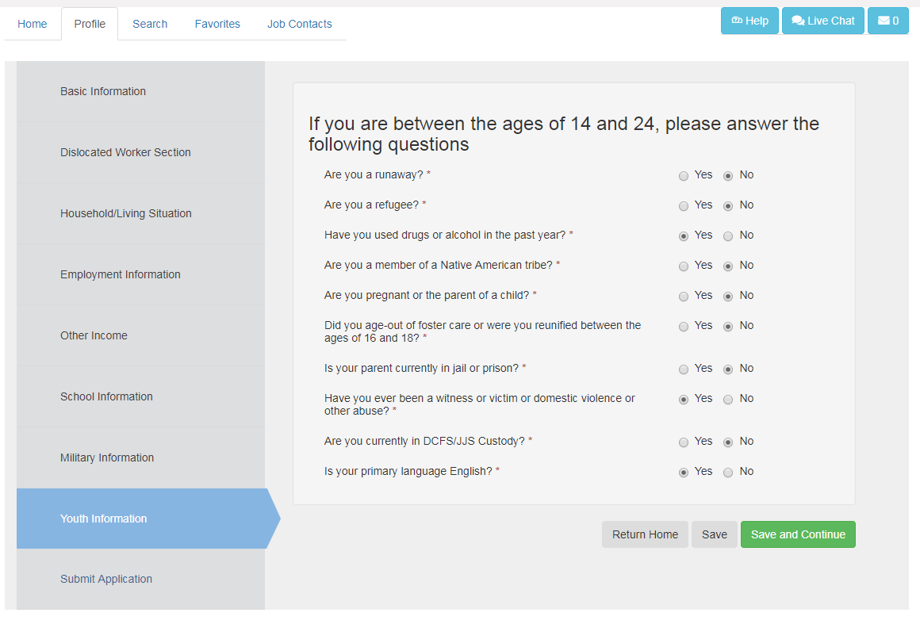
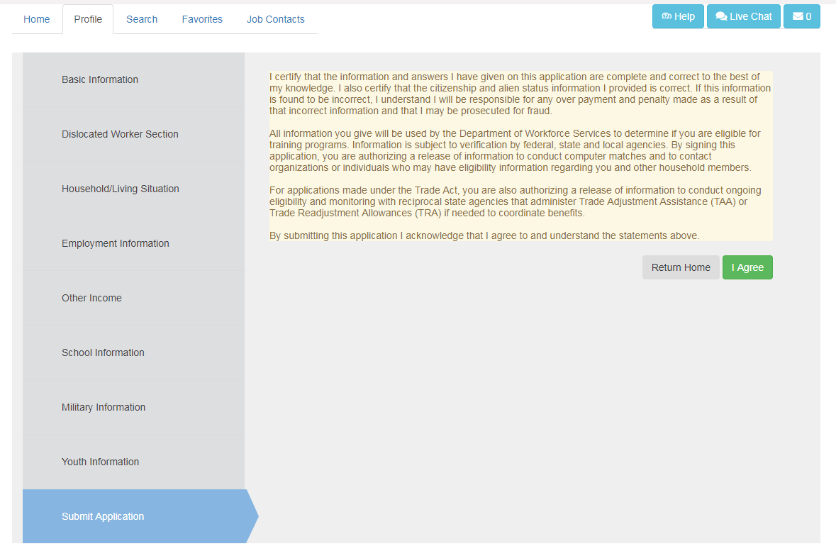

Slide 17
Utah State Office of Rehabilitation
Helping Utahns with disabilities obtain meaningful employment and increase independence:
Division of Services for Blind and Visually Impaired
Division of Services for Deaf and Hard of Hearing
Disability Determination
Division of Rehabilitation Services (“Voc Rehab”)

Slide 18
Division of Rehabilitation Services
Mission: To assist eligible individuals prepare for and obtain employment and increase independence
Activities:
Learn more about disability
Overcome barriers to getting/keeping job
Increase Self-Reliance/Self-Advocacy

Slide 19
DRS-Eligibility
Does a significant physical or mental impairment exist?
Does this impairment result in a substantial impediment to employment?
Does the individual require VR services?
Will the individual benefit in terms of an employment outcome?
Notes:
VR Counselors review medical records and initial interview information to make a determination of eligibility based on the following four criteria:
Does a significant physical or mental impairment exist?
Does this impairment result in a substantial impediment to employment?
Does the individual require VR services?
Will the individual benefit in terms of an employment outcome?

Slide 20
Disabling Condition Examples
Generalized Anxiety Disorder
Autism
Bipolar Disorder
Learning Disability
Hearing Impairment
Amputation
Cognitive Impairment
Traumatic Brain Injury
Visual Impairment

Slide 21
DRS-Eligibility cont….
Individuals receiving SSI/SSDI because of their disability are presumed eligible
VR can assist an individual in securing disability documentation
  Records request
  Records fees
  Evaluations if needed

Slide 22
VR Transition/Youth Services
Vocational Counseling and Guidance
Restoration and Disability Adjustment Services
Attend IEP and 504 Meetings
Training and Education
Disability Mentoring Days
Job Placement/Job Coaching
Assistive Technology
Temporary and Summer Work Experiences
Pre-Employment Transition Services
Supported Employment

Slide 23
Transition Services cont…
jobs.utah.gov/usor/vr/services/student.html
Find information about:
  VR Counselor Liaison list
  Job Readiness Workshops
  Pre-Employment Transition Services contracted services

Slide 24
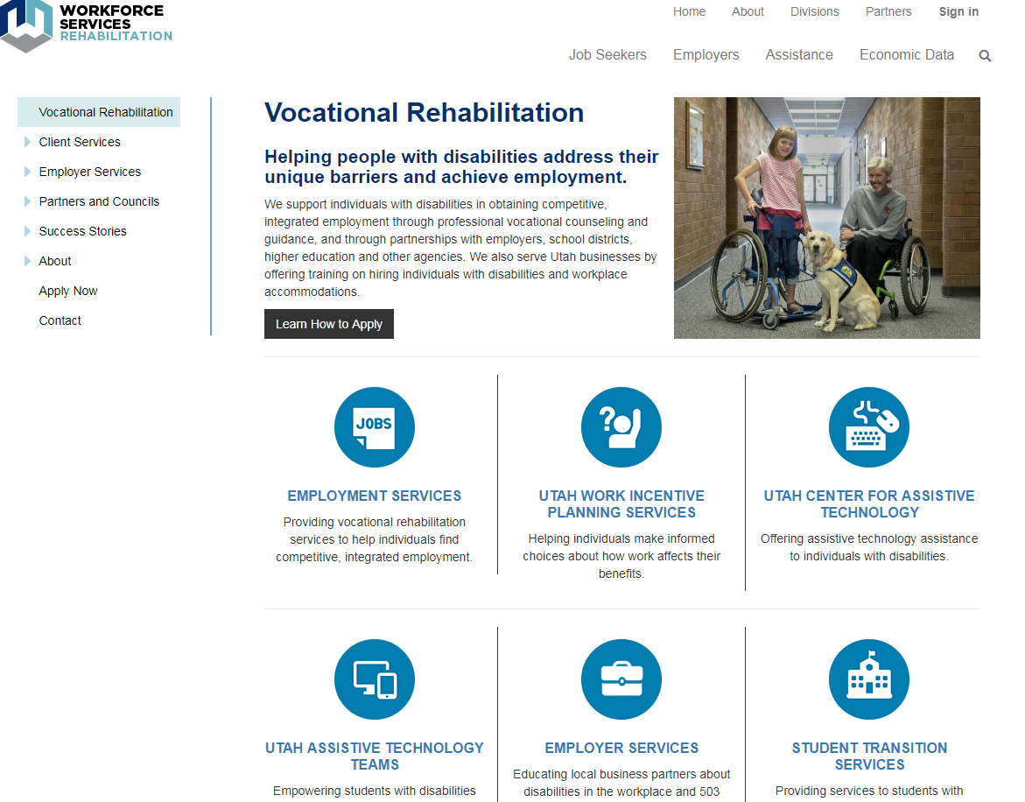
How to Apply
Visit our Website
  jobs.utah.gov/usor
  View welcome Videos
  Application
  Make appointment

Slide 25
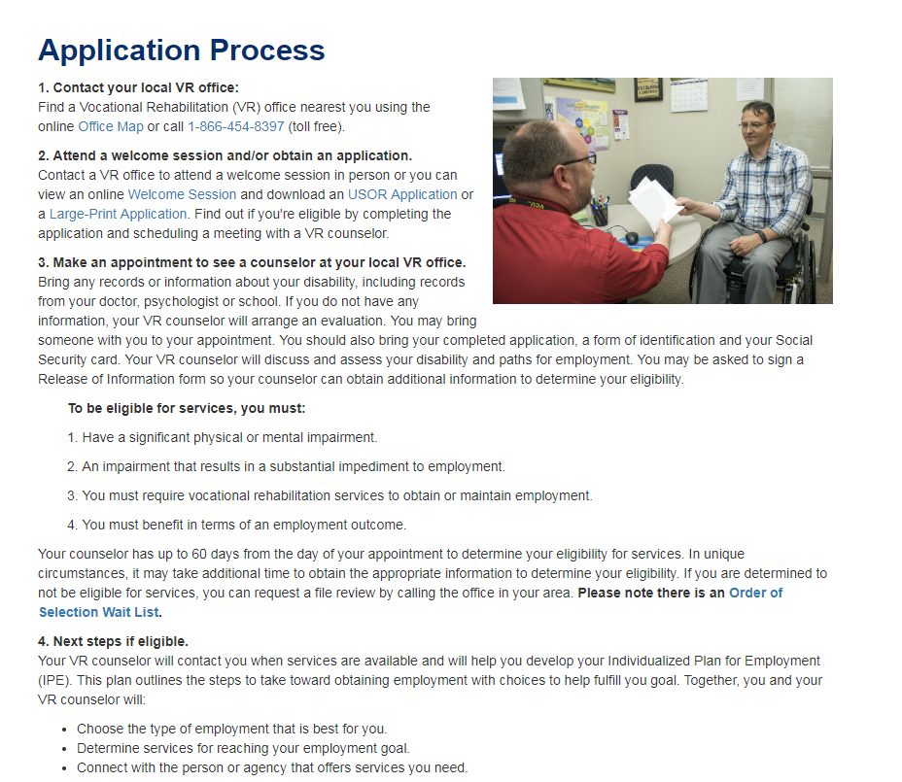
Application for VR

Slide 26
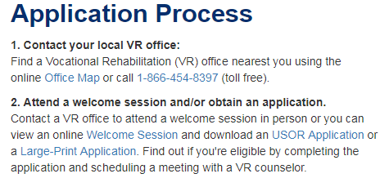
Other Ways to Connect
Attend an orientation at a VR Office
Connect with a VR Counselor liaison

Slide 27
Nycole Tylka
ngtylka@utah.gov
801-971-5450
Emily Stirling
estirling@utah.gov
801-887-9500

