Slide 1
Don’t forget the lollipops
Creating a positive learning environment

Slide 2

Drew Dudley – leading with lollipops
Notes:
https://www.youtube.com/watch?v=hVCBrkrFrBE

Slide 3
Shoulder partner conversation:
  Big picture thoughts about the video
  Are you a leader? Why or why not?
  Have you had a lollipop moment that has influenced you?
  Group Conversation
  Share out
  “Lollipop moments” can be power. What effect do you think a negative “lollipop moment” could have on an individual?

Slide 4
Notes:
https://www.youtube.com/watch?v=-VGHLIyyP-s

Slide 5
How can we avoid the negative chain reaction in our programs/classrooms?

Slide 6
“Inviting School Success” by William Watson Purkey and John M. Novak
Intentionally Disinviting
Unintentionally Disinviting
Unintentionally Inviting
Intentionally Inviting

Slide 7
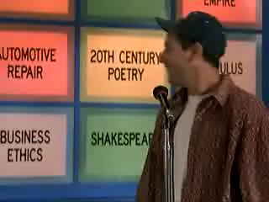
Intentionally disinviting
Notes:
https://www.youtube.com/watch?v=LQCU36pkH7c

Slide 8
Unintentionally Disinviting
Notes:
https://www.youtube.com/watch?v=9HWPquj-Q4U

Slide 9
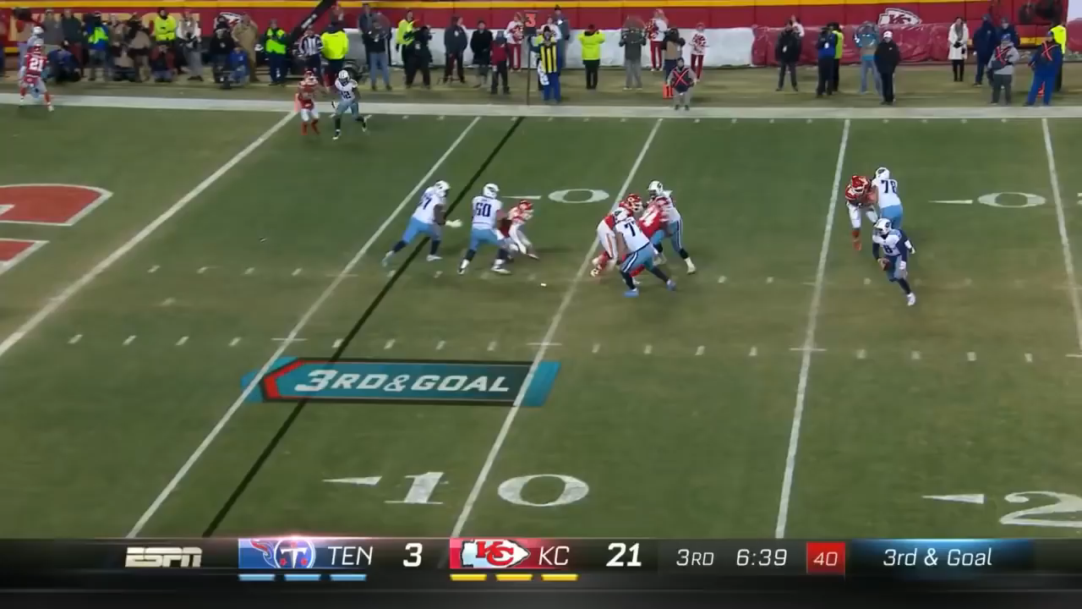
Unintentionally Inviting
Notes:
https://www.youtube.com/watch?v=1XwmIhZbQfM

Slide 10
Intentionally Inviting
Notes:
https://www.youtube.com/watch?v=SFnMTHhKdkw&t=87s

Slide 12
If you're not intentional in how you are acting, you may miss the warning signs that something is wrong…
Notes:
https://www.youtube.com/watch?v=bPWZ7ASnhiE

