Slide 1
The Reading and Pronunciation Connection
“The tongue of man is a twisty thing, there are plenty of words there of every kind, the range of words is wide, and their variance.”
HOMER, The Iliad,c.900 B.C.E
Presented by: Jamie Mathews, MA; Darece Sperry, MS, Erin Clark, MA;
Davis School District, Canyon Heights Adult Learning

Slide 2
Part I
Sound Advice about

Slide 3
How do we learn language sound and speak correctly?
Students need to know the consonants and vowels
  Some sounds can be difficult for students as they don’t have that sound in their native language.
Students need to know the basics of phonology
  Voiced/ Voiceless
  Place of Articulation
  Manner of Articulation
  Phonetic features that do not distinguish phonemes
    syllabic versus nonsyllabic
    stress versus nonstress
    aspiration versus non aspiration

Slide 4
The Consonants of North American English
Sound | Examples | Sound | Examples
/b/ | boy, cab | /h/ | his, ahead, whole
/p/ | pie, lip | /t∫/ | cheek, watch, righteous
/d/ | dog, bed | /ʤ/ | joy, budge, residual
/t/ | toe, cat | /m/ | me, seem
/g/ | go, beg | /n/ | no, sun
/k/ | cat, back | /ŋ/ | singer, bang, think
/v/ | view, love | /l/ | long, full
/f/ | fill, life | /r/ | run, car
/ð/ (voiced) | the, bathe, weather | /w/ | win, away
/θ/ (voiceless) People sometimes confuse these sounds as to which is voiced and which is voiceless. | thin, bath, through | /hw/ or /ʍ /* In many American dialects pronounced as /w/ | which, what
/z/ | zoo, goes | /j/ /y/* | you, soya
/s/ | see, bus | Other Frequently Used Symbols
/ʓ/ | leisure, beige, casual | /ʔ/ glottal stop | bottle, button (ʔ)uh(ʔ)oh
/∫/ | shy, dish, nation | /ɾ/ flap allophone | writer, latter, ladder
Consonants are identified by place of articulation, manner of articulation, and voicing.

Slide 5
Consonants
Fromkin, V., Rodman, R., & Hyams, N. (2006) stated that consonants are formed by where the airflow is restricted in the vocal tract how the tongue and lips move to create constriction, and the shape of the oral cavity in different ways. All these elements put together in different ways produce the various sounds.

Slide 6
The Vowels of North American English
Sound | Examples | Sound | Examples
/i/ /iy/ | pea, feet | /u/ | hoot, lute, into
/I/ | pin, fit | /ʊ/ | hood, put, could
/e/ /ey/ | pain, fate, ate | /o/ | hotel, coat, beau
/ɛ/ | pen, fed, bet | /ɔ/ many speakers of American English do not use this sound and have a hard time perceiving it—it can be very similar to /ɑ/ | all, bought, talk
/ӕ/ | fad, act | /ɑ/ the most common vowel in the languages of the world | pot, doll, awkward
/ʌ / stressed | pun, cut, above | /ɑɪ/ /ay/ /aj/ | pine, fight, kite
/ə/ unstressed | focus, above, sofa | /a ʊ/ /aw/ | mouth, foul, brown
/ɝ/ stressed | herder, earth, bird | /ɔ I/ /ɔy/ /ɔj/ | coin, poise, foil
/ɚ/ unstressed | herder, waterfall | /ju/ /uw/ | cue, stew
Vowels are identified by the different movements of the tongue height, back or front and rounding and the position of the mouth.

Slide 7
Vowels
“Vowel sounds carry pitch and loudness; you can sing vowels or shout vowels. They may be longer or shorter in duration. Vowels can stand alone and they can be produced without consonants before or after them” (Fromkin, V., Rodman, R., & Hyams, N. 2006).

Slide 8
Examples of Voiceless And Voiced
/f/ is a voiceless continuant.
/v/ is a voiced continuant.
  They have the same place of articulation. The bottom lip touches the top teeth.
Steps to teach students to make this sound:
  Have the students use their pencil to push their top lip up so their lips don’t touch. Then they bring their top teeth down to touch the bottom lip. Make a long sound. They can feel the voicing by putting their fingers on their vocal chords.
  Have them practice switching back and forth between /f/ and /v/ to feel and hear the difference.
(I.S.P.Nation & Newton, J. 2011)

Slide 9
Examples of Voiceless and Voiced
The following are two sounds some students get confused.
/r/ is a voiced continuant sound.
  The back of the tongue is near the top of the mouth which pulls it so it doesn’t touch the teeth.
  Steps to teach students to make this sound:
    Put a finger under the tongue and push it back and up. Make sure the tongue does not touch the top of the mouth. The pencil stops the tongue from touching the tooth ridge. Make a long sound.
/l/ is a voiced continuant sound.
  The tip of the tongue is touching the back of the top teeth.
  Steps to teach students to make this sound:
    Put a pencil under the tongue and push it up towards the teeth. Make a long sound.
(I.S.P.Nation & Newton, J. 2011)

Slide 10
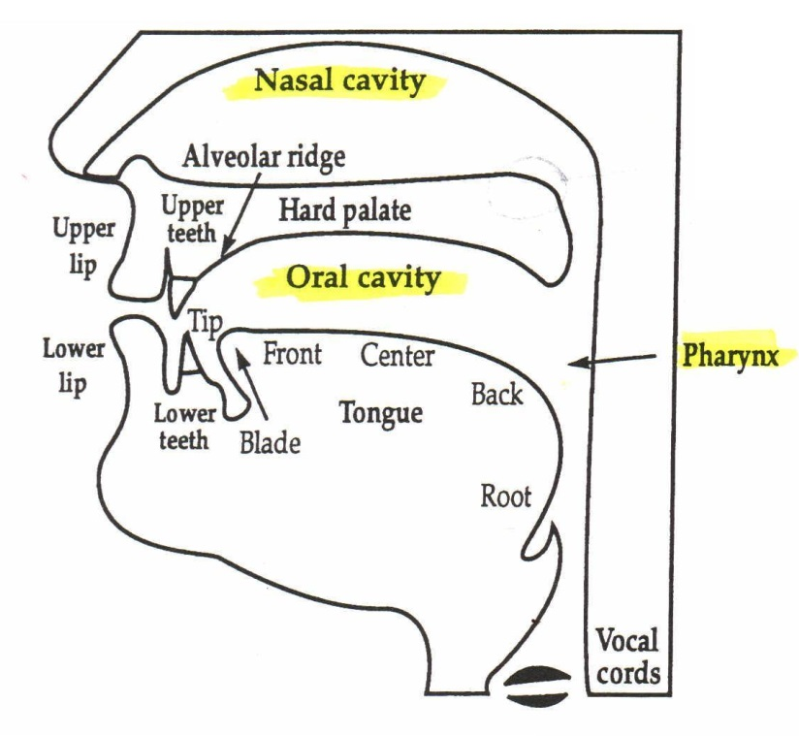
Place of Articulation
Place of Articulation tells us where a sound is made within the mouth and vocal chords. These areas are shown below in the picture: bilabial, labiodentals, dental, alveolar, palatal, velar, and glottal.

Slide 11
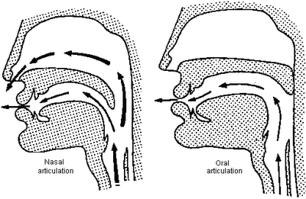
Place and Manner of Articulation
Manner of Articulation is the way that air is pushed or stopped by the different places articulation. Depending on the path the air takes in the mouth, the sound it could be nasal or oral. “Manner of articulation can be divided into two groups: obstruents and sonorants. Stops, fricatives, and affricates are various kinds of obstruents. Approximants (laterals, liquids, and glides) and nasals are forms of sonorants” (Fromkin, V., Rodman, R., & Hyams, N. 2006).

Slide 12
Syllabic and Non-Syllabic
In English, one or more of the syllables in every content word are stressed. A stressed syllable, is more prominent than an unstressed syllable. A student can tell the how many syllables by the number of vowel sounds. Sometimes there are consonants that act as vowel sounds. There are also vowels together to make a diphthong and one of the sounds is not as strong.
  Saw, Say, cattle, botany, star, boil are some examples.
“The schwa is pronounced with the mouth in a neutral position and is a brief, colorless vowel. The schwa is reserved for the vowel sound in all reduced syllables” (Fromkin, V., Rodman, R., & Hyams, N. 2006)

Slide 13
Stress versus Non Stress
Some words are spelled the same in English but the position in which you put the stress can change the meaning.
Examples
  Object
    If the stress is obJECT, then it means complain.
    If the stress is OBject, then it means a thing.
  Resume
    If the stress is reSUME, then it means to start again.
    If the stress is RESume, then it is a for a job document.
  Wind
    If the stress is WInd with a long I sound, it means to coil up.
    If the stress is WiNd with a short I sound, it means air blowing.

Slide 14
Aspirations versus Non Asperations
Examples
  The /p/ in the pin has more air that comes out than when you add an /s/ in front of that same word.
    pin, spin
    pit, spit
  When words start with an h sound and come after certain consonants the /h/ sound has more aspiration.
    watch here, grasshopper

Slide 15
Pronunciation Practice
Activity Ideas
Pronunciation Board Game
Challenge Chart
Reading Text example
“Consistent exposure to fluent input has been established as key to language development, especially when paired with interaction and output as explained by Krashen and Terrell (1983)” as cited by Robertson, K., Ford, K. (2008)

Slide 16
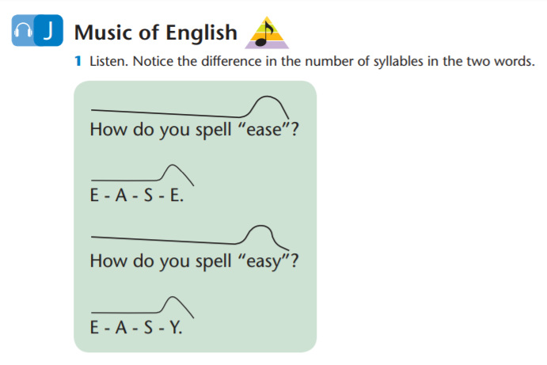
Part II: Stressing Stress in
Reading and Speaking

Slide 17
“Students tend to think that word stress is some sort of added
decoration, or else they do not notice is at all.
But far from being merely decorative, stress is an essential part of the part of the pronunciation of English words. This because English speakers tend to store vocabulary according to stress patterns.”
From Clear Speech by Judy B.Gilbert
(Brown 1977, 1990; Levelt, 1989)

Slide 18
“When a word is said with an incorrect stress pattern, the listener may spend time searching for the word in the wrong stress category. By the time the listener realizes something is wrong, the original sequence of sounds may have been forgotten.”
“A stress pattern mistake can…cause a great deal of confusion, especially if is accompanied by any sound error.”
Say what?!!

Slide 19


Slide 20



Slide 21
Word stress and vowel length
Word stress and vowel clarity
Word stress patterns
From Clear Speech by Judy B. Gilbert

Slide 22
Rules for stress and vowel length
In every English word of more than one syllable,
one syllable is stressed the most.
2. The vowel sound in the stressed syllable
is extra long. It is the peak vowel:
ba nan a

Slide 23
Canada Japan China
America English
Clear Speech by Judy Gilbert

Slide 24



Stressed: a e i o u
Unstressed: a e i o u
Reduced: ə ə ə ə ə

Slide 25
Word Stress Patterns
Two-syllable words
Words ending in -tion, -sion, -cian
Words ending in –ic and –ical
Acronyms
Compound nouns

Slide 26

For Real????
Notes:
https://www.youtube.com/watch?v=pp3TuT5Mp5k&t=25s

Slide 27
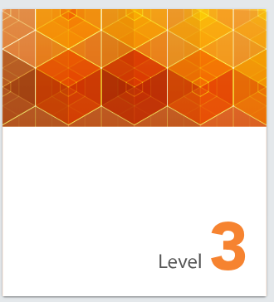
Application
Oxford University Press’
Step Forward

Slide 28
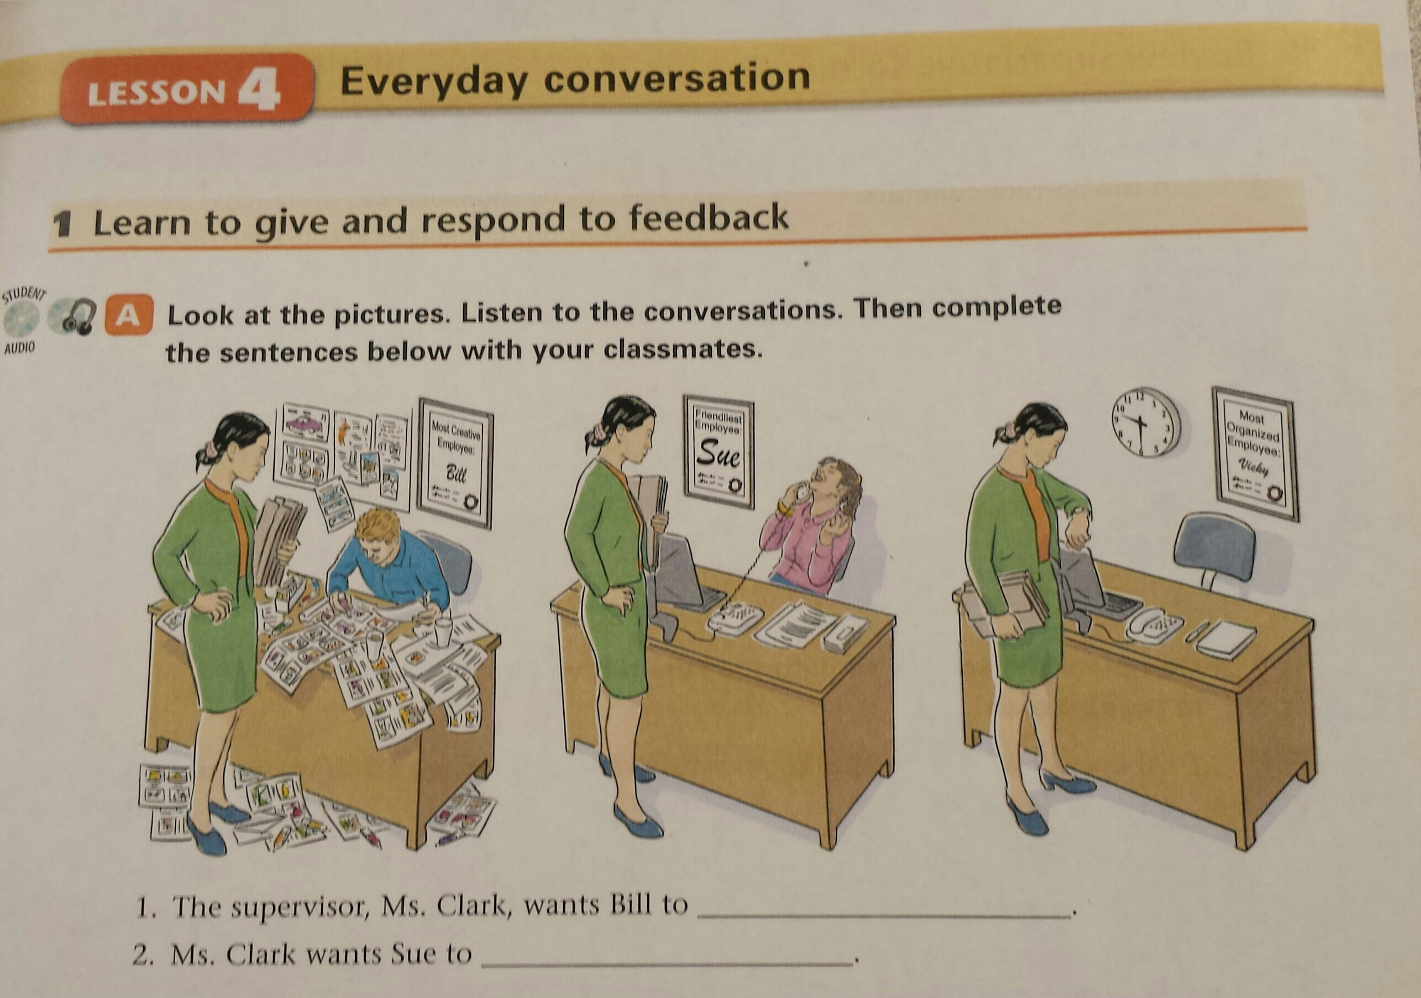

Slide 30
Application:
Newsela
Newsela.com

Slide 31
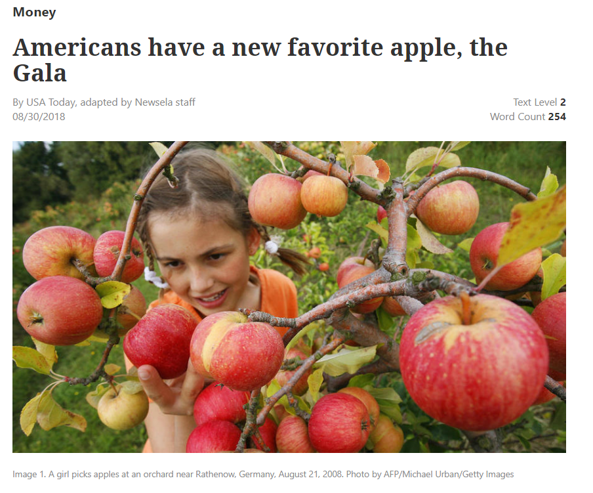

Slide 32
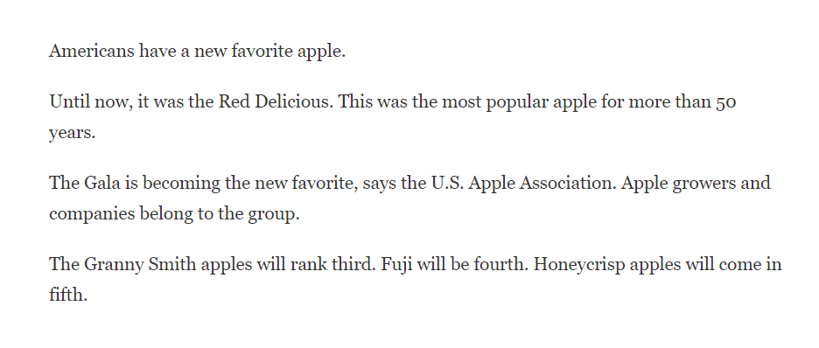

Slide 33
References
Edwards, H.T. (2003). Applied phonetics: The sounds of American English (3rd ed.). Thomson Delmar Learning.
Fromkin, V., Rodman, R., & Hyams, N. (2006). An introduction to language (9th ed.). Thomson: Boston, MA.
Hudson, J. (2010) Pronunciation Studio. Retrieved from www.anenglishaccent.com/e-book.html
Images (2013) Retrieved from http://iolp.anadolu.edu.tr/dersler/3527/Unit08/task3_3.htm
I.S.P.Nation & Newton, J. (2011). Teaching ESL/EFL listening and speaking (9th ed.). Wadsworth: Boston, MA.
Robertson, K., Ford, K. (2008) Language Acquisition: An Overview Retrieved from http://www.colorincolorado.org/article/26751/
Wood, D. (2010). Formulaic Language and Second Language Speech Fluency : Background, Evidence and Classroom Applications. London, GBR: Continuum International Publishing, 2010. Retrieved from http://site.ebrary.com/lib/westerngovernors/Doc?id=10403769&ppg=191

Slide 34
WEBSITES FOR PRONUNCIATION
http://www.e-pron.com/
http://www.englishclub.com/index.htm
http://www.teacherjoe.us/index.html
https://www.npr.org/programs/all-things-considered/
http://www.manythings.org/pp/

Slide 35
Part III
Improving Pronunciation and Expression through Reader’s Theater Activities

Slide 36
As students continue their repeated readings of the script, they are improving their reading skills and comprehension. They will also have the opportunity to practice speaking skills, such as pronunciation, inflection, expression, and varied volume.
--Kristina Robertson, “Reader’s Theater: Oral Language Enrichment and Literacy Development for Ells”

Slide 37
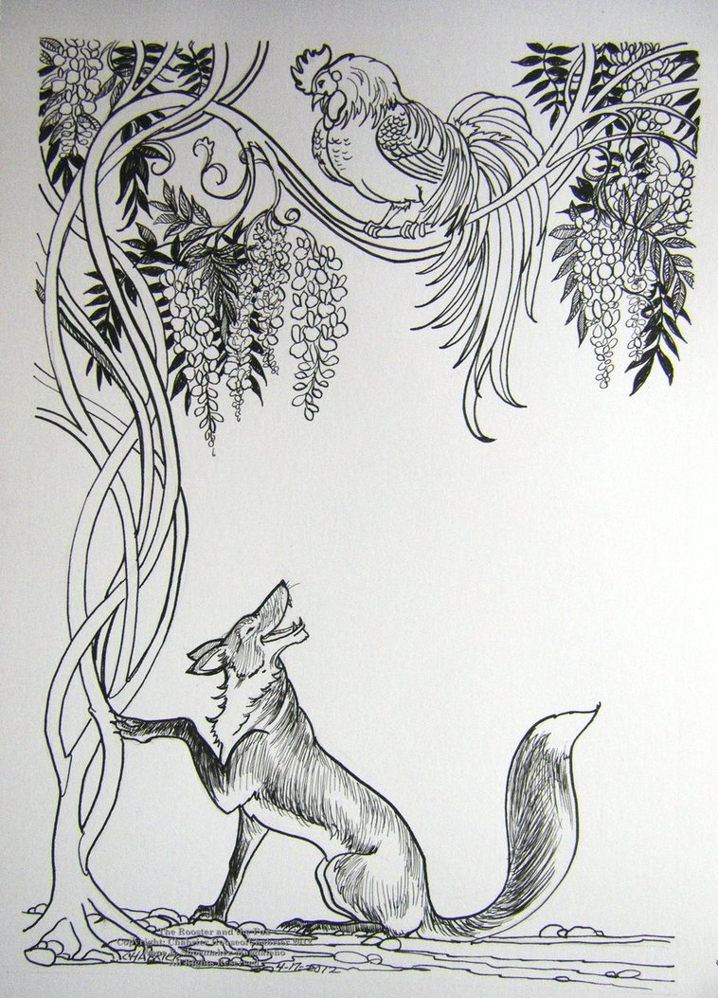
Getting started…
Choose a story with a lot of dialogue that you can easily convert to a script.
--Highlights Magazines and Scholastic Scope are good resources.
The story should already be familiar to the students and high interest. Humorous stories work really well.

Slide 38
Some helpful hints…
This activity can be differentiated
-- Use a section of a story for lower level students or for a shorter activity.
-- Convert a whole story for higher level students.
Choose an area of pronunciation you’d like the students to focus on. This could be individualized or done as a whole class.
--For example, -ed endings, sound reductions, word stress, or liaisons

Slide 39
Let’s give it a try.

Slide 40
The Rooster and the Fox, adapted from Highlights Magazine
A play based on a fable by Aesop
Narrator 1 : One evening Rooster flew up into a tree to sleep. He fluffed his feathers and flapped his wings three times. But just before he tucked his head under his wing, Rooster spotted a flash of red. It was moving behind the barn. He looked again and saw Fox standing beneath the tree.
Fox: “Good evening, Rooster, have you heard the good news?”
Narrator 1: Rooster was afraid of Fox, but he tried not to show it.
Rooster: “News?”

Slide 41
Narrator 1: He asked calmly.
Rooster: “What news?”
Fox “Why, all the animals have agreed to love one another, “
Rooster: “Oh, really?”
Narrator 2: Said Rooster, trying to sound pleasant.
Fox “That’s right. From now on, we are all going to be friends. No more fighting, no more need to be afraid. We can all live together happily. Isn’t that wonderful?”
Rooster: “Hmmm. That is great news, Fox.”

