Slide 1
Ogden-Weber Technical College (OWTC)

Slide 2
What is this YouthBuild thing? (A look at YouthBuild by our founder, Dorothy Stoneman)
Notes:
https://www.youtube.com/watch?v=4qzD6Ib08NA&feature=youtu.be

Slide 3
What is OWTC YouthBuild?
YouthBuild
(Department of Labor)
OWTC
(Construction Basics)
OWTC
YouthBuild
AmeriCorps
Community
Service

Slide 4
OWTC YouthBuild Staff
Bob Bodily
YouthBuild Construction Technology Instructor
Julia Branch
YouthBuild Coordinator
Roger Schroeder
YouthBuild
Academics Instructor
Lucio Gallegos
YouthBuild Onsite Instructor
Karrie Perry
YouthBuild
Success Coach
Spencer Egan
YouthBuild
Success Coach

Slide 5
Information on YouthBuild
Started in Harlem in 1978.
Currently 260 programs in 46 states, 15 countries internationally.
Helps place youth with future opportunities (careers, post-secondary, military, etc.)
11th cycle of YouthBuild programming at OWTC

Slide 6
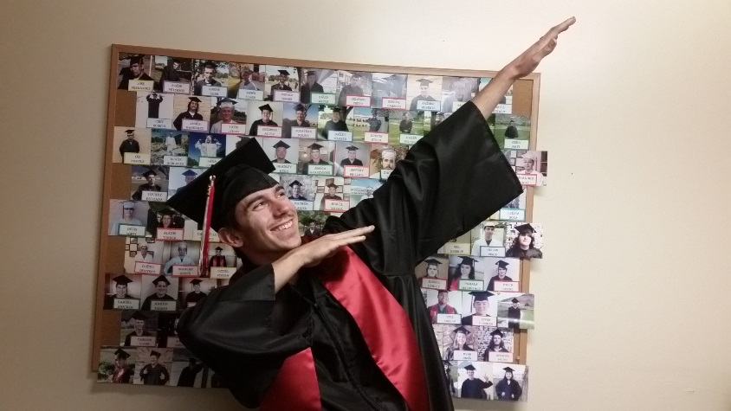
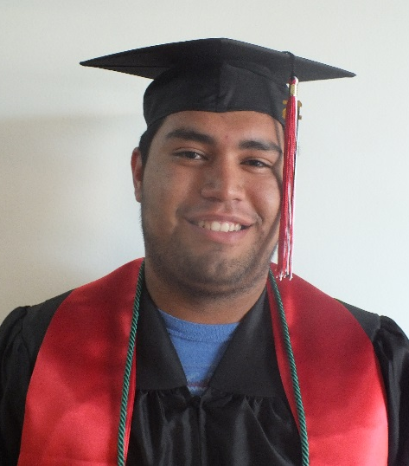
Information on YouthBuild Academics Program
Assists Adult Education students to earn either their High School Diploma or their GED.
Diploma seeking students need at least 14 credits toward high school diploma.
Notes:
Project management, design, construction administration
Soft skills learned are transferrable to other careers as well

Slide 7
Information on YouthBuild Construction Technology
Provides students with an introduction to the various disciplines and occupations in the construction industry and prepares them for entry-level positions
570 hours
Construction core & projects
Carpentry
Cabinetmaking
Electrical
Plumbing
Drafting
Notes:
Project management, design, construction administration
Soft skills learned are transferrable to other careers as well

Slide 8
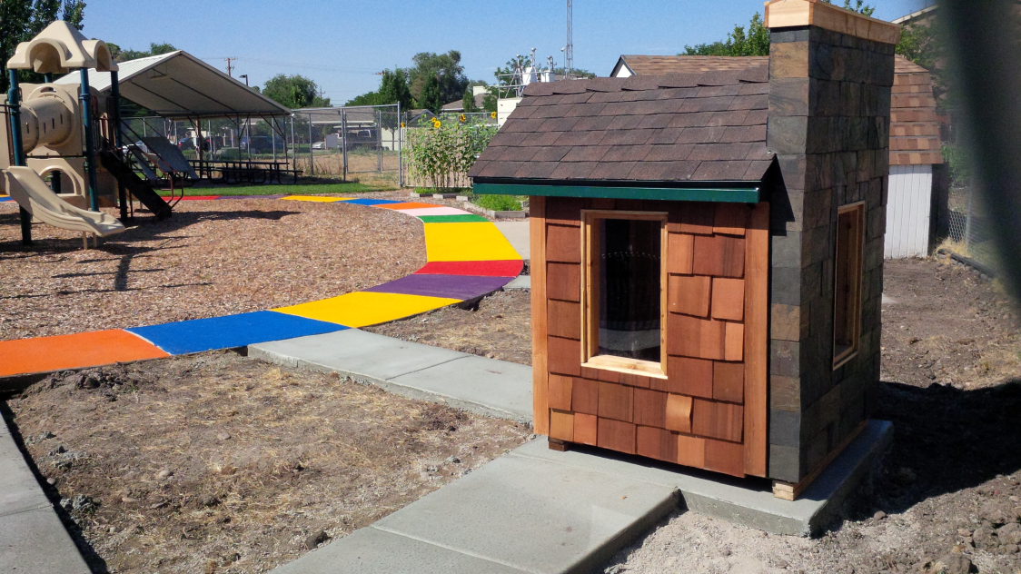
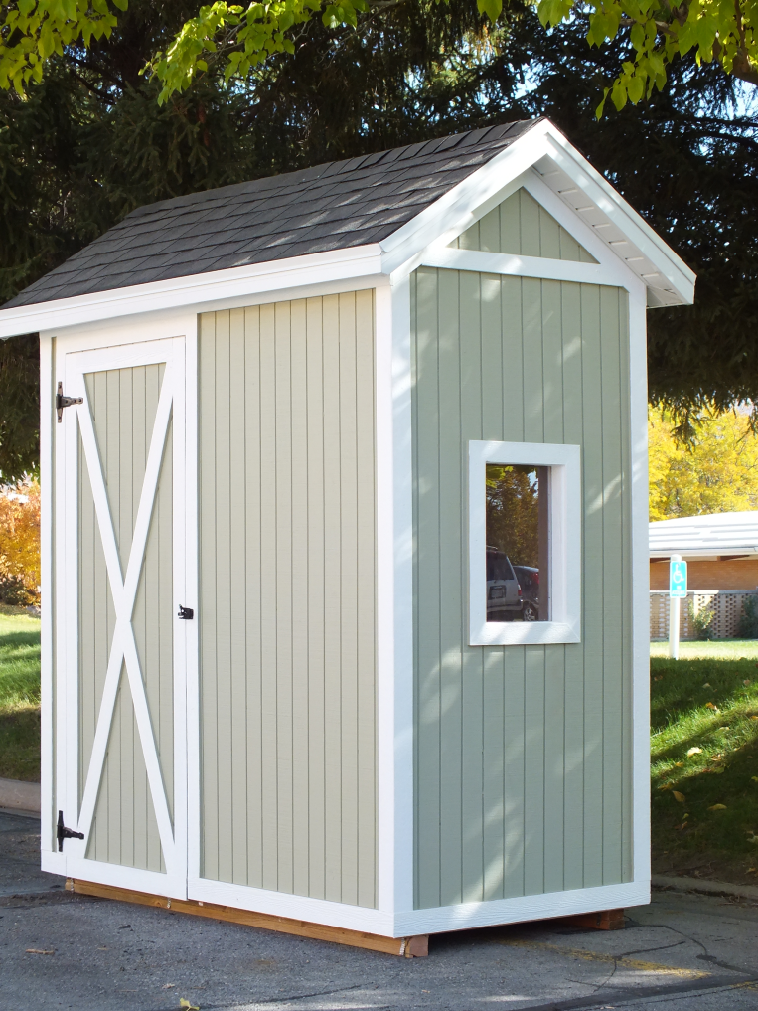
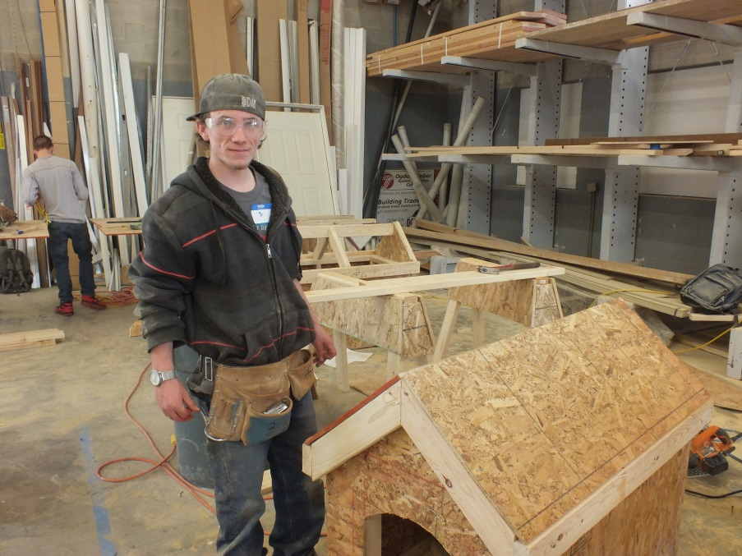
Examples of work done in labs

Slide 9
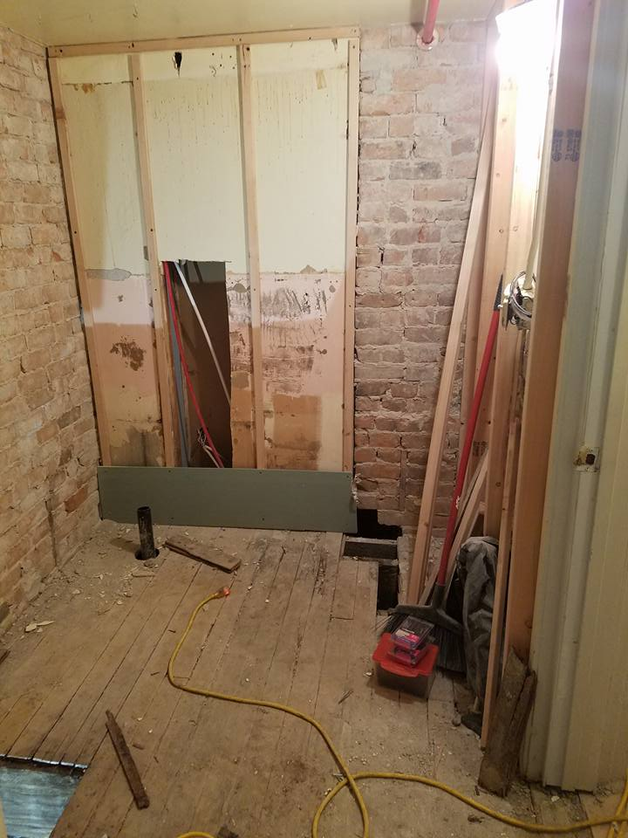
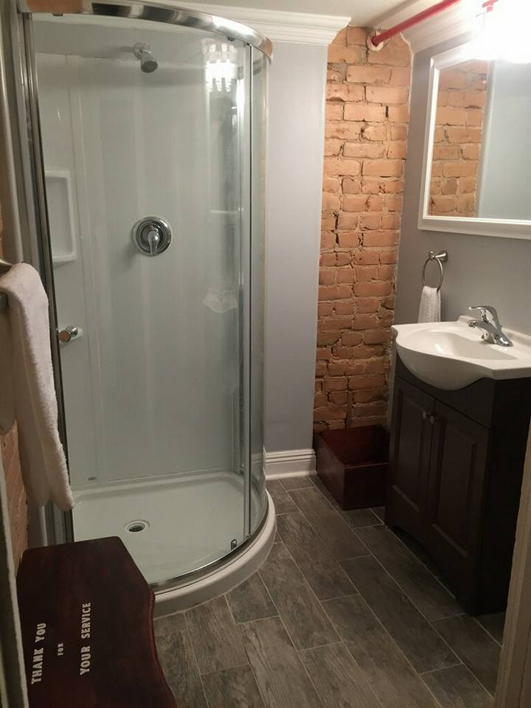
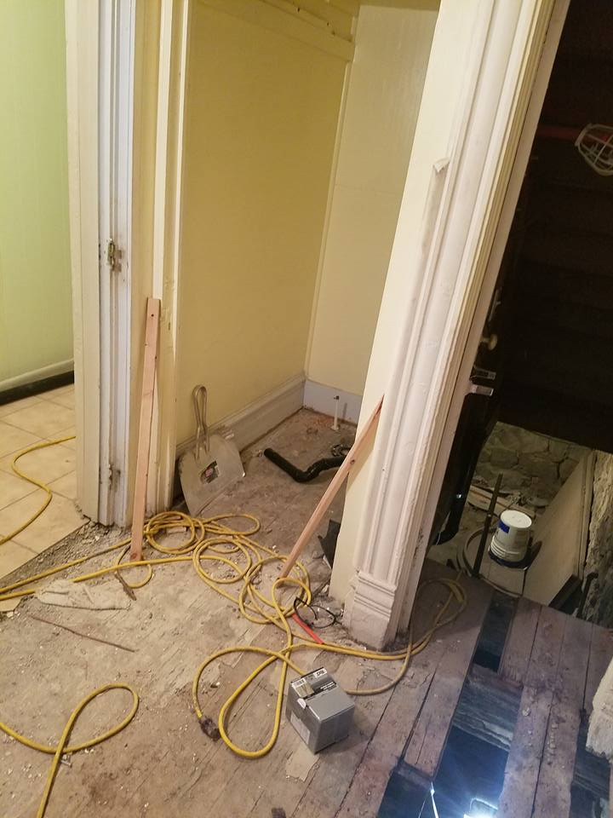
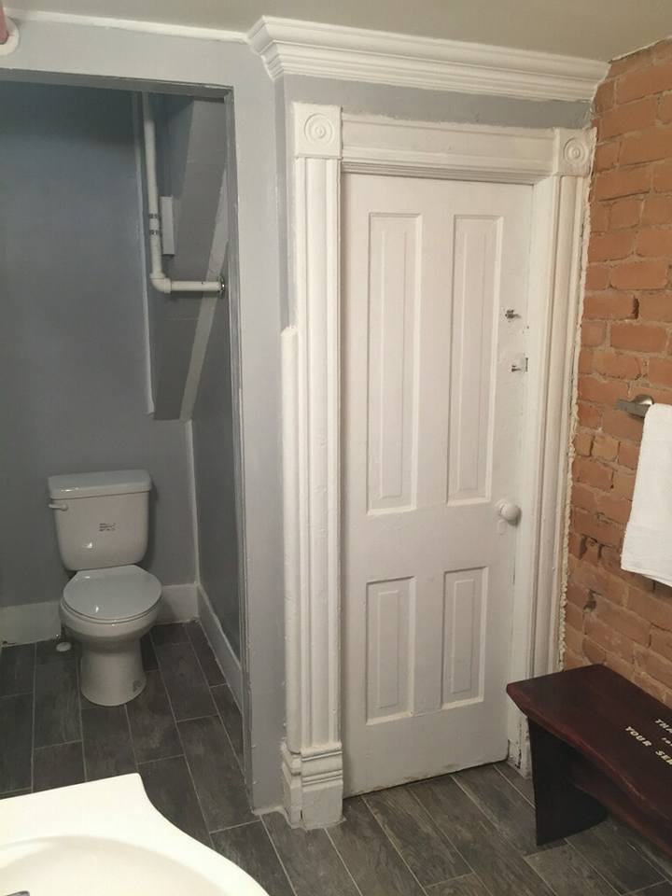
Examples of work done in the community

Slide 10
Information on YouthBuild’s AmeriCorps Program
As students serve in our construction labs, gain skills, and build shelters for low income families and the homeless, they earn service hours toward an approximate $1500 education award through YouthBuild AmeriCorps.
450 hours
80% of hours must be primary or secondary service:
Time in Construction Labs, Onsite, or with other community service projects
20% of hours may be training related:
Academic Classroom & Leadership Training hours
Notes:
Project management, design, construction administration
Soft skills learned are transferrable to other careers as well

Slide 11
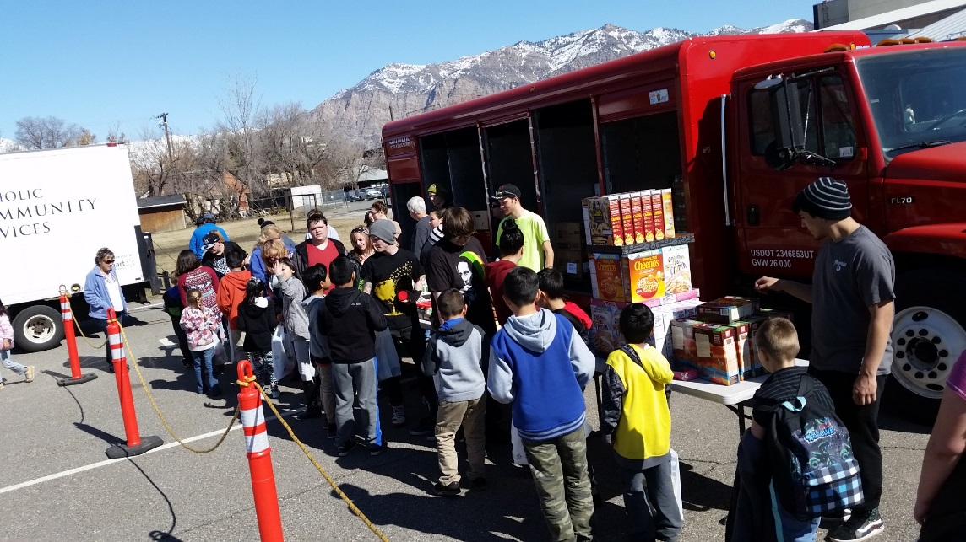
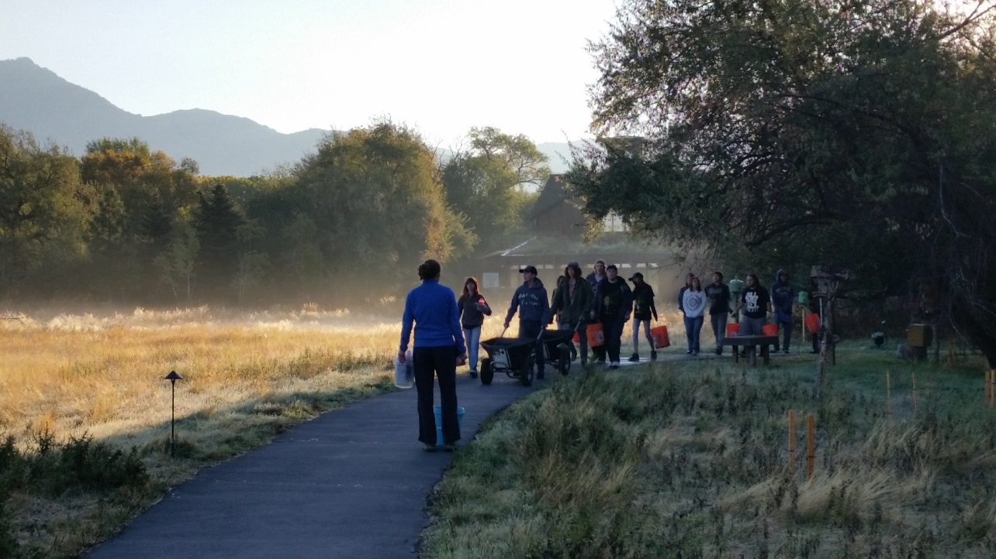
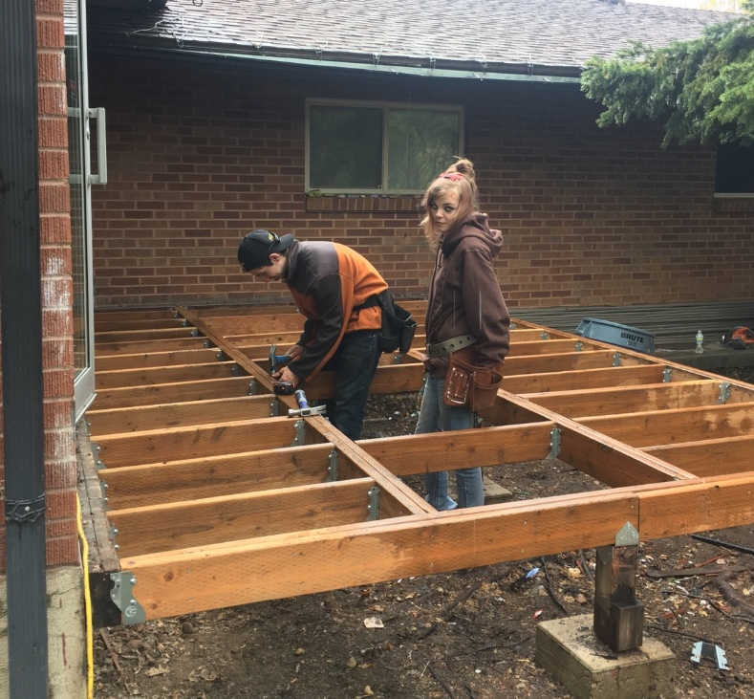
Examples of AmeriCorps Service
The Bridging the Gap Event-
Giving food to grade schoolers
Invasive plant removal at
The Ogden Nature Center
Building a Deck at the Ogden Women’s Retreat

Slide 12
Expectations & Selection Criteria
Ages 16-24
Meet at least one YouthBuild eligibility criteria
Low income
Foster care
Individual with a disability
Youth/adult offender
Child of an incarcerated parent
Migrant youth
Homeless
Be eligible for WIOA program
Interest in both construction and academic components of program
Drug free
Be on time and prepared
Committed to change
FOLLOW THROUGH
Notes:
Random drug testing will be done

Slide 13
OWATC YouthBuild from graduate’s perspective
https://www.youtube.com/watch?v=Ia2jdbNtAEc
Notes:
https://www.youtube.com/watch?v=Ia2jdbNtAEc

Slide 14
OWTC YouthBuild Accomplishments
70% completed their High School
3 students have received the Outstanding Student Award
98% had literacy gain equivalent to 2 grade levels
98% completed OSHA

Slide 15
Accomplishments Cont.
Students completed over 400 community service hours
Students completed over 2000 leadership & life skills hours
20 students competed in Skills USA competition
9 students served on the Youth Policy Committee.

Slide 16
GED/HS Passing Rate
96 Percent GED passing rate.
GED focused teaching.
70% High School Diploma Passing Rate
Group work
Competency based curriculum.

