Slide 1
Taking Integrated Education and training (IET) to the next level
Stephanie Patton
September 14, 2018

Slide 2
IET Requirements
Adult Education and Literacy Activities
Adult Education
Literacy
Family literacy activities
English language acquisition activities
Integrated education and training
Workforce preparation activities
Workforce Preparation Activities
Utilizing resources
Using information
Working with others
Understanding systems
Skills necessary for successful transitions
Other employability skills
Workforce Training
Occupational skill training
On-the-job training
Incumbent worker training
Workplace training and related instruction
Private sector training programs
Skill upgrading and retraining
Entrepreneurial training
Transitional jobs

Slide 3
Delivery requirements for components
The program is focused on a specific occupation or occupational cluster,
Each component must be of sufficient intensity and quality,
Components must be delivered simultaneously,
Instructional materials must be occupationally relevant (contextualized), and
IET programs must have a single set of learning objectives.

Slide 4
Identifying an occupation or occupational cluster
Work with workforce development partners (DWS) to identify in-demand occupations or clusters.
Medical Assistance Technicians
https://www.onetonline.org/link/summary/51-9082.00

Slide 5
Adult Education and literacy activities
What is the specific occupation or occupational sector?
Which adult education activity is included in the IET program?
Who is the target student group for this IET program?
What are the target group’s educational needs?
How are the College and Career Readiness Standards for Adult Education or English Language Proficiency Standards reflected in these activities?
Contextualization Toolkit:
https://jfforg-prod-prime.s3.amazonaws.com/media/documents/BT_toolkit_June7.pdf

Slide 6
Workforce preparation activities
What specific workforce preparation activities are included in the IET program?
What knowledge and skills are the activities focused on?
How will you know if students have attained the identified skills and competencies?
Workforce preparation activity resources:
http://www.paadultedresources.org/wp-content/uploads/2016/05/Foundation-Skills-Resources-Guide.pdf
https://cte.ed.gov/initiatives/employability-skills-framework
https://carey.jhu.edu/uploads/documents/Core_Competency_Model_2.pdf
*http://www.nc-net.info/employability.php
http://atlasabe.org/professional/transitions

Slide 7
Workforce training activities
Which workforce training activities are included in this IET program?
How are training activities being provided?

Slide 8
Intensity and quality
What is the intensity of the IET program?
What will the student’s combined schedule look like?
Is the schedule feasible for the targeted population?
Will all activities be offered in the same location?
If not, will students be able to access all locations?
What is the quality of the IET program?

Slide 9
Crosswalking competencies to create a single set of learning objectives
Medical Appliance Technicians
https://www.onetonline.org/
Occupational Skills needed:
Active listening
Critical thinking
Quality control analysis
Reading comprehension
Speaking
Technology Skills needed:
CAD software
CAM software
Microsoft Excel
Knowledge needed:
Production and processing
Raw materials, production processes, quality control, costs
Customer and personal service
English language
Mechanical
Design
Precision technical plans, blueprints, models

Slide 10
Workforce preparation skills
Identified O*Net Skill | Foundation Skill | Competency
Speaking | Module 2: Communication | Activity: Communicating on the Job Activity: Giving and Receiving Instructions Activity: Preparing Presentations

Slide 11
Single set of learning objectives
Module Unit Week | Objective(s) | Training Objective(s) | Basic Skills Objective(s) | Workforce Preparation Skills
Unit 1 | Students will be able to read machine specifications. | Students will be able to determine the type of product or device to be fabricated and the materials needed. | Students will be able to read and comprehend technical documents. | Students will be able to communicate effectively.
Example: Unit 1 | Example: Using the properly selected tool, students will be able to accurately measure and safely cut an 8 ¼ foot board with 100% accuracy. | Example: Students will be able to select the appropriate tools and demonstrate their use to cut boards. | Example: Students will be able to identify common fractions. | Example: Students will be able to observe critically.

Slide 12
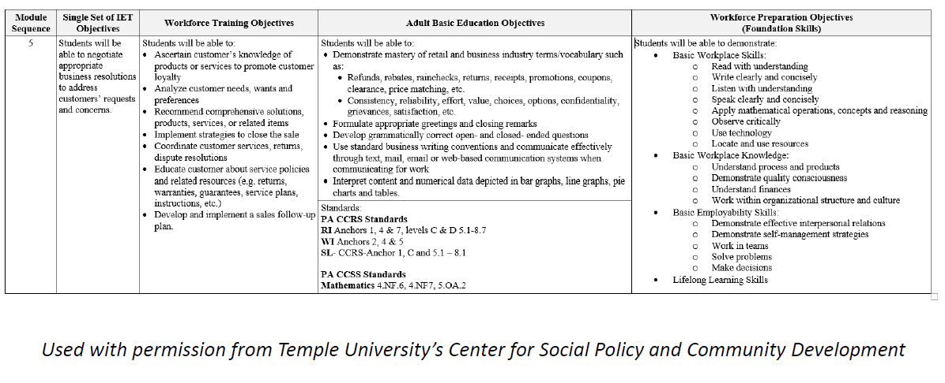
Single set of learning objectives

Slide 13
Career pathways
How does the IET program reflect the criteria of being a part of a career pathway?
A career pathway is a combination of rigorous and high-quality education, training, and other services that:
Aligns with skill needs of industries in the region;
Prepares an individual to succeed in secondary or postsecondary education options;
Includes counseling to support the individual’s education and career goals;
Includes education offered concurrently and contextually with workforce preparation and training;
Organizes education, training, and other services…to accelerate educational and career advancement;
Enables an individual to attain a secondary school diploma; and
Helps an individual enter or advance within a specific occupation or occupational cluster.

Slide 14
Funding and program delivery
What funding sources are being used to implement the IET program?
What supports are in place to ensure learner retention?
How is the program aligned with the State plan’s priorities to expand access to employment and education for individuals with barriers to employment ?

Slide 15
IET Model programs
https://www.clasp.org/sites/default/files/public/resources-and-publications/publication-1/WIOA-IET-Model-Programs.pdf

