Slide 1
Adult Education Summer Conference
American Job Centers:
Collaboration is the Key to Success
September 14, 2018
Notes:
Welcome/Introductions
Thanks for coming
Introductions
Kim will now give us an overview of the State plan which will help give some background on why we are here today.
Then we will discuss next steps in the process

Slide 2
American Job Center
What is it?

Slide 3
Workforce Innovation & Opportunity Act
WIOA’s Purpose:
Better align the workforce system with education and economic development in an effort to create a collective response to labor market challenges on the national, state and local levels.
Further engage business partners to lead local workforce development efforts and introduce increased flexibility and accountability of State Workforce Development Board members.

Slide 4
Performance Measures
Measurable Skill Gains - EFL level gain, diploma, GED
Median Earnings 2nd Qtr after Exit
Employment 2nd Qtr after Exit
Employment 4th Qtr after Exit
Credential Attainment

Slide 5
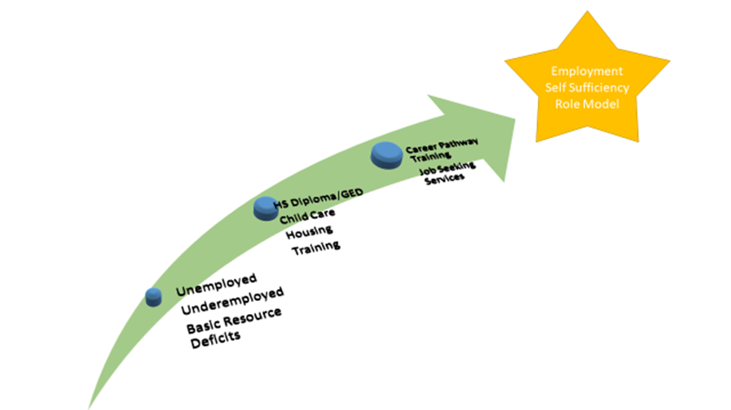
WIOA
Workforce Innovation and Opportunity Act
Notes:
Emily Make star print black
Arrow Chart
Lack of resources
Underemployed
Adult ed in the middle
Other Supports- next arrow
Employment, independence and economic stability at the end

Slide 6
Current Comprehensive One-Stops
Price, Logan, Provo, Cedar City
Notes:
● The common one-stop delivery system identifier is “American Job Center.” Each one-stop center must use “American Job Center” or “a proud partner of the American Job Center network” on all primary electronic resources, newly printed, purchased or created materials. It must be included on all products, programs, activities, services, electronic resources, facilities, and related property and new materials used in the one stop center. Mention SWDB

Slide 7
What To Expect?
A physical location where job seeker and employer customers can access the programs, services, and activities of all one-stop partners
A trained staff member who is familiar with all of the programs
Career services
Access to training services
Access to employment services
Access to programs and activities carried out by one-stop partners
Workforce and labor market information

Slide 9
Six Core Programs
Four Titles Under WIOA
Title I
Adult, Dislocated Worker and Youth formula programs administered by Department of Labor (DOL)
Title II
Adult Education and Literacy Act programs administered by the Department of Education (DoED);
Title III
Wagner-Peyser Act employment services administered by (DOL);
Title IV
Rehabilitation Act Title I programs administered by (DoED).
Notes:
• Adults - provides career and training services to help job seekers who are at least 18 years old succeed in the labor market. WIOA establishes a priority for serving low income individuals, recipients of public assistance, and those with basic skills deficits.
• Dislocated workers- career and training services for job seekers who meet the definition of dislocated worker
• Youth- 16-24 out of school youth access to individual training accounts
• Adult Education - Adult secondary and literacy programs
Wagner Peyser- Employment Service program (the front door) to all services available at the one stop
• Vocational Rehabilitation

Slide 10
Notes:
Work side by side
Contain some of the same elements
Entirely separate.
Serve a similar purpose

Slide 11
American Job Center Customers
Who are the American Job Centers for?
Youth
Job Seekers
Workers
Businesses

Slide 12
Required Partners
Job Corp
Jobs for Veterans State Grants
Community Service Block Grants
Temporary Assistance for Needy Families (TANF) (DWS Program)
Youthbuild (WIOA Title I)
Senior Community Service Employment Program
Trade Adjustment Assistance
Community Service Block Grants
Unemployment Insurance (DWS Program)
Career and Technical Education (CTE)
Indian and Native American Programs (WIOA Title I)
National Farmworkers Job Program (WIOA Title I)
Notes:
Community Service Block Grant funds local anti-poverty programs
YouthBuild programs -low-income young people learn construction skills through building affordable housing for homeless and low-income people in their neighborhoods and other community assets such as schools, playgrounds, and community centers. OWATC- administered through DWS
The TAA program assists US workers who have lost their jobs as a result of foreign trade, and provides trade-affected workers with opportunities to obtain the skills, resources, and support they need to become reemployed.
ndian and Native American (INA) Workforce Innovation and Opportunity Act (WIOA) Section 166 grantees and the Department of Labor share a vision of providing quality employment and training services to Native American communities that not only meet regulatory requirements, but also are administered in ways that are consistent with the traditional cultural values and beliefs of the people they are designed to serve.

Slide 13
Additional Partners
Ticket To Work
Small Business Administration
Supplemental Nutrition Assistance Program (SNAP)
Client Assistance Program (CAP)
Public Libraries
Human Service Transportation Coordination
Mental Health Agencies

Slide 14
One Stop Referrals
One-stop partner staff will:
Introduce the customer, in person, to the partner staff that will assist them.
Directly contact partner staff on behalf of the customer and make a personal, telephone introduction
Show the customer how to access information and/or services on the website and ensure they are able to accomplish their goals
Follow up with customers to make sure they successfully connected to partners and received the appropriate services when referred
New referral system coming soon

Slide 15
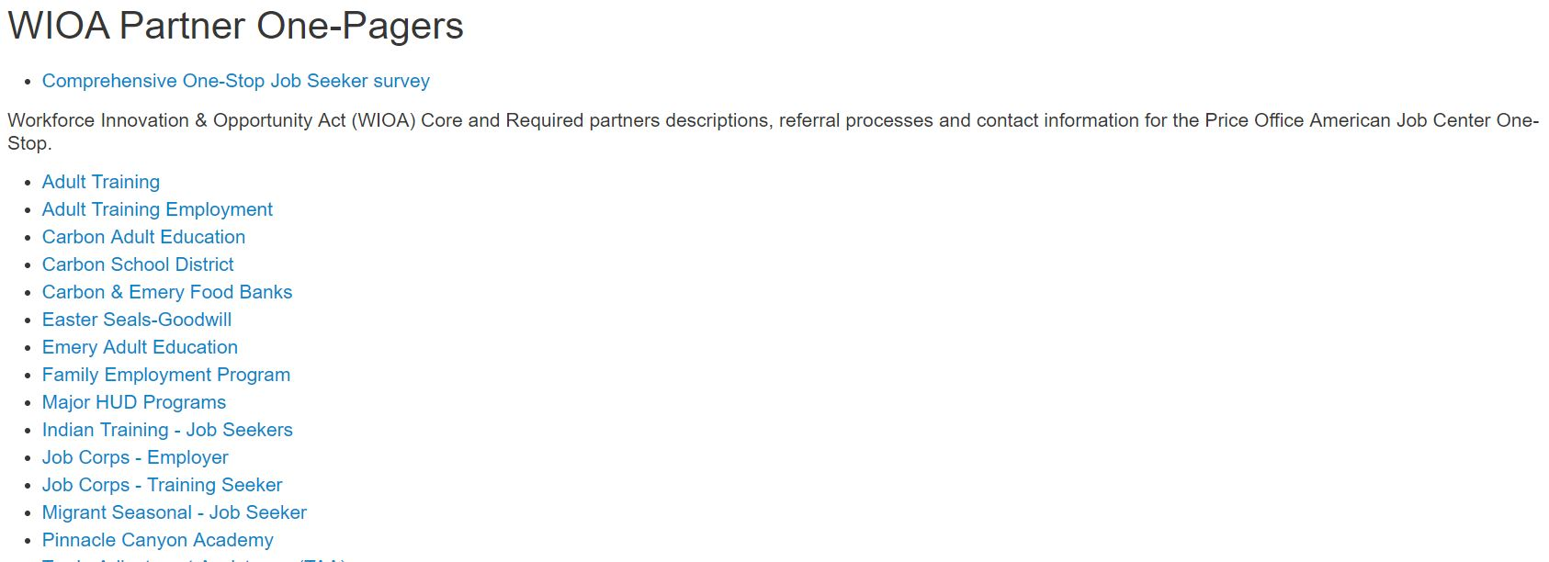
Price AJC Example

Slide 16
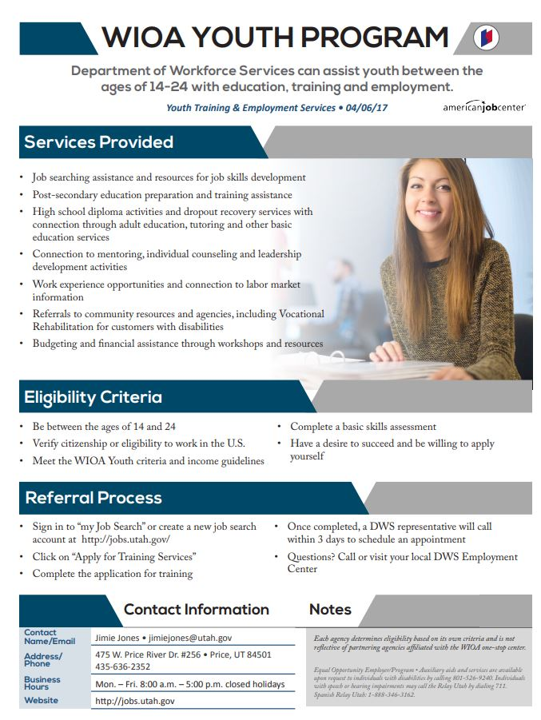
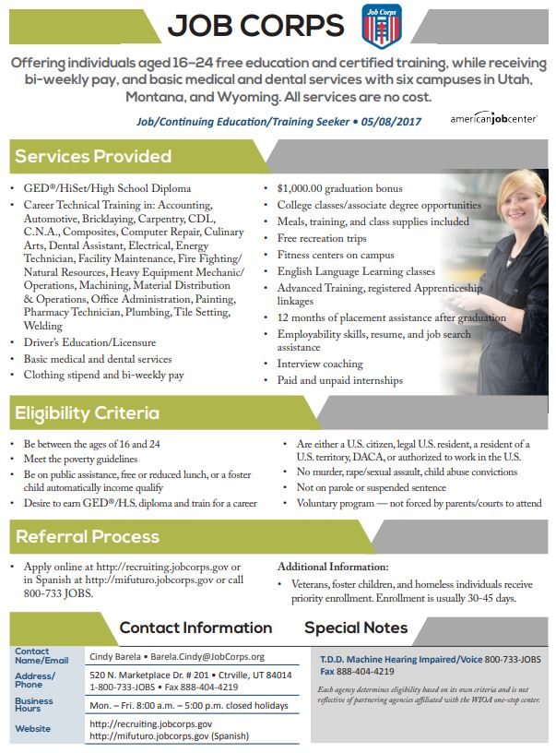
Referral Page Examples

Slide 17
Referral Activity
Comprehensive One Stop Referral Activity

Slide 18
Questions

