Slide 1
Strategic Priorities USBE CS Taskforce September 7, 2018 Thalea Longhurst Ashley Higgs Brandon Jacobson
Develop & Implement statewide K-12 framework for CS
Ensure students can access a majority of the 19 CS courses currently offered, (33 including IT courses); regardless of geography.
Start early by engaging students at the elementary level
Develop a statewide strategy to communicate the value of CS
Build capacity among educators at pre-service and in-service levels
Improve upon current course requirements to scaffold CS learning K-12

Slide 2
Computers and software are changing everything…
Therefore, Utah’s Vision:
Each student in secondary public schools will have access to robust and varied computer science courses by 2022. All students will enter secondary schools with exposure to computational thinking and competencies in digital literacy. This begins in our elementary schools with competencies in keyboarding, appropriate and responsible use of technology, and basic coding principles.
Notes:
Let’s talk about getting computer science into our K-12 schools
But let’s start by talking about dreams
Opportunities for you
Opportunities for your community
And most importantly, an opportunity to create something
The beauty of computer science is that imagination and creation lie at the heart of the field
This smart phone I have here or the laptop driving this presentation are innovation platforms
They allow dreamers, idealists and entrepreneurs anywhere in world to bring their ideas into reality IF they know how to write the software that drives our modern world

Slide 3
Strategic Priorities USBE CS Taskforce Step 1
Develop & Implement statewide K-12 framework for CS
Ensure students can access a majority of the 19 CS courses currently offered, (33 including IT courses); regardless of geography.
Start early by engaging students at the elementary level
Develop a statewide strategy to communicate the value of CS
Build capacity among educators at pre-service and in-service levels
Improve upon current course requirements to scaffold CS learning K-12

Slide 4
Develop & Implement statewide K-12 framework for CS
Definitions & Practices help understand Priorities
Computer Science is about logic, problem solving, and creativity
CS Grade by Grade Framework
Elementary – Recognizing Patterns, Problem Solving, Representation, and Sequencing
Middle/Jr. High – Building upon Elementary Definition. The thought process involved in expressing solutions as computational steps or algorithms that can be carried out by a computer. Recognizing, Developing, Creating, and Testing are added to the practices of the definition.
High School – Building upon the Middle/Jr. High Definition. Computational thinking practices Use, Modify, Create, Refine, Test, and Analyze concepts.

Slide 5
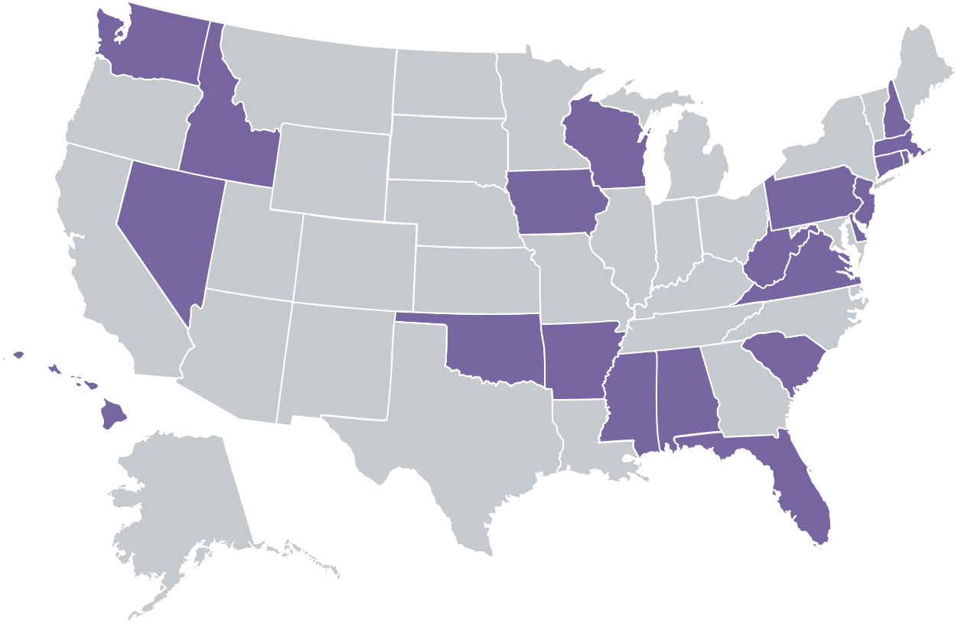
Model other state plans
Develop & Implement statewide K-12 framework for CS

Slide 6
K-12 Computer
Science Framework
States with K-12 CS Framework
Only 21 states (2018) have created K-12 computer science Frameworks.
Utah developed Framework concepts using the general framework from:
CS Teacher Association (CSTA),
k12cs.org/, and
other state plans.
States without K-12 CS Framework
Notes:
The question is, what to do about the lack of access to K-12 computer science?
What can we do when a student’s access to CS is determined largely on whether or not the school is lucky enough or forward thinking enough to have a computer science teacher?
What can we do when girls are not participating in this field or thinking that computer science is “not for them”?
The real question we face is how can our education system evolve to ensure that computer science is part of our student’s daily lives?
I’m here to tell you that it is already evolving
Already, several states have created K-12 computer science standards, all but one of those in the past two years, and several more are in progress.

Slide 7
Other States
Other Supporting efforts
Did you hear the news?
Aug 30, 2018
Code.org, CSTA+, and Pluralsight to provide PD, curriculum, content, and added skill development to national educators including $1,300,000 to support underrepresented and rural promotion of CS
Sept 7, 2018
Arkansas Governor Asa Hutchinson announced this week that all 528 Computer Science teachers in the state of Arkansas will receive CSTA+ membership! Valued at $50 a teacher = $26,000
Notes:
The question is, what to do about the lack of access to K-12 computer science?
What can we do when a student’s access to CS is determined largely on whether or not the school is lucky enough or forward thinking enough to have a computer science teacher?
What can we do when girls are not participating in this field or thinking that computer science is “not for them”?
The real question we face is how can our education system evolve to ensure that computer science is part of our student’s daily lives?
I’m here to tell you that it is already evolving
Already, several states have created K-12 computer science standards, all but one of those in the past two years, and several more are in progress.

Slide 8
CSTA offering
For Computer Science educators
Reinforce Computer Science concepts by aligning to national Computer Science Certification exams
Maps to 5 main content categories:
Impacts of computing
Algorithms & computational thinking
Programming
Data
Computing systems & networks
Designed to empower educators in preparing for the Praxis exam, increase their comfort level with fundamental programming concepts, and improve their lesson preparation
Pluralsight One CSTA Offering

Slide 9
Utah’s Vision Simplified:
Each student should have an opportunity in their school to learn about:
algorithms, how to make apps, and how the internet works.
Notes:
So let’s take a little audience pop-quiz
How many of you can answer these questions?
What is photosynthesis?
Or what is H2O?
These are all things that we expect kids to graduate high school knowing
Every 21st century student should also have a chance to learn about algorithms, how to make an app, or how the internet works.
Right now there’s no expectation in our schools that students will even have a basic understanding of these concepts, even though they are driving a large part of our society.
It is equally important that students understand what a “for loop” is and how it is used and how to design algorithms is as it is that they understand how to solve an equation or how plants live
The main reason that computer science is now foundational knowledge necessary in every school is because it will allow students to think about problems differently
Students will gain computational thinking skills, which embody a more robust way to think about problems
And the problem solving process can be applied to any field of study and to any problem
If you are facing a big, ambiguous project at home or at work, computational thinking and problem solving processes can help you break this problem into smaller chunks. Recognizing what’s important and what needs to be solved first are critical thinking skills that are valuable in ANY context

Slide 10
Implementation of Framework
Step 2
Develop & Implement statewide K-12 framework for CS
Start early by engaging students at the elementary level
Integrating computer science-related practices into early childhood education is not a departure from traditional notions of developmentally appropriate practice; rather, computer science supports play-based pedagogy, extends what educators are already doing in their classrooms, and guides young learners to notice, name, and recognize how computing shapes their world. In this way, pre-K brings computer science to life, preparing kids for the larger K–12 framework. Computer science is well-suited for early childhood education as it offers a learning environment where young children can “play to learn while learning to play” (Resnick, 2003).

Slide 11
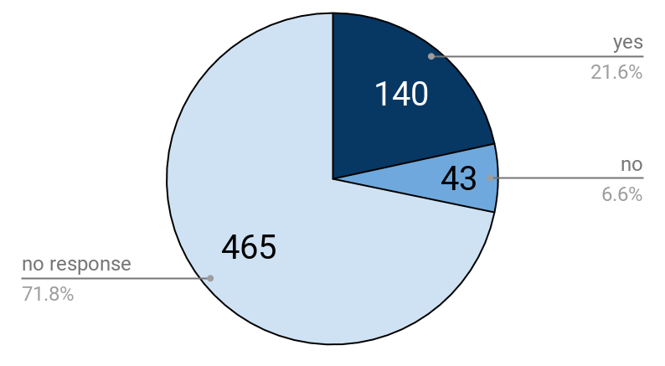
Utah elementary schools offering CS content
Implementation
Step 2 – Cont.
Develop & Implement statewide K-12 framework for CS
Start early by engaging students at the elementary level
Based off a survey: The responses demonstrate the portion of unique elementary schools that responded to the survey as a portion of the total number of public elementary schools across the state. Only 10% of these schools indicated that they were required to teach CS, demonstrating that those currently teaching CS are largely doing so either with the encouragement of their administration (60.4%) or simply of their own accord (29.6%).
Notes:
Only 10% of these schools indicated that they were required to teach CS, demonstrating that those currently teaching CS are largely doing so either with the encouragement of their administration (60.4%) or simply of their own accord (29.6%).

Slide 12
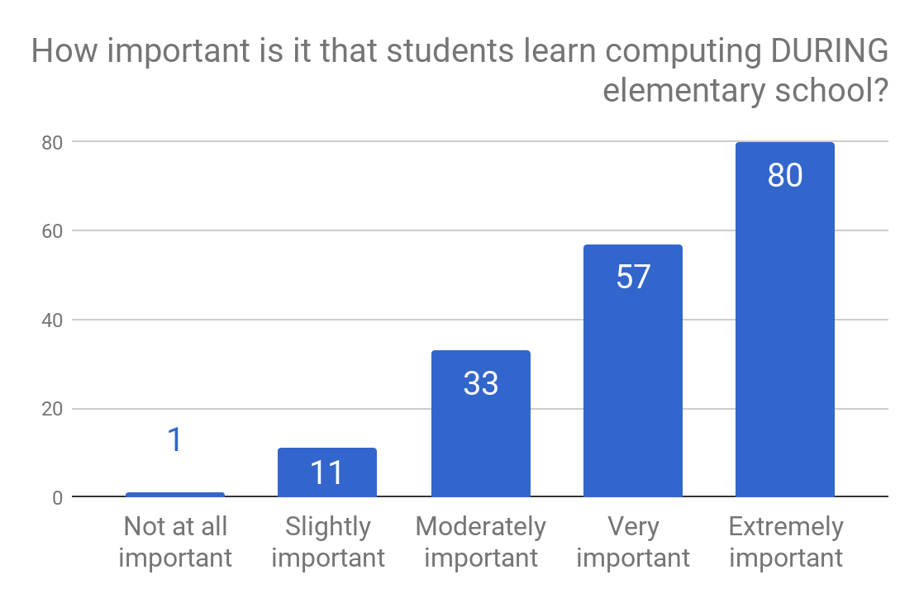
Implementation
Step 2 – Cont.
Develop & Implement statewide K-12 framework for CS
Start early by engaging students at the elementary level
All respondents were asked to rate how important they thought it was that all students receive CS instruction during elementary school, whether the school reported teaching it or not. 75.3% of respondents felt that it was very or extremely important that CS be taught in elementary school. What’s more, 85.7% felt that CS should be taught sometime in K-12.

Slide 13
Implementation
Step 2 – Cont.
What CHALLENGES do elementary teachers face teaching CS?
While successes dealt primarily with students, challenges in teaching elementary CS focused on administrative issues: time, funding, integrating CS within core subjects, and creating a shared vision.
Top challenges faced elementary CS educators*
Challenge | Definition | %
Time | Insufficiency or abundance of time necessary to teach subject | 44.75%
Training | The need for additional professional development and teacher education and/or experience | 31.49%
Funding | Resources such as money to pay for coding related costs | 18.78%
Technology & Equipment | Resources such as computers, robots, or technology for the coding | 11.60%
Implementation | Preparing to, implementing, or integrating the coding in a schedule, program, or system | 9.94%
Shared vision | The lack/presence of a shared valuation for coding in the classroom | 8.29%
Core | Comments about the core curriculum or requiring coding in curriculum(e.g., adding coding to the core) | 7.18%
* Reported by at least 5% of the time
Develop & Implement statewide K-12 framework for CS
Start early by engaging students at the elementary level

Slide 14
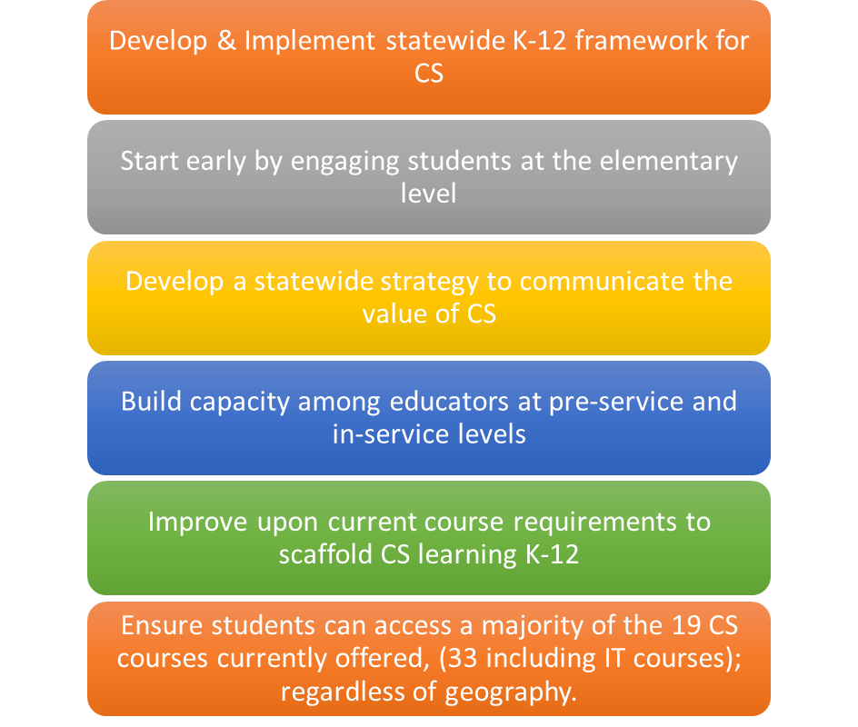
Implementation continued
Three Career Pathways within IT and CS for 2018-2019 Click Here
Information Systems
Linux
Etc.
Programming and Software Development
Computer Science Principles
Etc.
Web Development
Web Development
A+ Computer Repair
Network
Database
Computer Programming
Game Development
HTML5
Mobil Development
Algorithms and Data
Intro to IT
Database
Etc.
Cloud Computing
CyberSecurity
CyberSecurity (Ethical Hacking)
Cyber Forensic
Cloud Computing
Intro to IT
Etc.

Slide 15
Implementation continued
Four Career Pathways within IT and CS for 2019-2020
Information Systems
Linux
Etc.
Programming and Software Development
Computer Science Principles
Etc.
Web Development
Web Development
A+ Computer Repair
Network
Database
Computer Programming
Game Development
HTML5
Mobil Development
Algorithms and Data
Intro to IT
Database
Etc.
Cloud Computing
CyberSecurity
CyberSecurity (Ethical Hacking)
Cyber Forensic
Cloud Computing
Intro to IT
Etc.

Slide 16
Implementation continued
Five courses for Middle/Jr. High including Computer Science or coding concepts. Concern that a gap in CS courses existed in the middle level has now been mitigated with training and curriculum relevant to the courses.
STEM Concepts
Creative Coding
Intro to Python 1
Digital Literacy
6-8 grade level
6-8 grade level
7-8 grade level
Intro to Python 2
8 grade level
Required course for Middle/Jr. high advancement

Slide 17
Where are we?
Step 3 - Data
“The goal is to turn data into information, and information into insight.” – Carly Fiorina

Slide 18
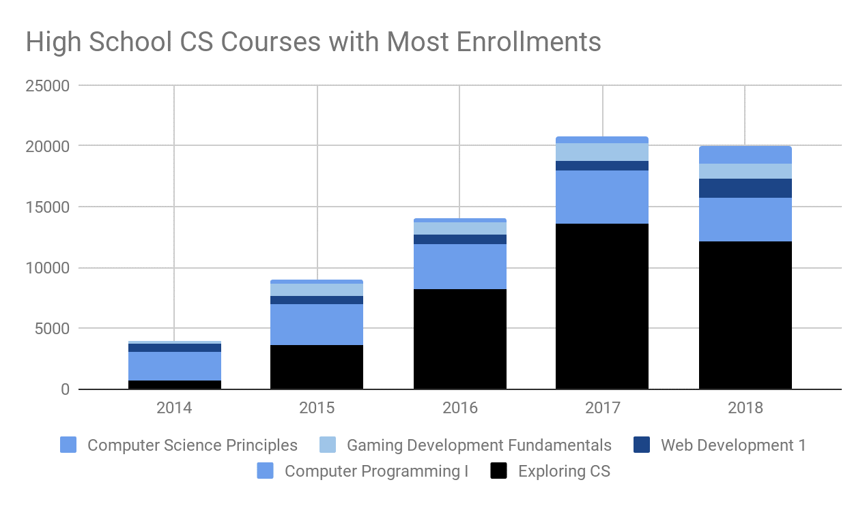
Enrollment in all high school CS courses increased annually by more than 5,000 students each year for three consecutive years until 2017-2018, when enrollment decreased by almost 1500 students. Among the five most popular courses (covering 95% of all CS related courses), only Web Development 1 and Computer Science Principles saw increases in enrollments in 2017-2018. A change in course coding may have contributed to the increase in Web Development 1, whereas the College Board’s introduction of the AP Computer Science Principles exam in 2017 may have increased interest in the Computer Science Principles course.

Slide 19
Why is this a huge change?
While fewer than 500 Utah students take the College Board Advanced Placement Computer Science (AP CS) exams each year, this data serves as a useful source of long-term trends. There have been three AP CS exams: AP Computer Science A (statewide data available 1998-present), AP Computer Science AB (1998-2009), and AP Computer Science Principles (2017-present). Starting in 1999, Utah experienced a dip in students taking AP CS exams. In fact, May 2017 was the first year that we had more Utah students taking AP CS exams than in 1999.

Slide 20
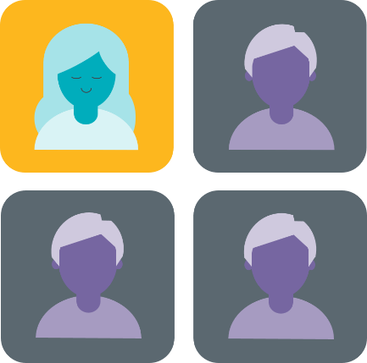
Solving the diversity problem begins in K-12
K-12 computer science
University computer science
Software workforce
Women who try AP Computer Science in high school are 10X more likely to major in it, and Black and Hispanic students are 7X more likely.
Sources: College Board, National Center for Education Statistics, Bureau of Labor Statistics
Notes:
Generally, VERY few students are taking AP high school computer science relative to all other AP tests
But even more troubling is that only 23% of total students taking AP CS are female.
Similar trends are found in computer science majors in college.
And the diversity problem in computing is now something that makes front page news about major tech companies struggling to create a diverse workforce
Out of all the computing jobs in our entire economy, women only make up a quarter of that workforce
Consider that these are the fastest growing, highest paying, most in-demand jobs in America
And if current trends continue, only one of out four of those jobs will be filled by women
And the stats about Black and Hispanic students tell a very similar story as well.

Slide 21
Percentage of Students Enrolled in High School Computer Science Classes
Demographics | In Utah Student Population | 2013 | 2014 | 2015 | 2016 | 2017 | 2018
Female | 49% | 17.6 | 18.7 | 20.7 | 27.0 | 31.5 | 33.6
American Indian | 1% | 0.8 | 1.0 | 1.6 | 1.7 | 1.2 | 1.3
Asian | 2% | 4.2 | 3.3 | 3.0 | 3.4 | 2.7 | 2.7
Black/African American | 1% | 1.1 | 1.3 | 1.3 | 1.4 | 1.7 | 1.7
Hispanic/Latino | 17% | 12.6 | 14.2 | 15.3 | 16.9 | 17.4 | 20.3
Multi race | 3% | 1.5 | 2.0 | 2.4 | 2.5 | 2.5 | 2.4
Pacific Islander | 2% | 0.9 | 1.0 | 1.1 | 1.4 | 1.5 | 1.6
White | 75% | 78.9 | 77.2 | 75.3 | 72.7 | 73.1 | 70.0
Notes:
Demographics of Utah high school CS students vary widely based on the class. Across all CS classes, female student enrollments have increased from 17.6% in 2012-2013 to 33.6% in 2017-2018. Racial / ethnic enrollments in high school CS classes approximately match the demographics for Utah’s public school student population. In fact, while female students are still under-represented in computer science courses, most traditionally under-represented minorities (with the exception of Pacific Islanders) are slightly over-represented in computer science courses. The diversity of these courses may reflect the presence of computer science courses in larger, more urban districts and the lack of these same courses in smaller, more rural districts.
However, most female students are enrolled in Exploring Computer Science (ECS), one of the most basic of computer science courses. If we count all CS classes except ECS, female enrollment only increased from 17.6% in 2012-2013 to 20.6% in 2017-2018. Similarly, the percentage of American Indian, Black, and Hispanic students decrease in more advanced classes. In particular, the percentage of Asians and White students enrolled in all CS courses are 3.1% for Asians and 73.1% for Whites if ECS numbers are discounted, and even higher if only looking at the more advanced computer science courses like AP, IB, Computer Programming, and Computer Science Principles courses (3.7% for Asians and 75.0% for Whites).

Slide 22
Who Is Teaching CS?

Slide 23
This is the issue we are solving with the taskforce
Notes:
Education today has numerous controversial topics
But computer science isn’t one of them
At a time that we are fighting about what should or shouldn’t be taught in our schools, 90% of parents are asking for computer science in their schools
We have momentum
We have grassroots support
What we need now is schools to put two things into place:
First, high-quality, rigorous curriculum and courses
Second, we need to prepare teachers to teach our students
We need states to launch initiatives build on these two goals and focused on improving access to CS education

Slide 24
Teacher Funding towards Endorsement – SB 93
Notes:
Education today has numerous controversial topics
But computer science isn’t one of them
At a time that we are fighting about what should or shouldn’t be taught in our schools, 90% of parents are asking for computer science in their schools
We have momentum
We have grassroots support
What we need now is schools to put two things into place:
First, high-quality, rigorous curriculum and courses
Second, we need to prepare teachers to teach our students
We need states to launch initiatives build on these two goals and focused on improving access to CS education

Slide 25
Strategic Priorities USBE CS Taskforce STATE PLAN
Develop & Implement statewide K-12 framework for CS
Ensure students can access a majority of the 19 CS courses currently offered, (33 including IT courses); regardless of geography.
Start early by engaging students at the elementary level
Develop a statewide strategy to communicate the value of CS
Build capacity among educators at pre-service and in-service levels
Improve upon current course requirements to scaffold CS learning K-12

