Slide 1
Score Report Insights to Drive Instruction, Part 1:
Focus on RLA and Social Studies
Debi Faucette September 2018

Slide 2
Session Objectives
Analyze the GED Ready® and Operational GED® Test Score Reports
Discuss the why and how of using score reports (as prescriptions) to drive instruction
Share ideas and resources

Slide 3
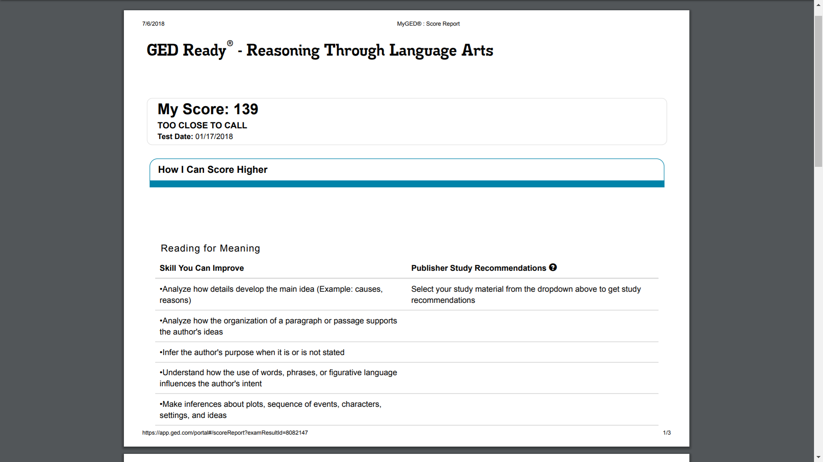
How Do YOU
Use Score Reports?

Slide 4
Common Score Report Uses
Look at the score only…to gauge how far from 145 the score is
Get a feel for what work needs to be done (in terms of skills and content)
Compare the GED Ready® and the GED® operational test scores for similarities and differences
Don’t really use the score report—consider the feedback too “generic”

Slide 5


So How Do You Take It
From This . . . …..……………………..To This?

Slide 6
How? Take Action!
Review
Diagnose
Prescribe

Slide 7
Features of the Enhanced Score Report
FEATURE | GED READY® PRACTICE TEST | GED® TEST
My Score | Indicates if a test-taker is likely to pass, too close to call, or not likely to pass the GED® test. | Indicates if a test-taker passed, passed with College Ready or College Ready plus credit scores, or scored below passing.
How I Can Score Higher | Shows the skills a test-taker needs to work on before taking the GED® test. Includes a personalized study plan with pages and chapters to review in popular study materials. | Shows the skills a test-taker needs to work on before trying again. Includes a personalized study plan with pages and chapters to review in popular study materials.
What My Score Means | Explains what skills the student successfully demonstrated on the GED Ready® practice test. | Explains what skills the student successfully demonstrated on the GED® test.
Review My Written Answers | Displays the test-taker’s written response to the extended response item. Educators can use the constructed response scoring tools to give test-takers feedback on their responses. | Available for the RLA test subject. Shows the students’ scores for their responses and the skills they need to work on to score higher. Not available for Science, Social Studies, or Math subjects.
Notes:
Key Points
Review the basic features of the score report and discuss that you will be showing them what these look like on the actual report.

Slide 8
What Instructors Need to Know
Resources for Success
.

Slide 9

Overview of RLA Test
Content - Integrated reading and writing
  Close reading
  Clear writing
  Editing and understanding the use of standard written English in context
Source texts – 75% nonfiction; 25% fiction
Passage length – 400-900 words
Range of text complexity, including texts at the college- and career-ready level
Technology-enhanced items and extended response
Notes:
Key Points
This slide provides a short overview of the content and context of the RLA Test. Review the information on the slide. For additional information, access the Assessment Guide for Educators Reasoning through Language Arts section.
Assessment Guide for Educators Reasoning through Language Arts is located at:
https://ged.com/wp-content/uploads/assessment_guide_for_educators_rla.pdf

Slide 10
A GED Ready® Score Report: Yellow Zone

Slide 11
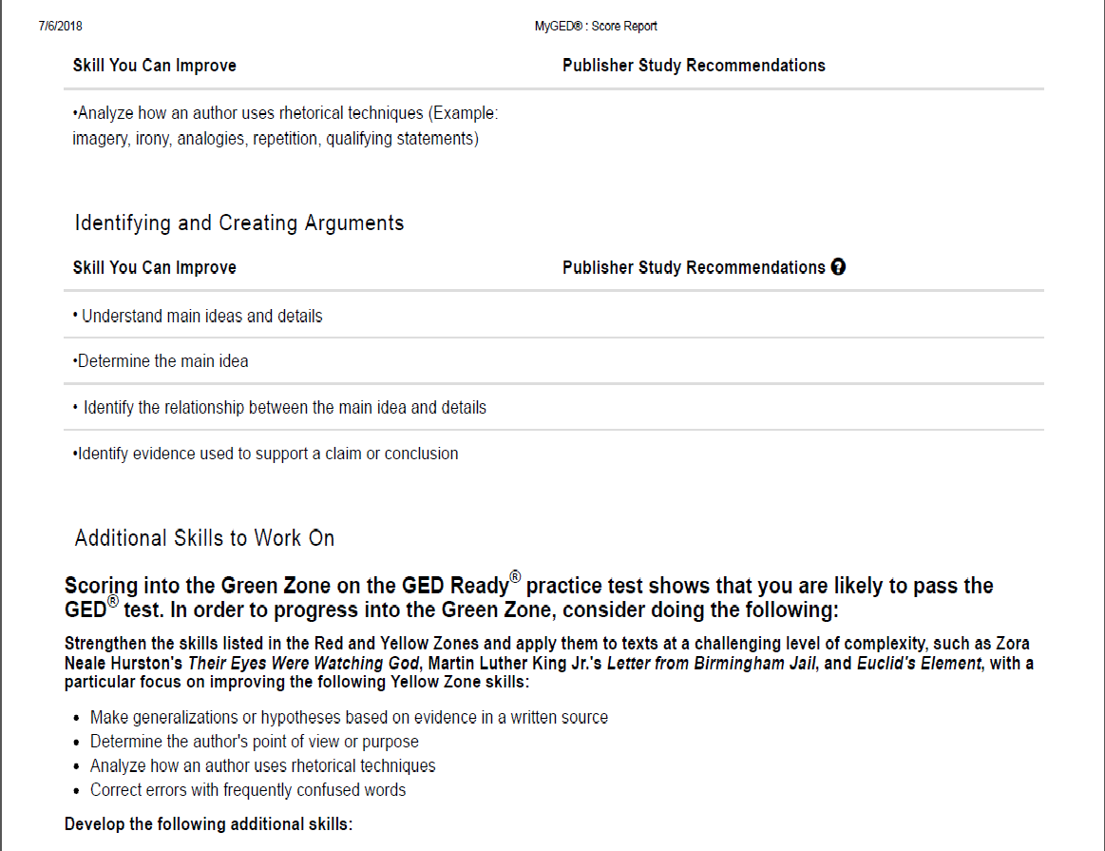

Slide 12
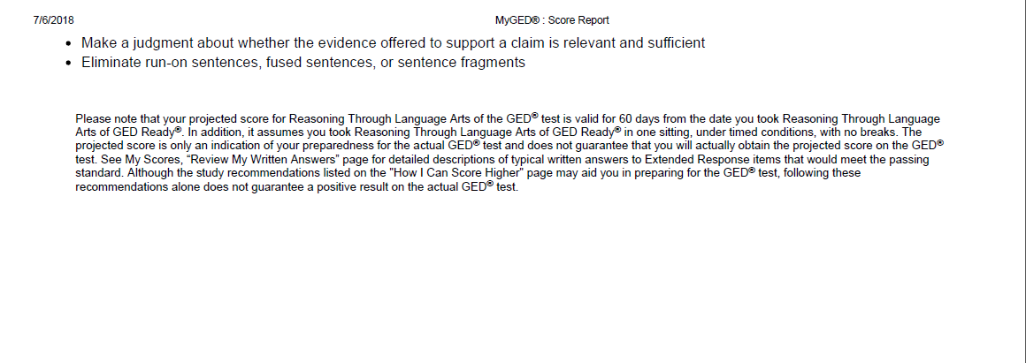

Slide 13
The GED Ready® RLA Score: 139
Areas for Improvement
Close Reading
Reading for Meaning
  Analyze how details develop the main idea (Example: causes, reasons)
  Analyze how the organization of a paragraph or passage supports the author's ideas
  Infer the author's purpose when it is or is not stated
  Understand how the use of words, phrases, or figurative language influences the author's intent
  Make inferences about plots, sequence of events, characters, settings, and ideas
Inference

Slide 14
Diagnosis
Conclusion: A “reluctant” reader
  To tackle the GED® test successfully—in any content area—students must become competent readers
Develop close reading skills
Practice engaging with text (noticing, wondering, questioning, relating, thinking, and on occasion, arguing)
Practice “reading between the lines” (aka inference)

Slide 15
The GED Ready® RLA Score: 139
Areas for Improvement
Text Structures
Identifying and Creating Arguments
  Understand main ideas and details
  Determine the main idea
  Identify the relationship between the main idea and details
  Identify evidence used to support a claim or conclusion
Additional Skills
  Make generalizations or hypotheses based on evidence in a written source
  Determine the author's point of view or purpose
  Analyze how an author uses rhetorical techniques
  Correct errors with frequently confused words
Evidence
Grammar!

Slide 16
Green Zone Skill Alert: What’s Missing
Inference
Make inferences about plot/sequence of events, characters/people, settings, or ideas in written sources
Infer what an author's stated and unstated purpose is based on the details in a written source
Identify the specific pieces of evidence that an author uses in support of claims or conclusions
Evidence

Slide 17
Diagnosis
In addition to building close reading skills…Our “reluctant” reader needs to work with
Text structures
Signal words
Evidence—and not just acquiring a broader definition of what evidence is…but ALSO how evidence is used as support for a position or conclusion in text

Slide 18
But…the Feedback Doesn’t Cover What Specific Questions Were Missed
No, the feedback summarizes the skills that are needed to earn a higher score
And yes, we are inferring what’s needed based on what was not demonstrated (and here we are talking about consistency)

Slide 19
Ideally, What Happens Next?
How do we get the biggest bang for the buck with the available time?
High Impact Indicators (HIIs)
Performance Level Descriptors (PLDs for Level 1- Not Passing and Level 2 – High School Equivalency)
PLDs = Stuff to Teach!
And, remember to have students review the Study Guide

Slide 20
How to Use PLDs in the Classroom
Use PLDs to:
  Tip 1: Assess student’s current skill level
  Tip 2: Determine when students are ready to test
  Tip 3: Shape learning activities
  Tip 4: Add perspective to lesson plans
Notes:
Key Points
There are many different ways that we can use PLDs to assist us in developing an effective curriculum. Here are four tips to get started.
Tip 1: Use PLDs to assess a student’s current skill level
Identify where to focus in order to develop the skills students need to move to the next performance level
Tip 2: Use PLDs to determine when students are ready to test
Determine if a student should take GED Ready® or the GED® test
Use with the Enhanced Score Report's personalized study plan to create a plan for developing student skills
Tip 3: Use PLDs to shape learning activities
Set learning objectives in your classroom based on the PLDs
Determine if you need to adjust how you're approaching the content
Work one-on-one with students to help develop needed skills
Tip 4: Use PLDs to add perspective to lesson plans
Determine how prepared your students are and create lesson plans accordingly
Identify the gaps in your students’ skills and develop focused lesson plans to address those gaps

Slide 21
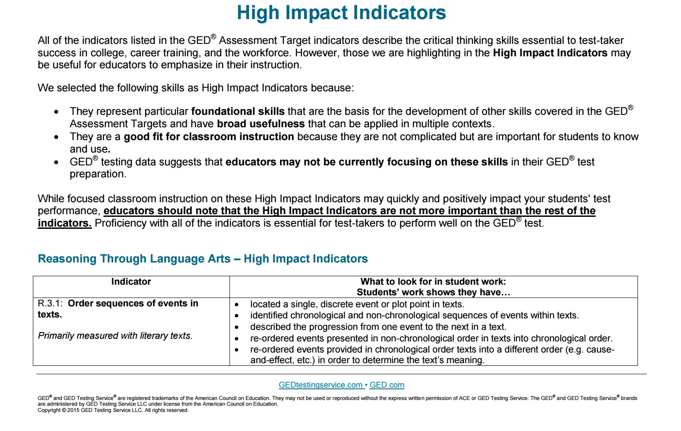
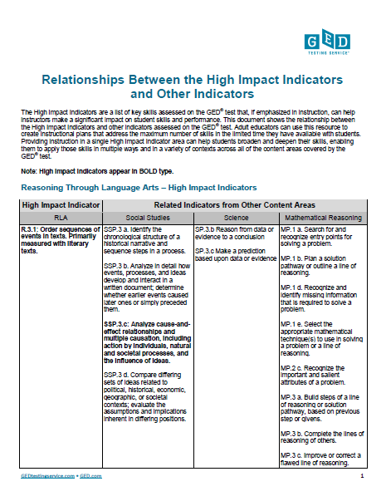
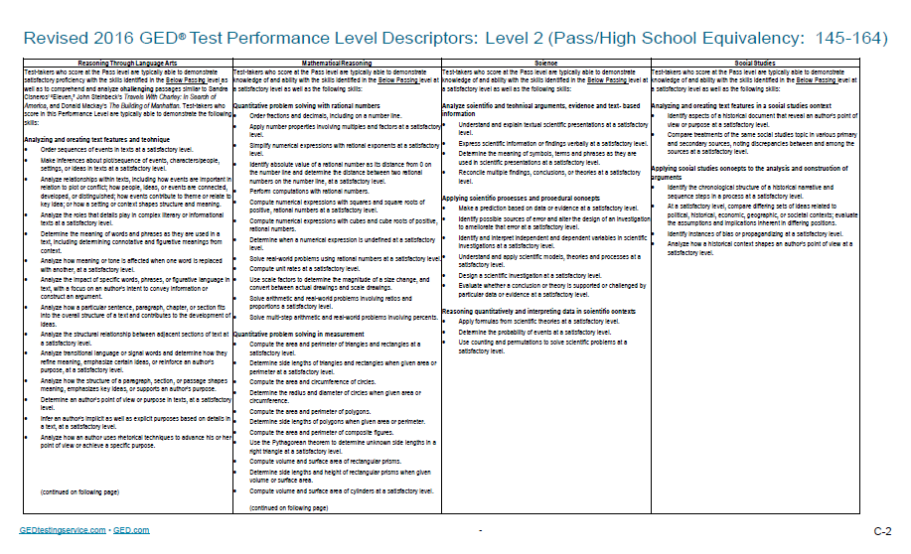
Getting Started with Content
Notes:
Key Points
You will want to spend time reviewing the Relationships Between the High Impact Indicators and Other Indicators chart, as well as the High Impact Indicators chart, and the Performance Level Descriptors. Remember, indicators not identified as high impact continue to be assessed on the GED® test and are very important to include in a GED® Preparation program.

Slide 22
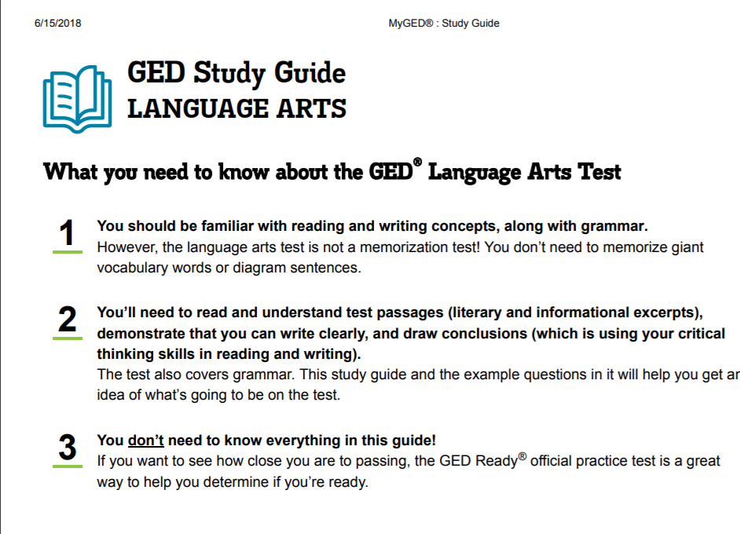

Slide 23
And What About Our “Too Close to Call” Test-Taker?
The RLA test score was 137—completely in line with the feedback from the GED Ready® RLA exam
The operational exam feedback identified the following areas as needing improvement
  Reading for Meaning
  Identifying and Creating Arguments
  Making Inferences
Sound familiar?

Slide 24
What Instructors Need to Know: Social Studies
Same Skills…Different Context

Slide 25

Overview of Social Studies Test
Content
  50% - Civics and Government
  20% - United States History
  15% - Economics
  15% - Geography and the World
Themes
  Development of Modern Liberties and Democracy
  Dynamic Responses in Societal Systems
Social Studies Practices – analyzing, thinking, reasoning
Technology-enhanced question items
Notes:
Key Points
This slide provides a short overview of the content and context of the Social Studies Test. Review the information on the slide. For additional information, access the Assessment Guide for Educators Social Studies section.
The Assessment Guide for Educators Social Studies is located at: https://ged.com/wp-content/uploads/assessment_guide_for_educators_social_studies.pdf

Slide 26
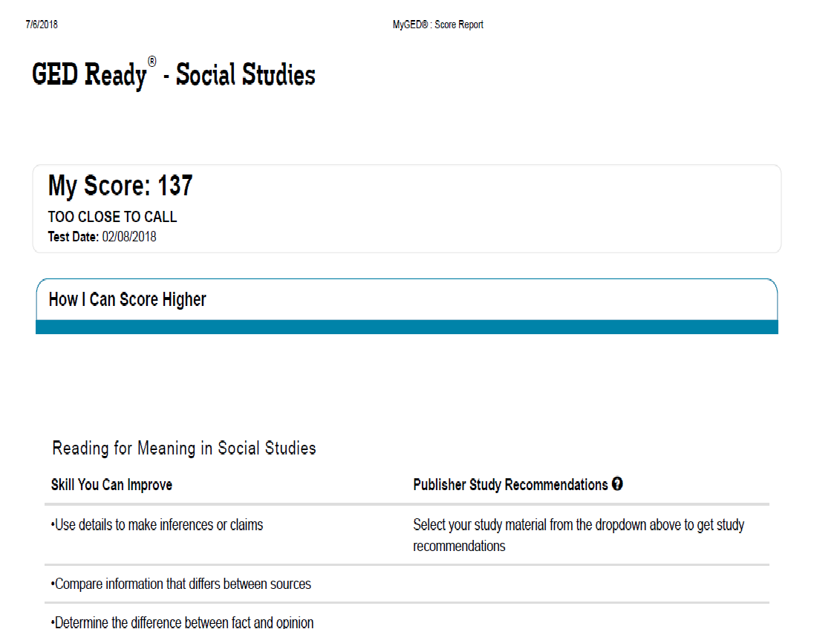

Slide 27
GED Ready® Social Studies Score: 137
Areas for Improvement
Inference
Reading for Meaning in Social Studies
  Use details to make inferences or claims
  Compare information that differs between sources
  Determine the difference between fact and opinion
Analyzing Historical Events and Arguments in Social Studies
  Determine which evidence supports an inference
  Identify bias and propaganda
  Analyze cause and effect relationships
  Describe the connections between people, places, environments, processes, and events
Comparison
Cause & Effect

Slide 28
GED Ready® Social Studies Score: 137
Areas for Improvement
Using Numbers and Graphs in Social Studies
  Analyze information from maps, tables, charts, photographs, and political cartoons
  Interpret, use and create graphs with appropriate labeling, and use he data to predict trends (Example: predict relationships or trends from scatterplots or line graphs)
  Expressing text into visual form (Example: charts, graphs, tables, etc.)
Yes—math has a role in Social Studies!

Slide 29
Skills to Work On
Determine the clearly stated details in primary and secondary sources, and use this information to make logical inferences or valid claims
Determine the central ideas or information of a primary or secondary source document
Determine the meaning of words and phrases used in a social studies context
Determine the difference between fact and opinion in a primary or secondary source document
Pull specific evidence from a document or other source to support inferences or analyses of given processes, events, or concepts
Analyze cause-and-effect relationships, including those with multiple factors

Slide 30
Additional Skills
Analyze numerical and technical materials (for example, charts, research data) and written materials on a common topic
Analyze information presented visually, for example, in maps, tables, charts, photographs, political cartoons, etc.
Put numerical information found in a written source into tables, graphs and charts, and express numerical information in words
Interpret, use and create graphs with appropriate labeling, and use the data to predict trends

Slide 31
Diagnosis
Conclusion: A “reluctant” reader
  Transform into a proficient reader—being able to sort through the structure of text to extract important details, evidence, and facts
Develop close reading skills (an essential)
Practice engaging with Social Studies texts (noticing, wondering, questioning, relating, thinking, and on occasion, arguing)
Practice “reading between the lines” (aka inference)

Slide 32
Explore the Relationships
R.8.6: Identify an underlying premise or assumption in an argument and evaluate the logical support and evidence provided. Primarily measured with informational texts.
AS.1.a: Cite specific textual evidence to support inferences, conclusions, or analyses of technical texts.
SSP.1 a. Determine the details of what is explicitly stated in primary and secondary sources and make logical inferences or valid claims based on evidence.
Notes:
Key Points
Review another HII for RLA that deals with inferences. Sometimes the question requires that test-takers look at what is provided explicitly in a source text and then must make inferences as to why something occurs.

Slide 33
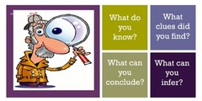
How Do Good Readers Make Inferences?
0
They use:
Word/text clues
Picture clues
Define unknown words
Look for emotion (feelings)
Use what they already know
Look for explanations for events
ASK themselves questions!

Slide 34
Inference is Process-Driven
The alchemy of inference:
Using active reading skills (beyond the basics)
Engaging with the text and/or information presented
  Questioning
  Thinking critically
  Making connections

Slide 35

Teach Inference from Simple to Complex
Inference = Finding the Clues
From Simple to Complex
Pictures/ Advertisements | Comics | Sentences | Short paragraphs | Longer, more intricate passages – fiction/ mysteries | Longer, more intricate passages – nonfiction
Notes:
Key Points
When teaching inference skills, start with simple documents before you move on the longer, more intricate sources texts found on the GED® test. Let’s look at some strategies.

Slide 36
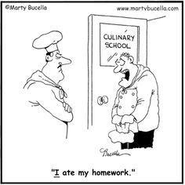
A Quick Example: Teaching with Comics
Sample Questions
What do you see?
What do you know about excuses on not having your homework done?
What does the student mean when he says, “I ate my homework.”?
Notes:
Key Points
Have participants look at the cartoon and answer the questions.
What do you see?
What do you know about excuses on not having your homework done?
What does the student mean when he says, “I ate my homework.”?

Slide 37
How Did Our Test-Taker Fare with Operational Testing?
GED® Social Studies test score: 134
The operational exam feedback identified the following areas as needing improvement
  Reading for Meaning in Social Studies
  Analyzing Historical Events and Arguments in Social Studies
  Using Numbers and Graphs in Social Studies
Sound familiar? It should…

Slide 38
Questions for Reflection
What Can YOU Take Away from this Session?

Slide 39
Questions to Ask Yourself…and Your Colleagues
What are the key ingredients in skill development?
What are some of the most effective ways to prompt persistence especially in students who struggle with reading, writing, or mathematical reasoning?
How can I bring these elements to the classroom?

Slide 40
A Few Takeaways…

Slide 41
Key Takeaways
Please unlearn the notion that there is ONLY one right way—whether it is writing, problem-solving, or thinking critically.
Once is not enough—if that were true, we would have legions of experts!
Flow with the plateaus—learning and skill development are not linear.
Remember that learning is both iterative and integrative. This will enable you to expect the best and have your students deliver their best.

Slide 42

https://ged.com
Notes:
Key Points
[Review url and how to access information. Discuss that there are additional websites for their review in the workbook.]

Slide 43
Questions?
Debi Faucette, Senior Director
Debi.Faucette@ged.com
202.302.6658
communications@ged.com

Slide 44
Thank you!
Communicate with GED Testing Service® communications@ged.com

