Slide 1
KEEP MOVING FORWARD Integrating the CCRS into Daily Instruction
Pathways to Success
Jeffrey A. Fantine, Ph.D.
UAACCE Conference
Salt Lake City
September 14, 2018

Slide 2
Jeffrey A. Fantine, Ph.D.
31 years in Adult Education
Instructor/Director of Local ABLE Program
Director, Professional Development Center (Ohio)
State Director of Adult Education (Maine)
Director of National Career Pathways Project (OCTAE)
COABE Vice President (2009 – 2014)
NCL Vice President and AALPD Chair
Current National Consultant/Trainer
Integrating the CCRS into Daily Instruction

Slide 3
Teaching with Standards
Session Objectives
Lesson Planning with Standards
Teaching with Standards
Contextualizing Instruction
Integrating the CCRS into Daily Instruction

Slide 4
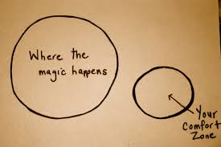
How comfortable are you with the CCRS - understanding and teaching?
A. Extremely Comfortable
B. Somewhat Comfortable
C. Both Comfortable and Uncomfortable
D. Somewhat Uncomfortable
E. Extremely Uncomfortable
Integrating the CCRS into Daily Instruction

Slide 5
Background and Purpose Understanding the Standards We Teach
Teachers must know and understand the standards
Teachers must plan to teach the standards in an organized and intentional order
Teachers must teach standards in a clear and concise manner
Students will master the standards
Integrating the CCRS into Daily Instruction

Slide 6
Integrating the Standards into Instruction
Helps us to:
Focus on the right content and skills
Teach to the appropriate level of complexity
Plan aligned curriculum/assessments
Support common expectations for students
Integrating the CCRS into Daily Instruction

Slide 7
4 Steps to Implementing Standards...
Review standards to determine skills and concepts addressed
Review current instruction to determine skills and concepts covered
Enhance current instruction to cover more and ensure mastery
Develop new instruction to cover remaining skills and concepts
Integrating the CCRS into Daily Instruction
Notes:
Jeff

Slide 8
The more structured I am; the more flexible I can be.
Integrating the CCRS into Daily Instruction

Slide 9
Key Characteristics of Effective Lessons
Aligns content of lessons to standards and provides structure
Ensures appropriate cognitive level and use of instructional shifts
Allows for activities and materials relevant to students needs and interests
Addresses content in a coherent sequence of learning
Assesses students’ level of understanding during the lesson
Promotes active learning and sense of community
Integrating the CCRS into Daily Instruction
Notes:
Sara
Poll: What makes an effective standards-based lesson?

Slide 10
6 Steps to Easy Lesson Planning and Active Learning
WARM – UP
EXPLANATION
MODEL
GUIDED PRACTICE
APPLICATION
ASSESSMENT
Integrating the CCRS into Daily Instruction
Notes:
Do we need this slide? Are we giving too much away?

Slide 11
How to Integrate the CCRS into Instruction…
Identify a main standard, and a group of supporting standards
Create Learning Targets
Determine Level of Knowledge
Incorporate Instructional Shifts
Utilize Resources
Contextualize: Career and Life Application
Integrating the CCRS into Daily Instruction
Notes:
Jeff

Slide 12
Key Shifts in Instruction with CCRS:
Even though the CCRS says to focus on certain shifts for ELA
and math, these shifts are relevant for teaching
in any content.
Focus
Coherence
Rigor
Complexity
Evidence
Knowledge
Integrating the CCRS into Daily Instruction
Notes:
Explain the idea of shifts as they relate to the CCRS. Before we review each shift in detail, ask participants if they can explain what they think these shifts mean/require teachers to do

Slide 13
ACTIVE TEACHING STRATEGIES
Active Student Participation
Questioning
Research-based Projects
Group Work
Simulations
Role Play
Discussion
Use of Prior Knowledge
Application
Reflection
Peer Learning
Ask or Tell
Integrating the CCRS into Daily Instruction

Slide 14
CONTEXTUALIZATION
In adult education, the term “Contextualized Instruction” describes a set of teaching, learning and assessment practices that:
are aimed directly at developing the skills and knowledge that adults need to deal with specific situations or perform specific tasks, and
that they have identified as important and meaningful to themselves “right now” in their everyday lives.
In addition, rather than focus only on the possession of basic skills and knowledge, contextualized instruction focuses on the active application of those skills and that knowledge “in a context”. (And this context should be as “real-world” as is feasible.)
Integrating the CCRS into Daily Instruction
Notes:
Jeff

Slide 15
CONTEXTUALIZATION
…acquiring real-world, relevant content and basic academic skills is not enough to prepare adults to be successful. Just as important are interpersonal, decision-making, and planning skills along with the knowledge of when and how to apply these skills within life contexts.
Integrating the CCRS into Daily Instruction
Notes:
Jeff

Slide 16
CONTEXTUALIZATION
EXAMPLE: CONTEXTUALIZING TO CAREERS
We have a set curriculum with 4 levels of math courses. We had previously developed homework sheets for each day of each math course, and are now adding additional homework sheets contextualized to 3 career clusters for each lesson in each of the 4 courses. Our career clusters, based on LMI, are construction, health care, and office administrative support occupations. So when students are on day 5 of the fractions decimals and percents class and are learning to add and subtract fractions, they can do the regular homework or the assignment contextualized to health care, or the assignment contextualized to construction, or the assignment contextualized to office administrative support. This allows us to teach the skills to everyone together since we don't have enough students for separate classes, but then provides contextualized application. The teachers can also use some of these problems in class as appropriate.
Integrating the CCRS into Daily Instruction
Notes:
Jeff

Slide 17
CONTEXTUALIZATION
How to Contextualize Instruction?
Promote the transfer of the knowledge, skills and strategies learned across a series of real-life tasks.
Begin with real-life situations or tasks and “back into” the knowledge, skills, and strategies required to perform those tasks.
Integrating the CCRS into Daily Instruction

Slide 18
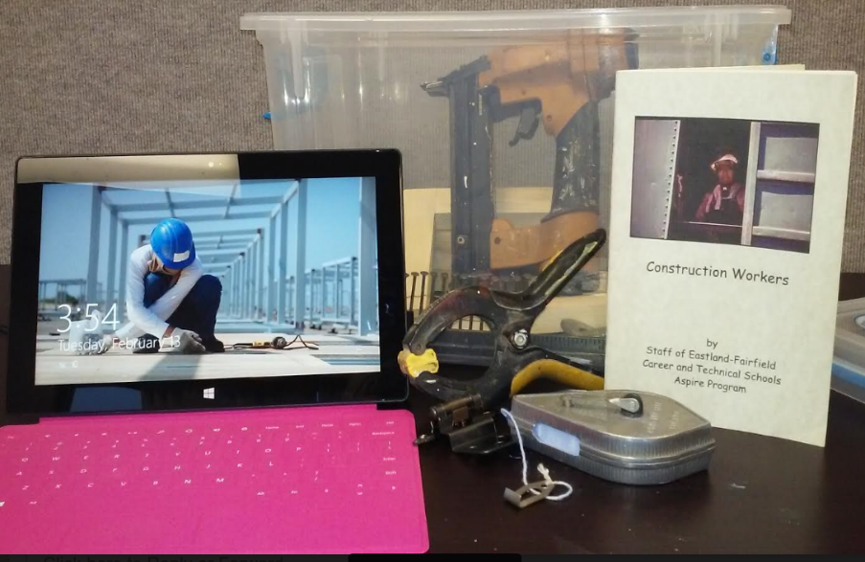
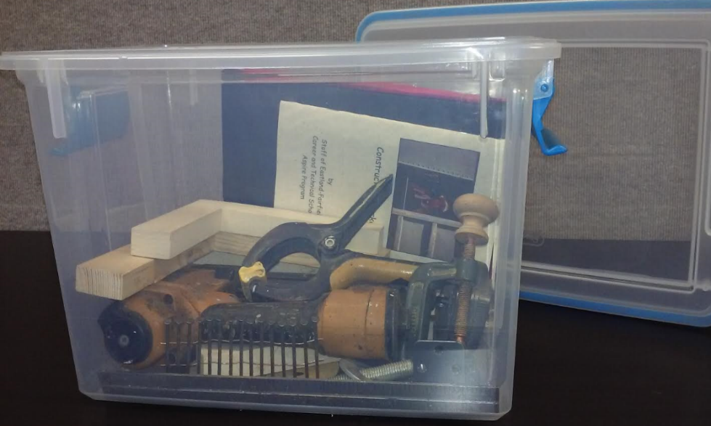
Implementing a Comprehensive Career Pathways Model…
What have you accomplished so far with implementing your career pathways models?
Eastland-Fairfield Career & Technical Schools
Contextualized Lesson in a Box Project: the tablet has construction videos, trade articles and career exploration. We are going to use all of the containers at orientation, open houses, and in classroom instruction for HSE and ESOL.
Integrating the CCRS into Daily Instruction

Slide 19
Making Your Instruction SMARTER with Career Context
S – State the Question
M – Map the Content
A – Apply Career Context
R – Rehearse
T – Use Technology
E – Evidence
R - Reflect
Integrating the CCRS into Daily Instruction

Slide 20
Contextualizing Instruction
CONTEXTUALIZATION
Formative Assessment Time
ELA/Literacy STANDARD: Describe how a narrator’s or speaker’s point of view influences how events are described.
Math STANDARD: Fluently add and subtract within 20 using mental strategies. Know from memory all sums of two one-digit numbers.
RL.5.6
What activities could you do to help students apply the skills in these standards to the context of careers?
2.OA.2
Integrating the CCRS into Daily Instruction
Notes:
Jeff

Slide 21
Practice…
Each pair will receive a CCRS standard, discuss how you would go about teaching this standard using instructional shifts and contextualization.
Integrating the CCRS into Daily Instruction
Notes:
One big Circle

Slide 22
Integrating the CCRS into Daily Instruction

Slide 23
Questions:
Jeff Fantine
jeff.fantine@gmail.com
740-503-4923
Integrating the CCRS into Daily Instruction

