Slide 1


KEEP MOVING FORWARD
Building Career Pathways in Rural Programs
Pathways to Success
Jeffrey A. Fantine, Ph.D.
UAACCE Conference
Salt Lake City
September 14, 2018

Slide 2
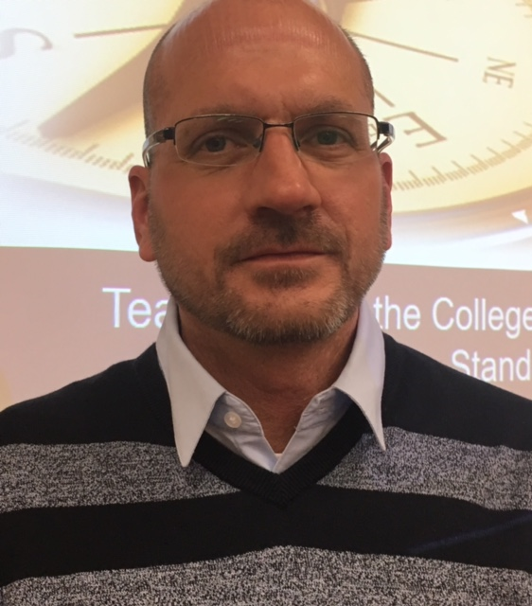

Jeffrey A. Fantine, Ph.D.
31 years in Adult Education
Instructor/Director of Local ABLE Program
Director, Professional Development Center (Ohio)
State Director of Adult Education (Maine)
Director of National Career Pathways Project (OCTAE)
COABE Vice President (2009 – 2014)
NCL Vice President and AALPD Chair
Current National Consultant/Trainer
Building Career Pathways in Rural Programs

Slide 3

Creating a Career Pathways System
CAREER PATHWAYS DEVELOPMENT: The local board, with representatives of secondary and postsecondary education programs, shall lead efforts in the local area to develop and implement a career pathways system within the local area by aligning the employment, training, education, and supportive services that are needed by adults and youth, particularly individuals with barriers to employment.
PROGRAM DESIGN: Provide an objective assessment for the purpose of identifying appropriate services and career pathways for participants, and develop service strategies for each participant that are directly linked to one or more of the indicators of performance and that identify career pathways that include education and employment goals, appropriate achievement objectives, and appropriate services.
Building Career Pathways in Rural Programs

Slide 4
Creating a Career Pathways System
WIOA defines career pathways to mean a “series of rigorous and high-quality education and training strategies and other services that enable individuals to secure employment within a specific occupational sector and to advance over time to successively higher levels of education and employment in that sector. Elements of Career Pathways will:
A. align with the skill needs of industries in the economy of the State or regional economy involved;
B. prepare an individual to be successful in any of a full range of secondary or postsecondary education options, including registered apprenticeships;
C. include advising to support an individual in achieving the individual’s education and career goals;
D. include, as appropriate, education offered concurrently with and in the same context as workforce preparation activities and training for a specific occupation or occupational cluster (IET);
E. organize education, training, and other services to meet the particular needs of an individual in a manner that accelerates the educational and career advancement of the individual to the extent possible;
F. enable an individual to attain a secondary school diploma or its recognized equivalent and at least one recognized postsecondary credential; and
G. help an individual enter or advance within a specific occupation or occupational cluster.”
.
Building Career Pathways in Rural Programs

Slide 5
Integrated Education and Training
CONCURRENT
ADULT EDUCATION
WORKFORCE PREPARATION
JOB TRAINING
Building Career Pathways in Rural Programs

Slide 6


Developing a Career Pathways Model
Marketing and Promotion: Career Preparation Program
Partnerships: Stakeholders in Education & Training
Alignment: Seamless and Without Remediation
Local Demands: Feed Job Growth Projections
Career Context (Program Services):
Assessment/Exploration
Planning
Employability, Education and Job Training
Advising
Knowledge, Skills and Credentials
Transitions
Relevant Policy, Funding and Outcomes
Building Career Pathways in Rural Programs

Slide 7
Career Context
Career Focused Marketing and Promotion
Career Interests and Abilities
Career Options
(with local workforce needs)
Provides Education, Job Training and Work Readiness
Acquire
Knowledge, Skills and Credentials
Transition
(postsecondary, advanced job training, employment
Advising
Building Career Pathways in Rural Programs

Slide 8
THE CHALLENGE UNDER WIOA
How do we create and deliver career pathways:
1.) specifically in adult education
2.) for small programs/rural areas
3.) to low-level students
4.) for all populations:
                ESOL, ABE, Corrections
????
Building Career Pathways in Rural Programs

Slide 9
Developing A Career Pathways Service Delivery Model
CAREER CONTEXT:
HOW Do You Integrate Career Related Services Across Your Service Delivery Model?
Promote as a College and Career Readiness program
Engage with necessary partners throughout service delivery
Offer career assessment and exploration
Help students set goals and plan for college and career
Provide career advising
Articulate your services with career pathways
Integrate employability skills & job training into instruction
Provide contextualized ABE/ASE/ESOL instruction
Expose students to college and jobs
Assist students with successful transition into college and jobs
1
2
3
4
5
6
7
8
9
10
11
12
Building Career Pathways in Rural Programs
Notes:
Explain the idea of shifts as they relate to the CCRS. Before we review each shift in detail, ask participants if they can explain what they think these shifts mean/require teachers to do

Slide 10

Creating a College and Career Culture
A college and career going culture refers to the environment, attitudes, and practices in schools and communities that encourage students to obtain the information, tools, and perspective to enhance access to and success in post-secondary education and career opportunities…
STRATEGIES
College and Career Talk: “when you’re in college…”
Create school experience like a job
Nurture student ownership of their career path
Offer post-secondary and career exposure, navigation and planning opportunities
Require college visit and/or job shadowing while in program
Promote students to have a job or acceptance into college upon completion of program
Building Career Pathways in Rural Programs
Notes:
Explain the idea of shifts as they relate to the CCRS. Before we review each shift in detail, ask participants if they can explain what they think these shifts mean/require teachers to do

Slide 11
Pathways Strategies for Small, Rural Programs
Offer Program Tracks/Strands by Levels
Utilize Partners - Exposure to Job Opportunities
Intensive Student Engagement
Career Focused Project Based Learning
Career Exploration Course
Work with CCRS at Lower Levels (Curriculum)
Contextualized Services/ Technology
Focus of Metacognitive Skills
Building Career Pathways in Rural Programs

Slide 12
Organize Services in a College and Career Context
Skills Track
Lower Level (0-5)
Focus on Basic Skills
Contextualized Lessons
Integrate Employability Skills
Employment Track
Middle Level
Focus on Job Training
Include IET Programming
Contextualized Lessons
Integrate Employability Skills
Job Exposure Opportunities
Credential Attainment
College Prep Track
ASE Level
Focus on Mastering Basic Skills
College Prep Activities: Tour, Financial Aid, Academic Assistance, Advising and Transition
Dual Enrollment
Building Career Pathways in Rural Programs

Slide 13

Creating Student Pathways
Develop career pathway maps specific to your program that can be shared with students.
Pathways should describe services one needs, (i.e, the knowledge and skills they should acquire) and the certifications they should achieve as they progress along a pathway.
Integrate academic instruction
with job training aligned to
CCR standards.
Offer students exposure to
career opportunities.
Building Career Pathways in Rural Programs

Slide 14
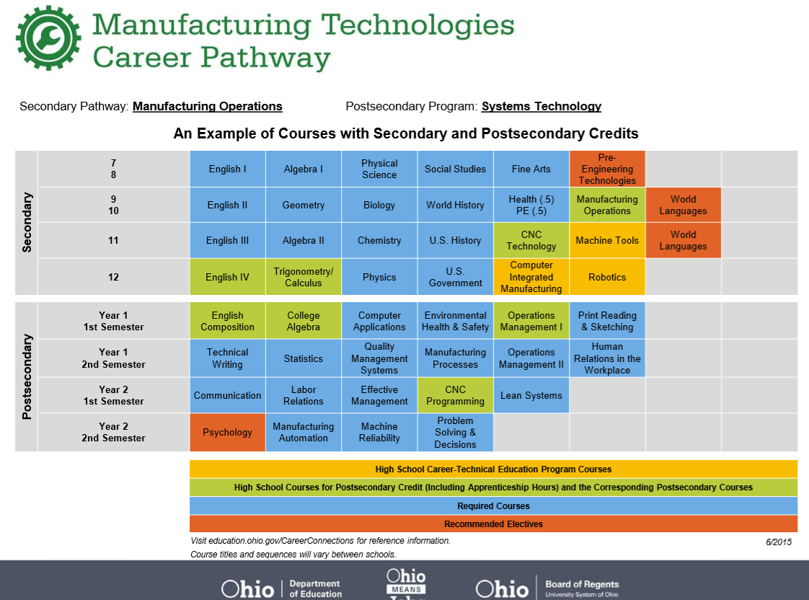
Building Career Pathways in Rural Programs

Slide 15
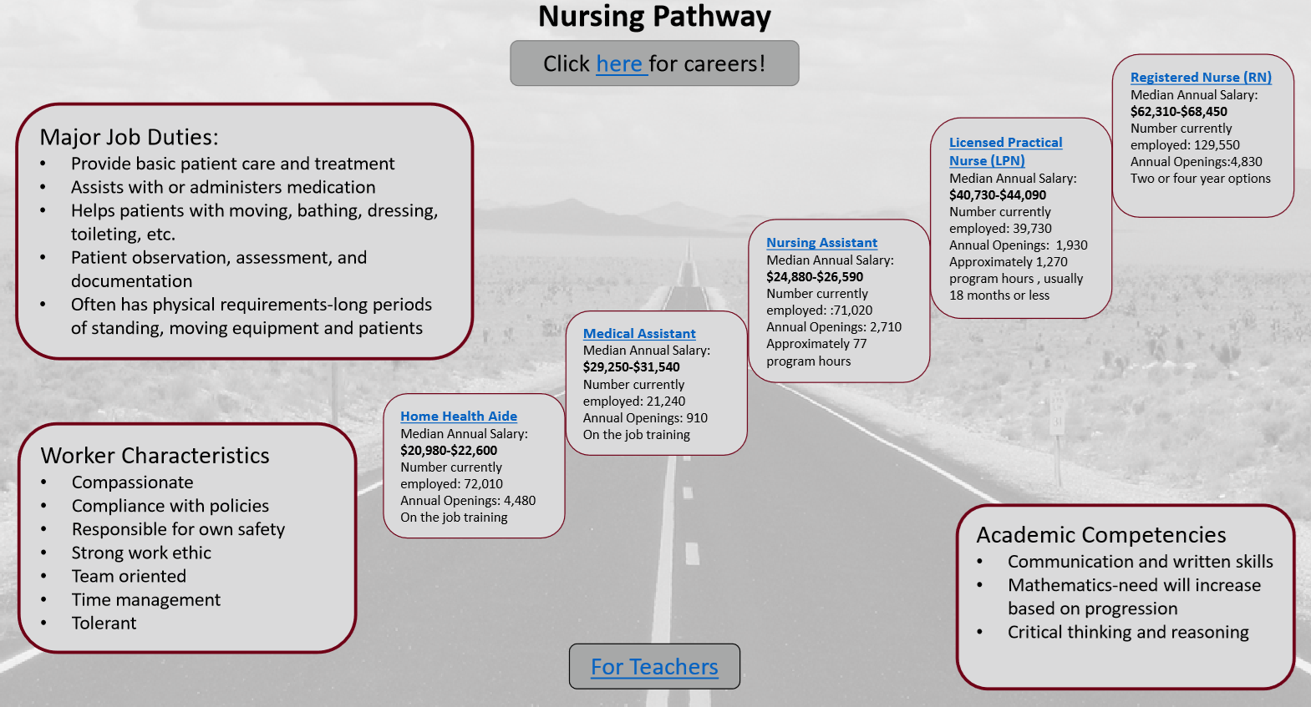
Creating Student Pathways
Building Career Pathways in Rural Programs

Slide 16
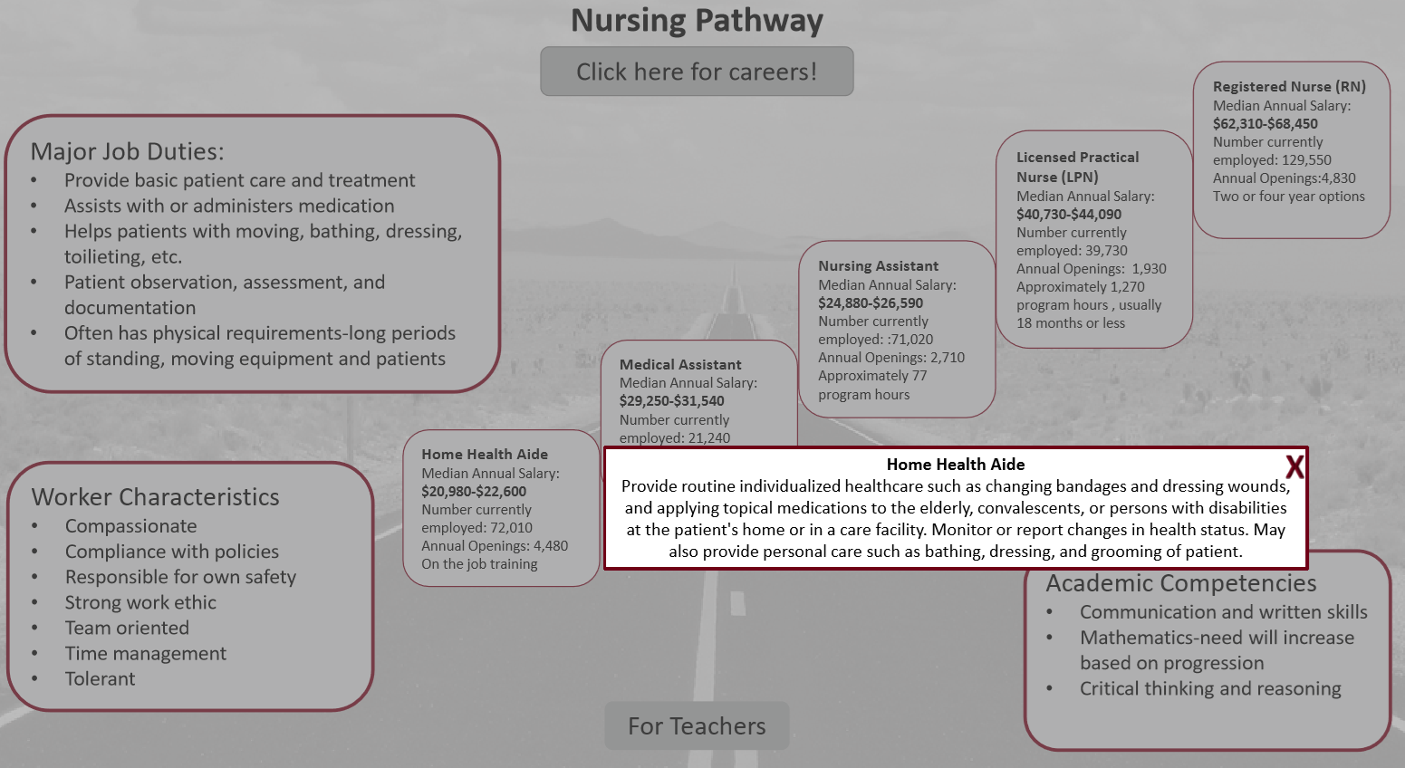
Creating Student Pathways
Building Career Pathways in Rural Programs

Slide 17
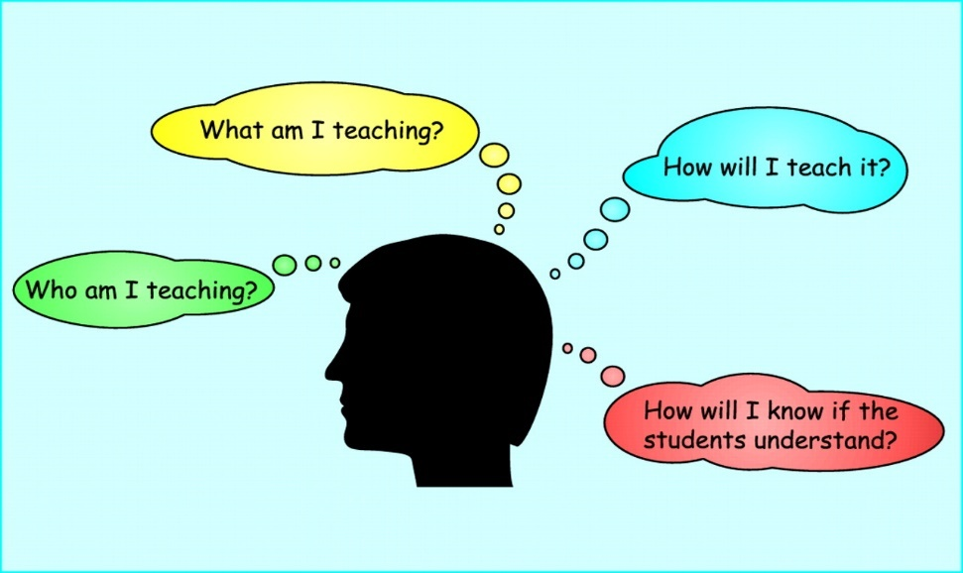
Lesson Planning
SHOULD INCLUDE
Skills identified within the CCR Standards
Incorporating Instructional Shifts
Application to Careers
        Student Engagement
        Cohorts/Group Work
        Use of Technology
Building Career Pathways in Rural Programs

Slide 18

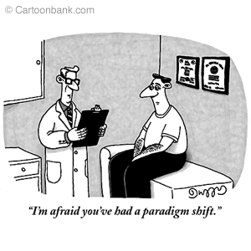
College & Career Readiness Standards
Key Shifts in Instruction with CCRS:
  Focus
  Coherence
  Rigor
  Complexity
  Evidence
  Knowledge
Building Career Pathways in Rural Programs
Notes:
Explain the idea of shifts as they relate to the CCRS. Before we review each shift in detail, ask participants if they can explain what they think these shifts mean/require teachers to do

Slide 19
Making Your Instruction SMARTER with Career Context
S – State the Question
M – Map the Content
A – Apply Career Context
R – Rehearse or Role Play
T – Use Technology
E – Evidence
R - Reflect
Building Career Pathways in Rural Programs

Slide 20

Implementing a Comprehensive Career Pathways Model…
What have you accomplished so far with implementing your career pathways models?
Southwestern City Schools
We have initiated a partnership with the Fitness Loft in Columbus near Children’s Hospital. The goal of the partnership is to utilize the community space at The Fitness Loft to conduct community classes in ESL. Within the class we plan to embed a certification given in tandem by The Fitness Loft and South-Western City Schools. The certification would document that a student successfully completed the course, has had experience speaking and learning English and obtained a intermediate level of understanding and fluency, and has also had basic training in the fitness industry relative to entry level fitness employability skills.
Building Career Pathways in Rural Programs

Slide 21
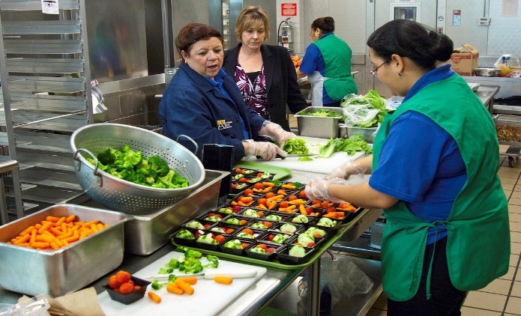
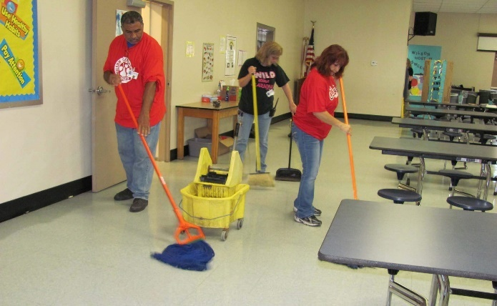
Implementing a Comprehensive Career Pathways Model…
What have you accomplished so far with implementing your career pathways models?
Springfield City Schools
LMI information indicated that food prep/servers and maintenance/repair workers were two occupations with the most annual projected openings in our area over the next five years; thus, we decided to pursue job shadowing opportunities in these occupational areas. In our school district (one of the largest employers in our rural community) we struggle to fill substitute positions in food service and maintenance/custodial areas, so we thought this might be a good time to see if we could put together some job shadowing in the school district for students who meet certain criteria. My thinking was that if students had a chance to shadow, they would have some exposure to working in the school district, as well as an idea of what these particular jobs entail.
Building Career Pathways in Rural Programs

Slide 22
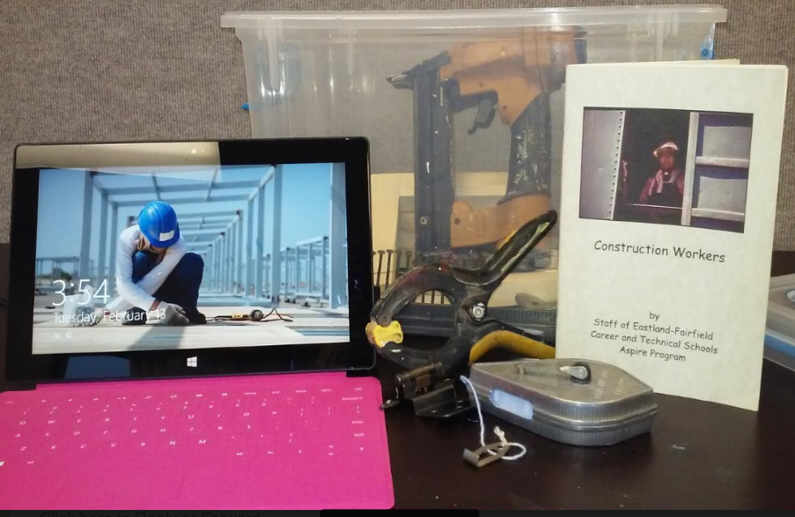
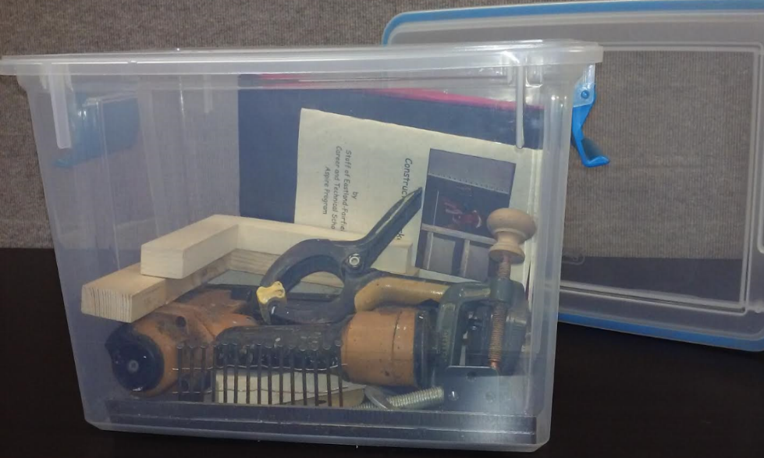
Implementing a Comprehensive Career Pathways Model…
What have you accomplished so far with implementing your career pathways models?
Eastland-Fairfield Career & Technical Schools
Contextualized Lesson in a Box Project: the tablet has construction videos, trade articles and career exploration. We are going to use all of the containers at orientation, open houses, and in classroom instruction for HSE and ESOL.
Building Career Pathways in Rural Programs

Slide 23
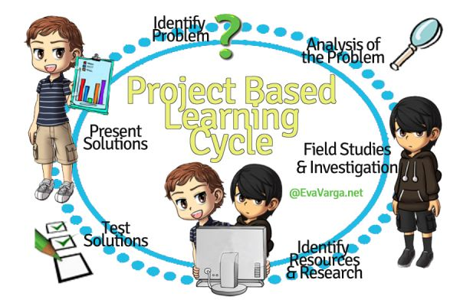
Implementing a Comprehensive Career Pathways Model…
What have you accomplished so far with implementing your career pathways models?
Kettering City Schools
We are implementing Project-Based Learning into our classrooms. Teachers develop lesson plans aligned to the CCR standards and then students are grouped and are given problems to solve or projects to create. Some recent examples include developing marketing campaigns, developing budgets, creating an emergency response plan, creating a newsletter. We hope to develop more, but implementing PBL has brought more energy and active engaged learning into our classrooms.
Building Career Pathways in Rural Programs

Slide 24
Implementing a Comprehensive Career Pathways Model…
What have you accomplished so far with implementing your career pathways models?
Sector Partnerships:
We developed sector partnerships around workforce needs and included employers in those industries. Each partnership also included education, workforce, economic, and community organizations in supportive roles. These partnerships develop and continuously evaluate goals, policies, and service-delivery strategies to meet the needs of employers in a given sector. Students are encouraged into these pathways where they acquire the knowledge, skills and credentials necessary to access entry level jobs in these sectors.
Hawaii Adult Education has initiated statewide sector partnerships:
Healthcare Systems Coordination Sector Action Team
Workplace Wellness Sector Action Team
Hospitality & Tourism Job Training Coordination Sector Action Team
Construction Trade Certification Sector Action Team
Building Career Pathways in Rural Programs

Slide 25
Implementing a Comprehensive Career Pathways Model…
Canton City Schools Adult College and Career Readiness Center Orientation Outline
Career Advising begins during the 4-day orientation process and continues at each end-of-session conference.
Day 1
Talk about why you are here – your goals
Talk about previous education and work experience and the credentials and skills gained. Record on Education and Career Plan
Register on OMJ
Take OMJ Career Profile. Look at results and discuss the interest areas. Record on Education and Career Plan
Day 2
Deeper look at interest areas from Day 1
Discuss factors to consider when choosing a career including level of effort and in demand jobs
View careers on OMJ site based on interested from career profile
Day 3
Discuss career clusters and career pathways using handouts
In OMJ explore the occupational search (show how can search 4 ways). Record what explored on Education and Career plan
Day 4
Review discussion – Why are you here? What are you thinking now? How sure are you?
Discuss how can we help you reach those goals?
Writing sample about career interests
Post career goal on wall under decided or thinking about
Individual conference with each student to make a plan. Write career or cluster goal on Education and Career plan
Building Career Pathways in Rural Programs

Slide 26

Building Career Pathways in Rural Programs

Slide 27


Questions:
Jeff Fantine
jeff.fantine@gmail.com
740-503-4923
Building Career Pathways in Rural Programs

