Slide 1
Adult Education Conference Adult ESL Friday, September 14, 2018 Jordan Commons
Priority#1: Adult Learning Needs
Priority #2: Dialogue Education
Priority #3: Learner-Centered & Personalized

Slide 2
120 Home Languages Spoken https://statisticalatlas.com/place/Utah/Salt-Lake-City/Languages

Slide 3
TWELVE PRINCIPLES OF ADULT LEARNING - Jane Vella
1. LNRA - Learning Needs and Resource Assessment: Participation of the learners in naming what is to be learned.
2. Safety in the environment and the process. Creating a context for learning that is learner-centered.
3. Sound relationships between teacher and learners and among learners.

Slide 4
LNRA: INTERVIEW YOURSELF
ASK yourself:
What information will help you to know more about the individuals who are coming to your workshop or class, and how they will be using what you are teaching?
What situations or challenges are they encountering that would indicate the content you are teaching will be useful to them?
What question could you ask to learn more,
and provide assurance of the course’s value
to the learner?

Slide 5
LNRA: DECIDE
What can you share about the course that would:
1. Minimize any fears or concerns people might have?
2. Increase people’s enthusiasm for coming?
3. Give people a sense of “who you are” or your style?
4. Provide a glimpse or more of what people can expect?

Slide 6
TIPS FOR CREATING AN LNRA
Are your questions and the introduction to them inviting and clear?
Do any of the question’s words have a double meaning that may cause misunderstanding?
Have you avoided using any terms that may not be understood by everyone?
Have you given a deadline by which the responses are due?
Are most, if not all, open questions?

Slide 7
TWELVE PRINCIPLES OF ADULT LEARNING continued
4. Sequence of content and reinforcement.
5. Praxis: action with reflection or learning by doing.
6. Respect for learners as decisionmakers.

Slide 8
TWELVE PRINCIPLES OF ADULT LEARNING continued
7. Ideas (cognitive), feelings (affective) and (hands-on) actions.
8. Immediacy of learning.
9. Clear roles and role development.

Slide 9
TWELVE PRINCIPLES OF ADULT LEARNING continued
10. Teamwork and use of small groups.
11. Engagement of the learners in what they are learning.
12. Accountability: how do they know they know?

Slide 10
#2 What is dialogue and How is it different from discussion?
Priority#1: Adult Learning Needs
Priority #2: Dialogue VS Discussion
Priority #3: Personalized & Learner-Centered

Slide 11
DISCUSSION: BREAKING APART
“Discussion has the same root as “percussion” and “concussion” and “really means to break things up.”
Discussion is a process of analyzing (breaking up) and “will not get us far beyond our own viewpoints.”
Rather, “the object of the game is to win or gain points for yourself.”

Slide 12
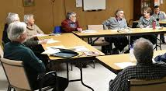
DIALOGUE: CREATING MEANING
“A dialogue can be among any number of people, not just two.
Even one person can have a dialogue with herself.”
Dialogue makes possible a flow of meaning…out of which may emerge some new understanding…which may not have been in the starting point at all.”

Slide 13
OPEN QUESTIONS VERSUS CLOSED QUESTIONS
Open Questions. ...
Are designed to encourage a full, meaningful answer:
using the subject's own knowledge and/or feelings.
It is the opposite of a closed-question, which encourages a short or single-word answer.

Slide 14
CLOSED QUESTIONS
Are you feeling better today?
Have you completed your homework?
Is that your final answer?
Which languages do you speak?
Can I help you with that?
Is math your favorite subject?
When did you come to Utah?

Slide 15
OPEN QUESTIONS
What is your favorite memory from childhood?
How did you and your best friend meet?
What are some of the things that bring you the most joy?
What helps you learn?

Slide 16
#3 What is Learner-Centered Education?
Priority#1: Adult Learning Needs
Priority #2: Dialogue Education
Priority #3: Learner-Centered

Slide 17
LEARNER-CENTERED EDUCATION

Slide 18
Learner-Centered Education
Learner-centered education is:
used to describe approaches to instruction that are grounded in mind/brain research, learning theory, and youth development research;
motivates and engages students in deep learning.
The design is guided by
4 broad principles:

Slide 19
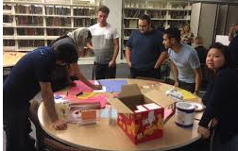
Principle #1: Learners have ownership of their learning
Students understand that they improve by applying effort strategically.
They have frequent opportunities to reflect and understand their strengths and learning challenges.
They take increasing responsibility for learning and support and celebrate each other’s progress.

Slide 20
Principle #2 Learning take place anytime and anywhere
Students learn outside of the typical classroom in a variety of settings, taking advantage of:
a variety of learning technologies, family and community resources, and receiving credit for learning, wherever it happens.

Slide 21
Principle #3 Learning is Competency-based
Students move ahead when they demonstrate competency and have multiple means and opportunities to do so.
Differentiated supports ensure that each student has what she or he needs to achieve his or her learning goals.

Slide 22
Principle #4 Learning is Personalized
Each student is well known by teachers and peers and benefits from individually paced learning tasks, tailored to their needs and interests.
Learning is deepened through collaboration with others and through engaging, authentic, and increasingly complex learning tasks.

Slide 23
WHAT IS PERSONALIZED LEARNING? Three Characteristics
U.S. Department Education’s 2016 National Educational Technology Plan (NETP) and 2017 NETP Update
Instruction in which
1. The pace of learning and the instructional approach are optimized for the needs of each learner;
2. The learning objectives, instructional approaches, and instructional content (and its sequencing) may all vary based on learner needs.

Slide 24
CHARACTERISTIC #3 PERSONALIZED LEARNING
3. Learning activities are made available that are meaningful and relevant to learners, driven by their interests and often self-initiated.

Slide 25
4 Actions for Personalized Learning
ACTION #1. All learners are engaged in a individualized learning experience.
This could include teacher-led whole-class or small-group activities, learners working in groups or individually, and learners engaged in digital learning activities.

Slide 26
4 Actions for Personalized Learning
Action #2. Each learner’s performance is measured.
The type of learning experience determines the types of data that can be collected. For example, as learners participate in a small-group activity, the teacher might ask them targeted, open-ended, probing questions that will help to provide scaffolding and reinforcement to go deeper in conversation.

Slide 27
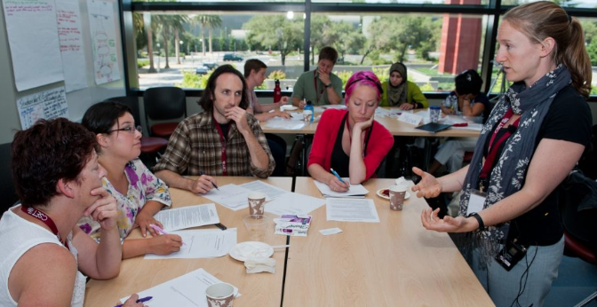
Personalized Learning: Action #3
Each learner’s performance data is interpreted against established criteria.
Criteria could include learning objectives. It could also include measures of other success skills like problem solving and critical thinking.

Slide 28
Personalized Learning: Action #4
Each learner’s performance is measured again.
Once a learning experience has been personalized, the teacher and a technology-based system measures performance again and the cycle repeats.
Data collected is used by the teacher and the learner, to improve the experience for the learner as well as to improve the
technology-based
System
designed to support
the personalized learning.

Slide 29
3 Reasons to Personalize
REASON #1:
When the pace of learning is adjusted for each learner,
all learners have
the time needed
to demonstrate
mastery.

Slide 30
Reasons to Personalize
REASON #2:
When learning is optimized and tailored for each learner,
and driven by learner interests,
it can be more meaningful and relevant,
which can lead to
greater engagement
and achievement.

Slide 31
Reasons to Personalize
REASON # 3:
When learners are given more choice, they tend to take more ownership of their learning and develop the academic mindsets, learning strategies, and self-regulated learning behaviors that are necessary
for meeting immediate goals
and
for lifelong learning.

Slide 32
QUESTIONS, COMMENTS, SUGGESTIONS, FEEDBACK

