Slide 1
Differentiation and Accommodation in the Adult Education Setting
Cathleen Carter M.Ed
Coordinator, Granite Peaks Lifelong Learning
Notes:
Disclaimer: This was written with my experiences in the K-12 setting and now as a Coordinator for Granite Peaks. From time to time, I will refer to examples of situations that I have experienced and worked through either as a teacher or as a coordinator.

Slide 2
Disclaimer:
These methods and definitions are skills and techniques that I have found effective in my past 13 years as a Special Education/Elementary Teacher and the past 2 years as an Adult Education Coordinator and Home Hospital Teacher.
Throughout this PowerPoint, I am citing my sources to show the methodology and data behind the effectiveness and the importance of Differentiation and Accommodations that I am sharing with you today.
Due to time constraints, I will be sharing a few differentiation ideas. These I’ve found to be the most helpful during my educational career.

Slide 3
Definitions:
Accommodation: An adjustment made in an adult education program that allows a student equitable access to educational opportunities afforded to all students.
Those who are legally blind will need the TABE/CASAS in braille.
Extended time on tests/classwork.
Expectations and performance standards DO NOT have to be lowered.
Notes:
As we start, there are times that certain words mean different things to different people. In this situation we will use the Utah State Board of Education definition as “an adjustment made in an adult education program that allows a student equitable access to educational opportunities afforded to all students”
Some examples would be providing the TABE or CASAS in braille, extended time on tests or classwork. One thing that we must remember is that the expectations and performance standards DO NOT have to be lowered when accommodating students. As teachers, coordinators, administrators etc… we are providing accommodations to give an equal playing field to all learners.

Slide 4
Legal Basis
Individuals with Disabilities Education Act 1997
Section 504 of the Rehabilitation Act of 1973
Americans with Disabilities Act of 1990
Utah’s State Laws and USBE
Notes:
As we enter into Accommodation we need to understand why this is necessary for us as Adult Education professionals. From a legal standpoint everyone has a right to a Free Appropriate Public Education. The following laws state the following in a nutshell:
IDEA provides a clear mandate for identifying, assessing, and serving all students with disabilities aged 3-21. Being that Granite Peaks accepts students aged 16 + it is vital to remember that ALL of our students with disabilities deserve to have accommodations/modifications in order to be successful.
Section 504 guarantees that a person with a disability will not be discriminated against in any program, educational service, or activity receiving federal funds. These rights extend to all students with disabilities as defined by Section 504 and ADA and doesn’t have an age limit.
Americans with Disabilities Act of 1990 expands section 504 to enable individuals with disabilities to participate fully in all aspects of society. This also includes auxiliary aids and services such as interpreters, adapted equipment and taped texts when necessary.
Utah also has many state laws protecting the rights of those with disabilities as well. If you go to the USBE page, you will also find a 27 page document detailing Section 504, IDEA and ADA act of 1990. As part of our program responsibilities, we need to be sure that students with disabilities are not excluded taking into account the needs of such persons in determined the services to be provided. We are also required by the USBE to provide appropriate academic interventions that afford an individual with a disability an equal opportunity to participate, to obtain the same results, to gain the same benefit and to reach the same level of achievement as others participating in adult education programs.

Slide 5
USBE Adult Education Students with
Disabilities page 22
Notes:
This form can be found on the USBE webpage. It is a good way to not only track the accommodation, but look at the student’s progress as they progress through your program. Being we are obligated by IDEA, Section 504, Americans with Disabilities Act and the USBE’s requirements we need to keep accurate data on the students that we are accommodating.

Slide 6
Possible Accommodations by the USBE Page 9 Adult Education Students with Disabilities Section
TABE | BEST | CASAS
Extra Time Test reader for directions Test reader for passages and items Spelling assistance Test Items restated/paraphrased Alternate Test Settings Recorded responses Calculators or math tables Marking in test booklets Braille or enlarged print | Test Item restated | Plain straight edge ruler Magnifying strips or glass May take one test per day rather than all in one session Colored Overlays Sign language interpreter for instructions only Alternate test settings Ear plugs Simple calculator for Level A/B only Computer- Spelling and grammar check disabled Braille or enlarged print Extra time Frequent breaks Headphones for listening test Scribe/writer/communication board
Notes:
According to the USBE, the following accommodations can be given to students. What we need to remember as educators and testers in this area is that these are merely suggestions and the accommodation needs to be based on the needs of the learner NOT the disability category.
When I first started teaching special education, I was in a meeting with our Special Education Director. She told us that we need to make sure that we can answer in great detail why the student needs the accommodation for testing or in the classroom and encouraged us to make sure that the accommodation didn’t become a distraction.

Slide 7
Differentiation
Teaching the same material to all students using a variety of instructional strategies or it may require the teacher to deliver lessons at varying levels of difficulty based on the ability of each student.
Notes:
For Differentiation, I will be using the definition from Concordia University- Portland: “Teaching the same material to all students using a variety of instructional strategies, or it may require the teacher to deliver lessons at varying levels of difficulty based on the ability of each student.”
In looking at the history of differentiation, it can date back to the days of the one room schoolhouse. Many teachers had students of multiple ages and abilities and all of the students were expected to learn at the same time. This isn’t a new technique, rather a refined one.

Slide 8
The Brain
Visual
Auditory
Kinesthetic
Notes:
When we learn something new, we create neural networks in the brain. According to neurobiologist Dr. Janet Zadina we need to create multiple pathways that create activation in each lesson. This is useful to know in differentiation because many people resort to Drill and Kill strategies. Please note that drill and kill actually is one of the worst ways we can learn.
While using differentiation we should be focusing on a visual, Auditory or Kinesthetic method as we learn something new while using differentiation. When we use a visual, auditory or kinesthetic method more neural networks are fired in the brain creating stronger connections with our students. The more the neural network is fired in the brain, the stronger the network becomes. This process takes a lot of time, energy and effort, but if done properly can leave lasting results in our students long term memory.
We are going to do an auditory and kinesthetic activity together today to work on our long term memory. Many of the students I work with struggle with basic math concepts, so I’ve brought whack it today. On each wall/table , I have random numbers. Each group member has a flyswatter and the goal is to be the first person to “whack” the correct answer. I will call out the problem orally and let’s see who will win.

Slide 9
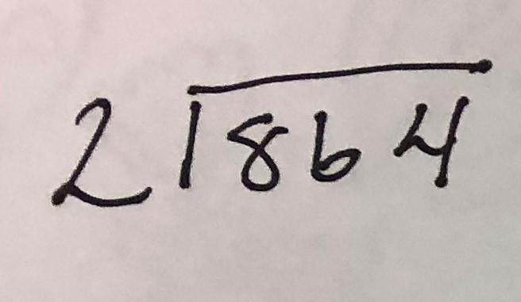
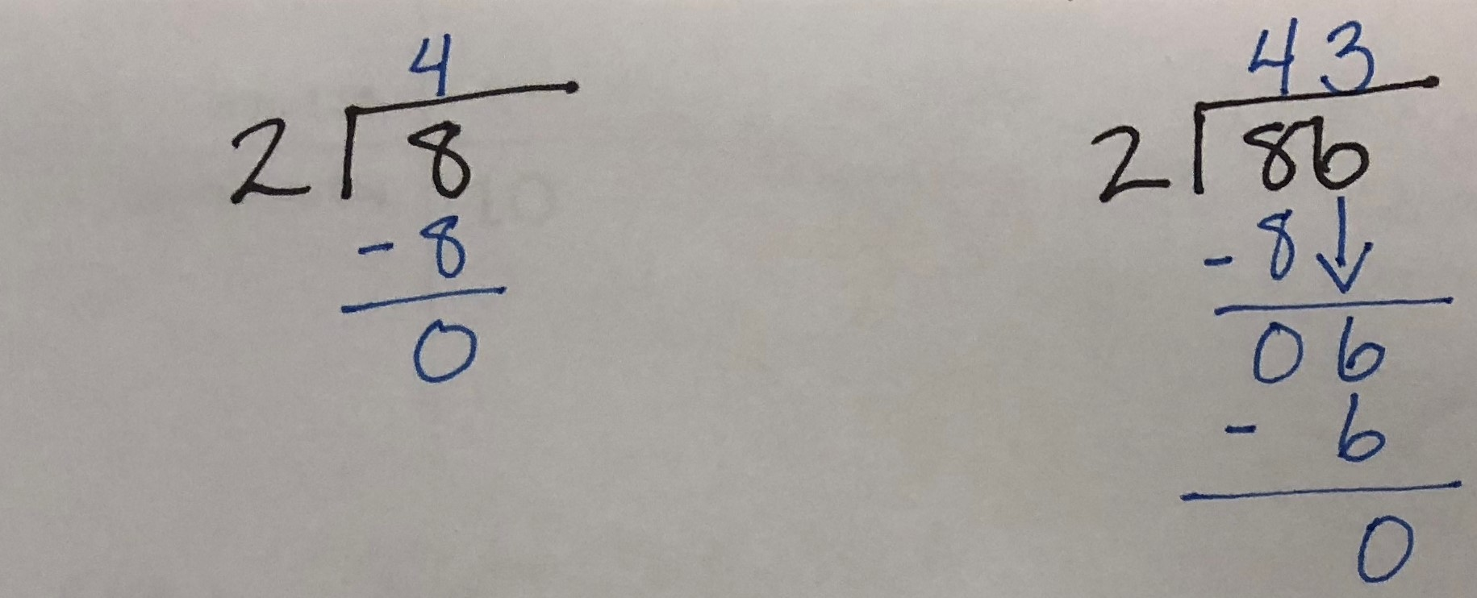
Scaffolding
Goal:
Gaining and maintaining the learner’s interest in the task
Making the task simple
Emphasizing certain aspects that will help with the solution
Control the student’s level of frustration
Demonstrate the task
Making the task simple
Notes:
As I stated before, we should never lower our standards for our students.
Scaffolding consists of activities provided by the educator or peer to support the student as he or she is led through the ZPD. Support is tapered off as it becomes unnecessary, and the end goal is for the student to be able to complete the task on their own. As a teacher we continue to build on the ZPD as the students learn new skills.
There are five processes that aid effective scaffolding:
1- Gaining and Maintaining the learner’s interest in the task
2- Making the task simple
3- Emphasizing certain aspects that will help with the solution
4- Control the student’s level of frustration
5- Demonstrate the task
I’m including an example to the side of some work that I recently completed with one of my students. He has been very frustrated and is receiving 1:1 tutoring in hopes of improving his math skills. The student struggled quite a bit with lattice division and we had to rethink how to teach the student to divide. He remembered a bit of division from when he went to school as a child and we used his current knowledge to make connections and simplify the task. I would emphasize that we could break down the division problems to build up to the solution. His frustration levels have decreased greatly and he is now able to independently divide without promptings of any type.

Slide 10
Reflect and Connect
Tool for professional growth and change.
Collective musings resulting in a mental process that creates disequilibrium and a desire to understand and act
Notes:
Reflection is a tool for professional growth and change. According to the Virginia Education Association, Reflection is a collective musing resulting in a mental process that creates disequilibrium and a desire to understand and act.
When we work with students, this gives our students an opportunity to define or question an issue and respond to a higher set of expectations. For example, with my student that I referred to before, it was practically painful to watch him reflect because I wanted so badly to give the answer. But during reflection time, I would give short but encouraging statements and the reflections helped him to find his ‘aha’ moment with his math that he struggled with so much.

Slide 11
Resources
Accommodations and Modifications for Students with Disabilities in Vocational Education and Adult General Education
Marty Beech, Ph.D.
Adult Education Students with Disabilities
Utah State Board of Education
https://www.schools.utah.gov/file/b264c43f-2f8c-4598-80a3-ecfac8d6f02c
Adult Education Programs
M.P. Auerbach
Multiple Pathways to the Brain
Janet Nay Zadina
Virginia Education Association

