Slide 1
Addressing Student trauma by questioning labels
As presented by:
Darrell Bingham & Jeff Hendricks

Slide 2
Labels: Seek to Understand – if this then that…

Slide 3
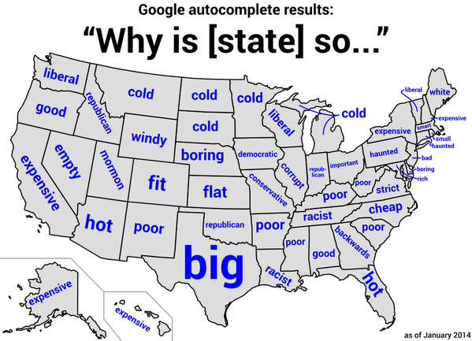
Labels are created through a process of…
Needs or Fundamental Drives
Nature & Nurture
Cognition
Subjective Experience
Notes:
All 4 elements are required in the search for truth as well as the creation of negative labels or stereotypes. One does not outweigh the other as so this following list is presented as components of a whole. Each are necessary in understanding the concept of belief.

Slide 4
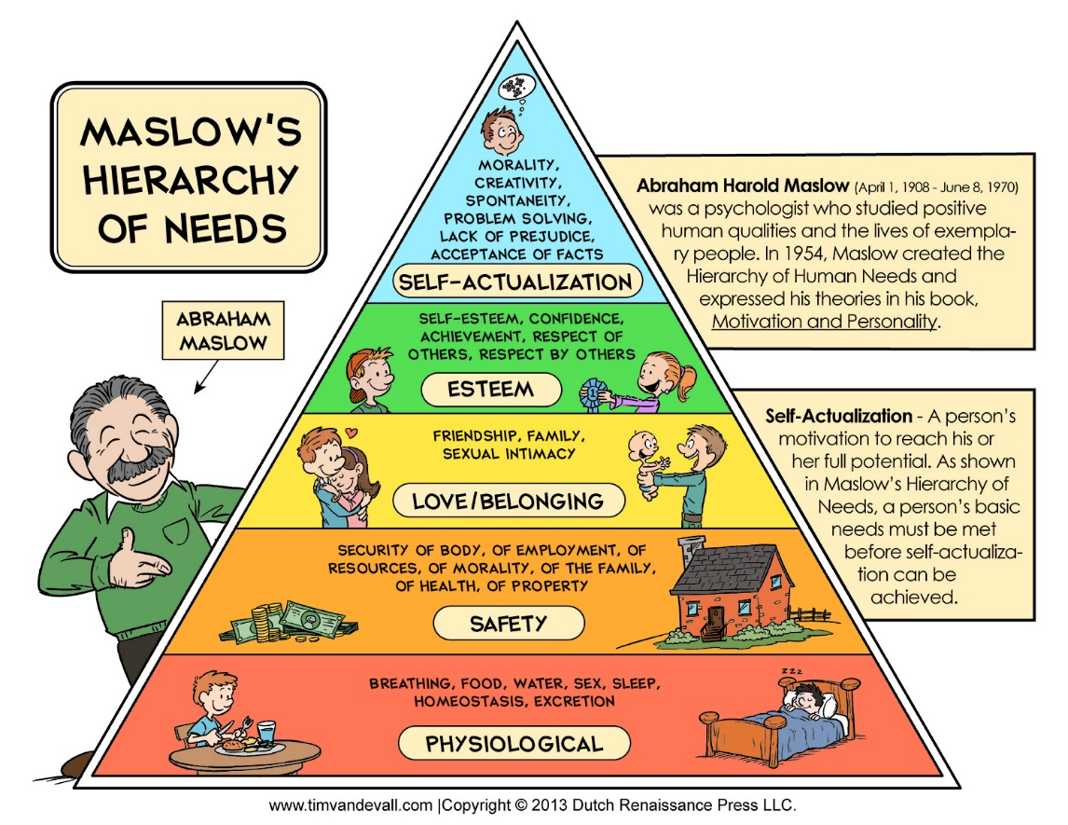
Maslow Hierarchy of Need…
“…human needs and motivations could be construed in a hierarchy…more basic needs must be met before higher needs emerge.”
Engel, John W. "Abraham Maslow." Salem Press Encyclopedia of Health, 2013. EBSCOhost, ezproxy.uvu.edu/login?url=http://search.ebscohost.com/login.aspx?direct=true&db=ers&AN=93871741&site=eds-live.
Notes:
Maslow was correct in that he postulated human need on a spectrum of dependence. This concept simply suggest needing this before that. The practical application says I must feel safe before in order to feel love and includes any number of maladaptive behaviors associated to feelings of mistrust.

Slide 5
Nature & Nurture…
“…neither the environment nor genes are determinants of an adult's success in coping…”
“Rather, it is the number of enduring relationships and activities a child has in his or her immediate environment that drives effective human development.”
Lang, Susan S. "Researchers Challenge Nature Vs. Nurture Argument." Human Ecology Forum, no. 3, 1995, p. 3. EBSCOhost, ezproxy.uvu.edu/login?url=http://search.ebscohost.com/login.aspx?direct=true&db=edsggo&AN=edsgcl.18129921&site=eds-live.
Notes:
The strength of human relationships trumps genetics and environment in regard to early human development. Logic suggest this pattern continues throughout life.

Slide 6
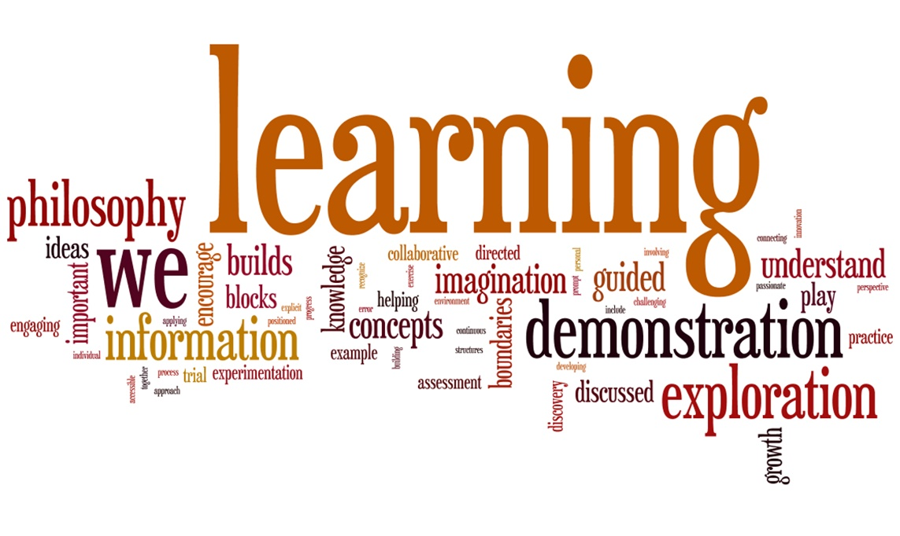
Cognition…
Cognition
“…is the ability to perceive the world through processes such as language, memory, learning, perception, and reason. The performance of cognition is related to the comprehension of ideas through these processes and learning new skills to improve those areas. Cognitive function begins at birth, and cognitive abilities continue to develop throughout one’s life.”
Kehley, Coviello. "Cognitive Function." Salem Press Encyclopedia, 2013. EBSCOhost, ezproxy.uvu.edu/login?url=http://search.ebscohost.com/login.aspx?direct=true&db=ers&AN=90558263&site=eds-live.
http://sites.psu.edu/edtec467/wp-content/uploads/sites/3397/2013/05/LearningPhilosophyWordle.jpg

Slide 7
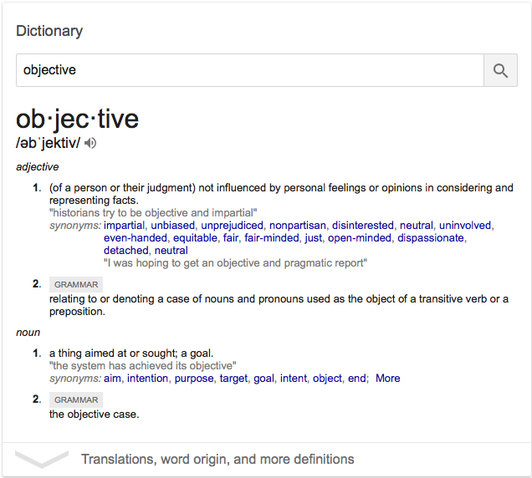
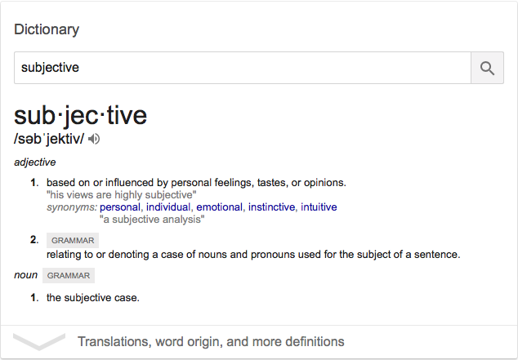
Subjective Experience…
Notes:
Subjective refers to my own understanding based on my perceptions of past experience or what is true for me. Objective refers to a collective understanding or what is true for us all. Combining subjective experience is the process where objective truth is discovered. Objectivity can only be found when I am open to dynamic condition of subjective perceptions.

Slide 8
Combining Need, Environment, Cognition, & Subjective experience to create Core belief…
Cognitive Consistency
Maladaptive Traits
“…the tendency of a person’s beliefs and actions to be logically consistent with one another. When cognitive dissonance, or the lack of such consistency, arises, the person unconsciously seeks to restore consistency by changing his or her behavior, beliefs, or perceptions.”
"Cognition." Funk & Wagnalls New World Encyclopedia, 2017, p. 1p. 1. EBSCOhost, ezproxy.uvu.edu/login?url=http://search.ebscohost.com/login.aspx?direct=true&db=funk&AN=CO171200&site=eds-live.
“…the key issue for the sustainability of adaptive culture is the conversion of maladaptive traits into adaptive ones through effective filtering, and the resilience of adaptive traits against their corruption into maladaptive ones…”
Antoci, Angelo, et al. "Cultural Ecologies of Adaptive Vs. Maladaptive Traits: A Simple Nonlinear Model." Communications in Nonlinear Science and Numerical Simulation, vol. 58, n.d., pp. 92-106. EBSCOhost, ezproxy.uvu.edu/login?url=http://search.ebscohost.com/login.aspx?direct=true&db=edswss&AN=000416034300008&site=eds-live.
Notes:
Core belief is created through experience. As humans we seek consistency and will adapt to find this security. The power of relationships, in relation to natural tendencies, becomes paramount because a person will rise to the standard most readily required. This process speaks of reasons why a person can switch belief, often radically, based on involvement with primarily positive or negative environments.

Slide 9
Maladaptive Core Belief…
“…negative core beliefs about self underlie maladaptive self- schemas. These core beliefs… …are expressed in brief and definite statements such as “I am helpless” and “I am unlovable”. Negative core beliefs about self form an important component of the self-concept…”
Otani, K, et al. "Marked Differences in Core Beliefs about Self and Others, between Sociotropy and Autonomy: Personality Vulnerabilities in the Cognitive Model of Depression." Neuropsychiatric Disease and Treatment, Vol Volume 14, Pp 863-866 (2018), 2018, p. 863. EBSCOhost, ezproxy.uvu.edu/login?url=http://search.ebscohost.com/login.aspx?direct=true&db=edsdoj&AN=edsdoj.00729ddded9e4a2389eec0cc468e4ec8&site=eds-live.

Slide 10
Maladaptive behavior presents as symptoms of maladaptive core belief…
Traumatic Events
Measured Symptoms
Serious Accident or Explosion
Natural Disaster
Victim of Violent Crime
Physical or Sexual Abuse as Child
Sexual Abuse as an Adult
Physical; Abuse as an Adult
Violent Injury or Death Witnessed
Life-Threatening Danger
News of Unexpected Death
Other Traumatic Events
Other Trauma – Private
Perceived Stress
  Feeling Nervous or Stressed
  Controlling Irritations
Depressive Symptoms
  Sleep Patterns
  Sadness
  Appetite
  Weight Levels
  Loss of General Interest
  Suicidal Thoughts
  Energy Level
  Feelings of Restlessness
Quality of Life
  Mood
  Work
  Social Relationships
Boals, Adriel. "Trauma in the Eye of the Beholder: Objective and Subjective Definitions of Trauma." Journal of Psychotherapy Integration, vol. 28, no. 1, Mar. 2018, pp. 77-89. EBSCOhost, doi:10.1037/int0000050.

Slide 11
As a result of the strength of subjective experience…
“…[trauma] exposure criterion has been removed from the Diagnostic and Statistical Manual of Mental Disorders.”
Boals, Adriel. "Trauma in the Eye of the Beholder: Objective and Subjective Definitions of Trauma." Journal of Psychotherapy Integration, vol. 28, no. 1, Mar. 2018, pp. 77-89. EBSCOhost, doi:10.1037/int0000050.

Slide 12
Challenging maladaptive core belief…

Slide 14
Bring light into life by asking these two questions…
Which of my core beliefs are hindering my progress?
Which of my core beliefs are hindering the progress of others?

Slide 15
For a full list of references please contact…
Darrell K. Bingham
dkbingham@Utah.gov
801-319-7740
Jeff Hendricks
jeff.Hendricks@nebo.edu
801-358-9131

