Slide 1
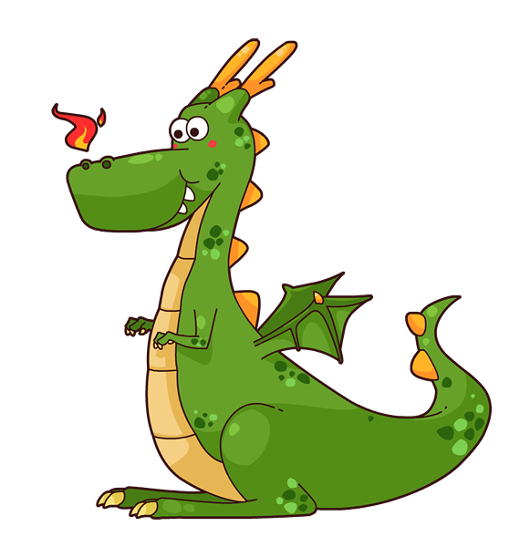
Slaying the pedagogical dragon: Raising scores through learner content
Deborah Young & Betsy Folland
Literacy Action Center
USBE/UAACCE 2018 Conference
Notes:
Slide 1. Introduce us and the session (2m)

Slide 2
Andragogy – art & science of teaching adults
Key principles:
Self-concept - planning and evaluation
Experience - engaging activities
Immediacy - relevance and impact
Orientation - problem-centered
Notes:
Slide 2. Introduce the session (2m)

Slide 3
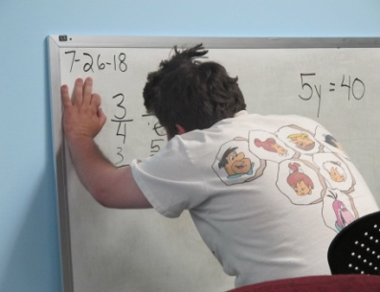
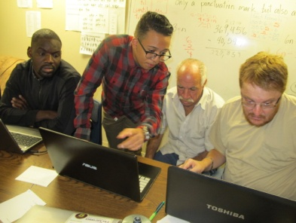
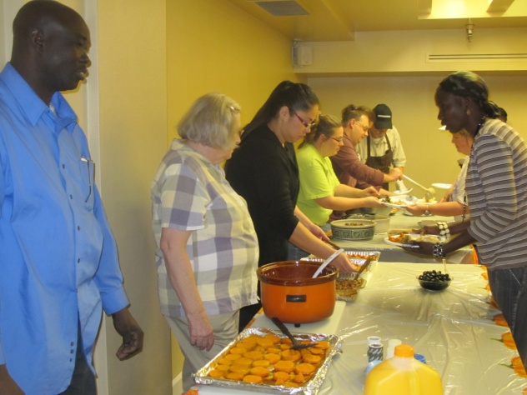
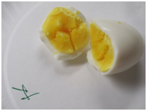
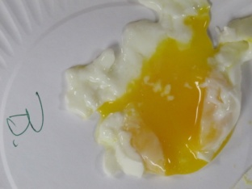
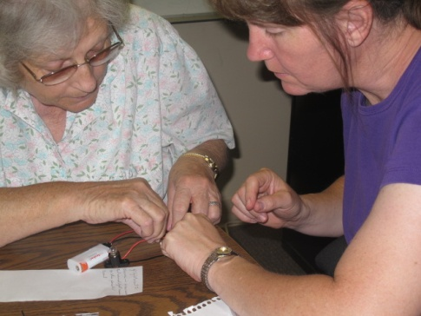
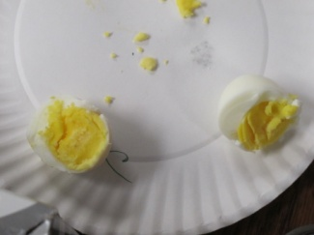
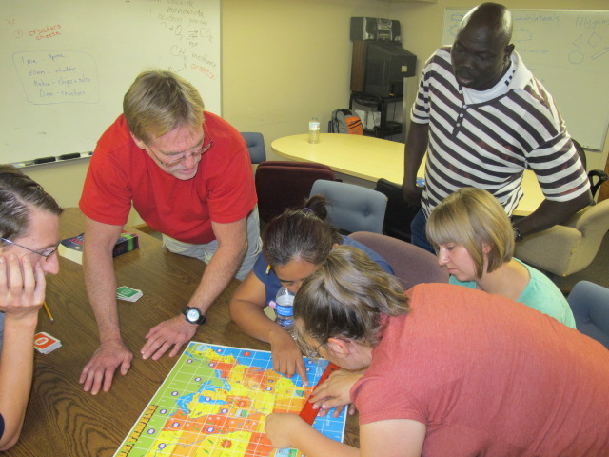
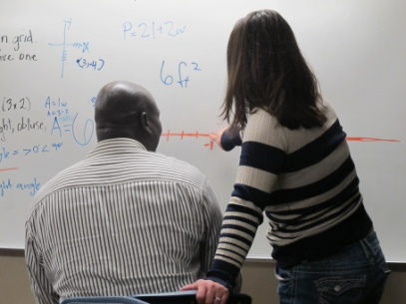
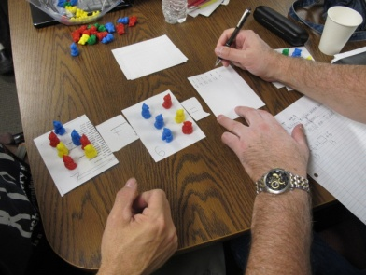
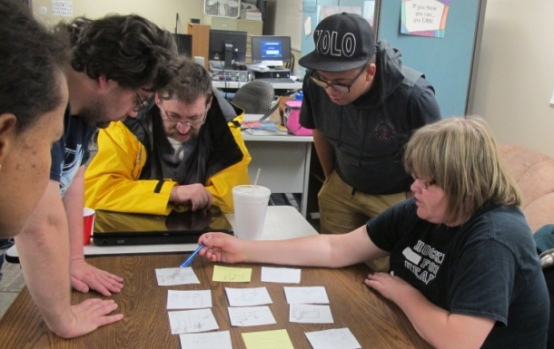
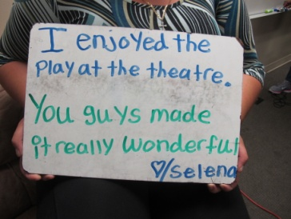
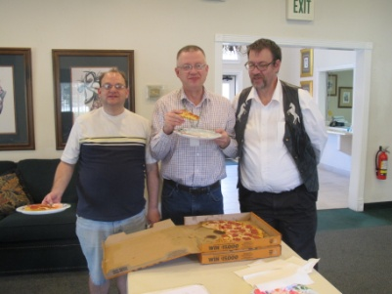
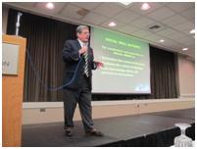
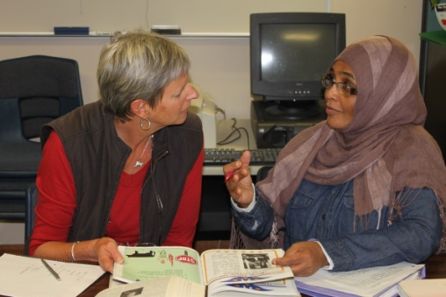
individual
tech savvy
events
engage
reading
experiment
one-to-one
writing
question
explore
group
math
careers
field trips
public speaking
What is Literacy Action Center?
Notes:
Slide 3. Intro LAC (3m)

Slide 4
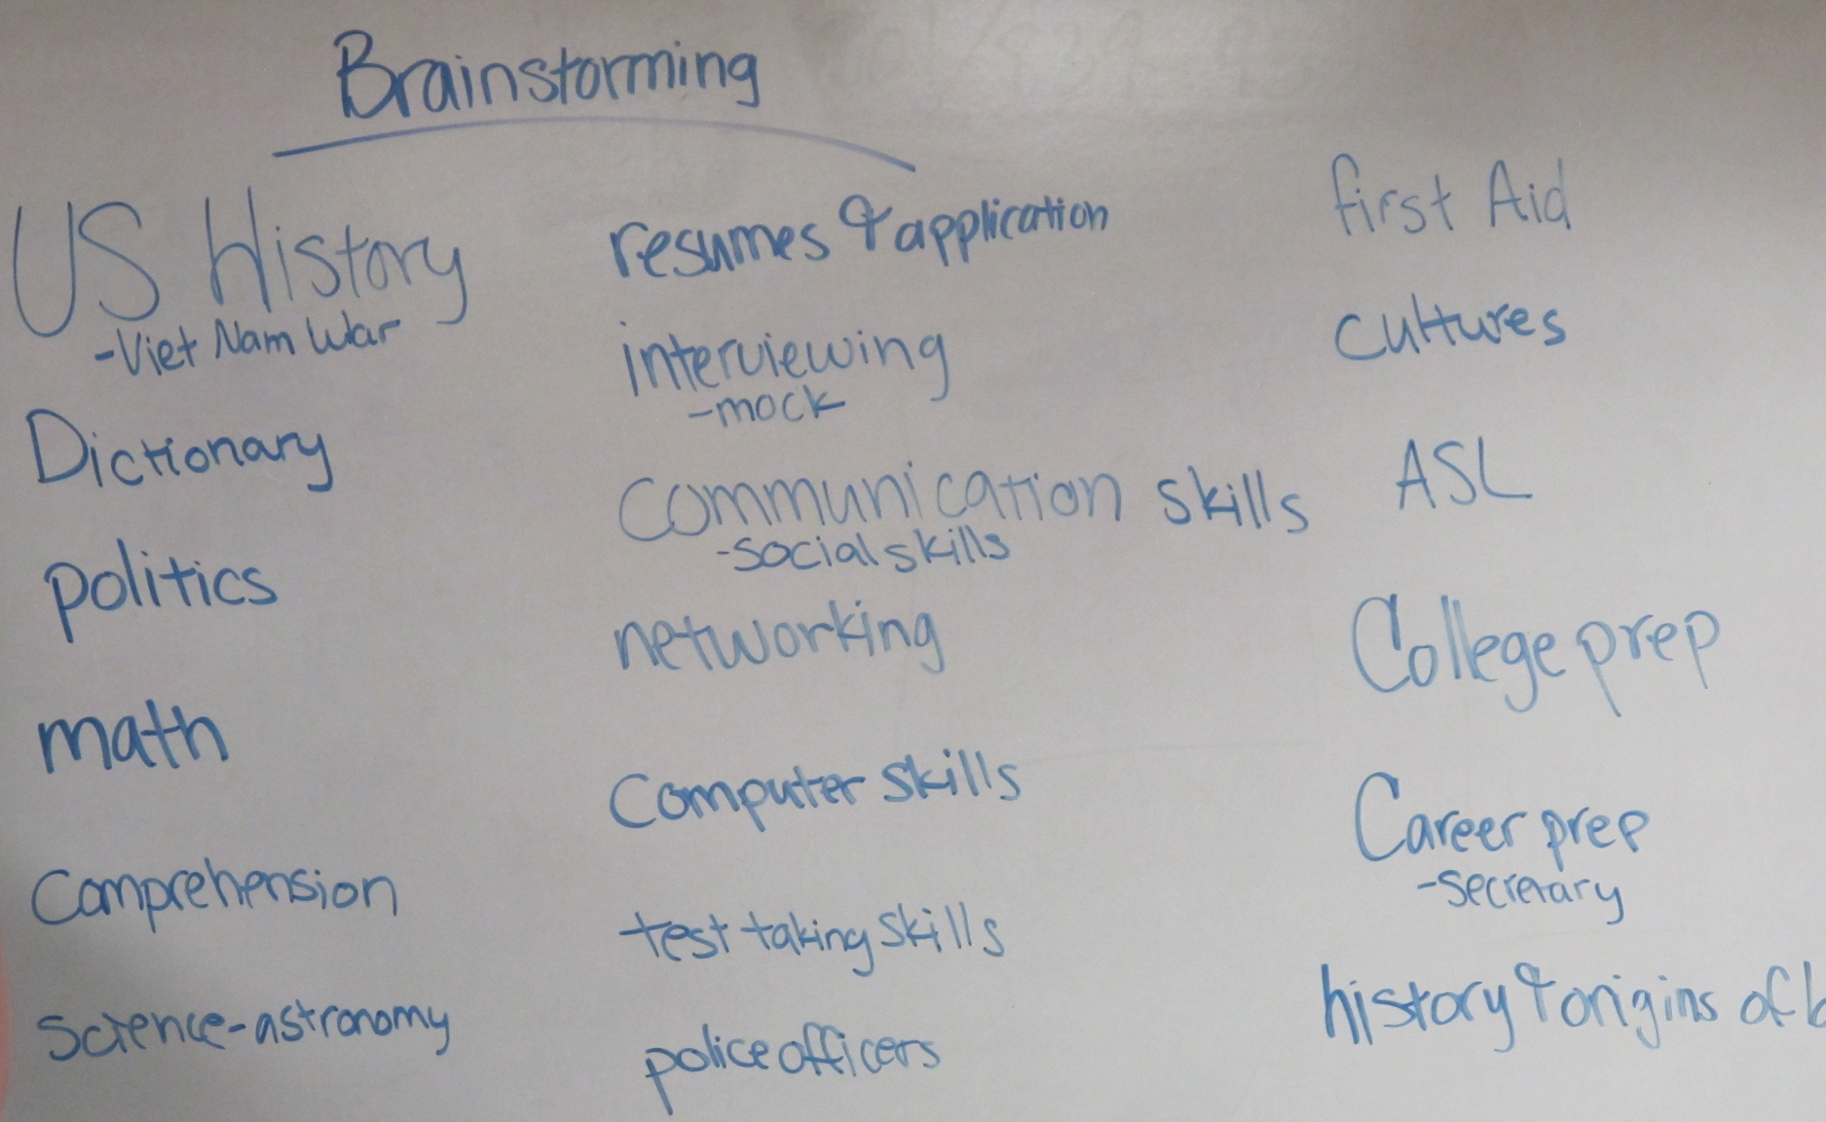
Brainstorming – a bountiful of choices
Notes:
Slide 4. Brainstorming Process (6m)

Slide 5
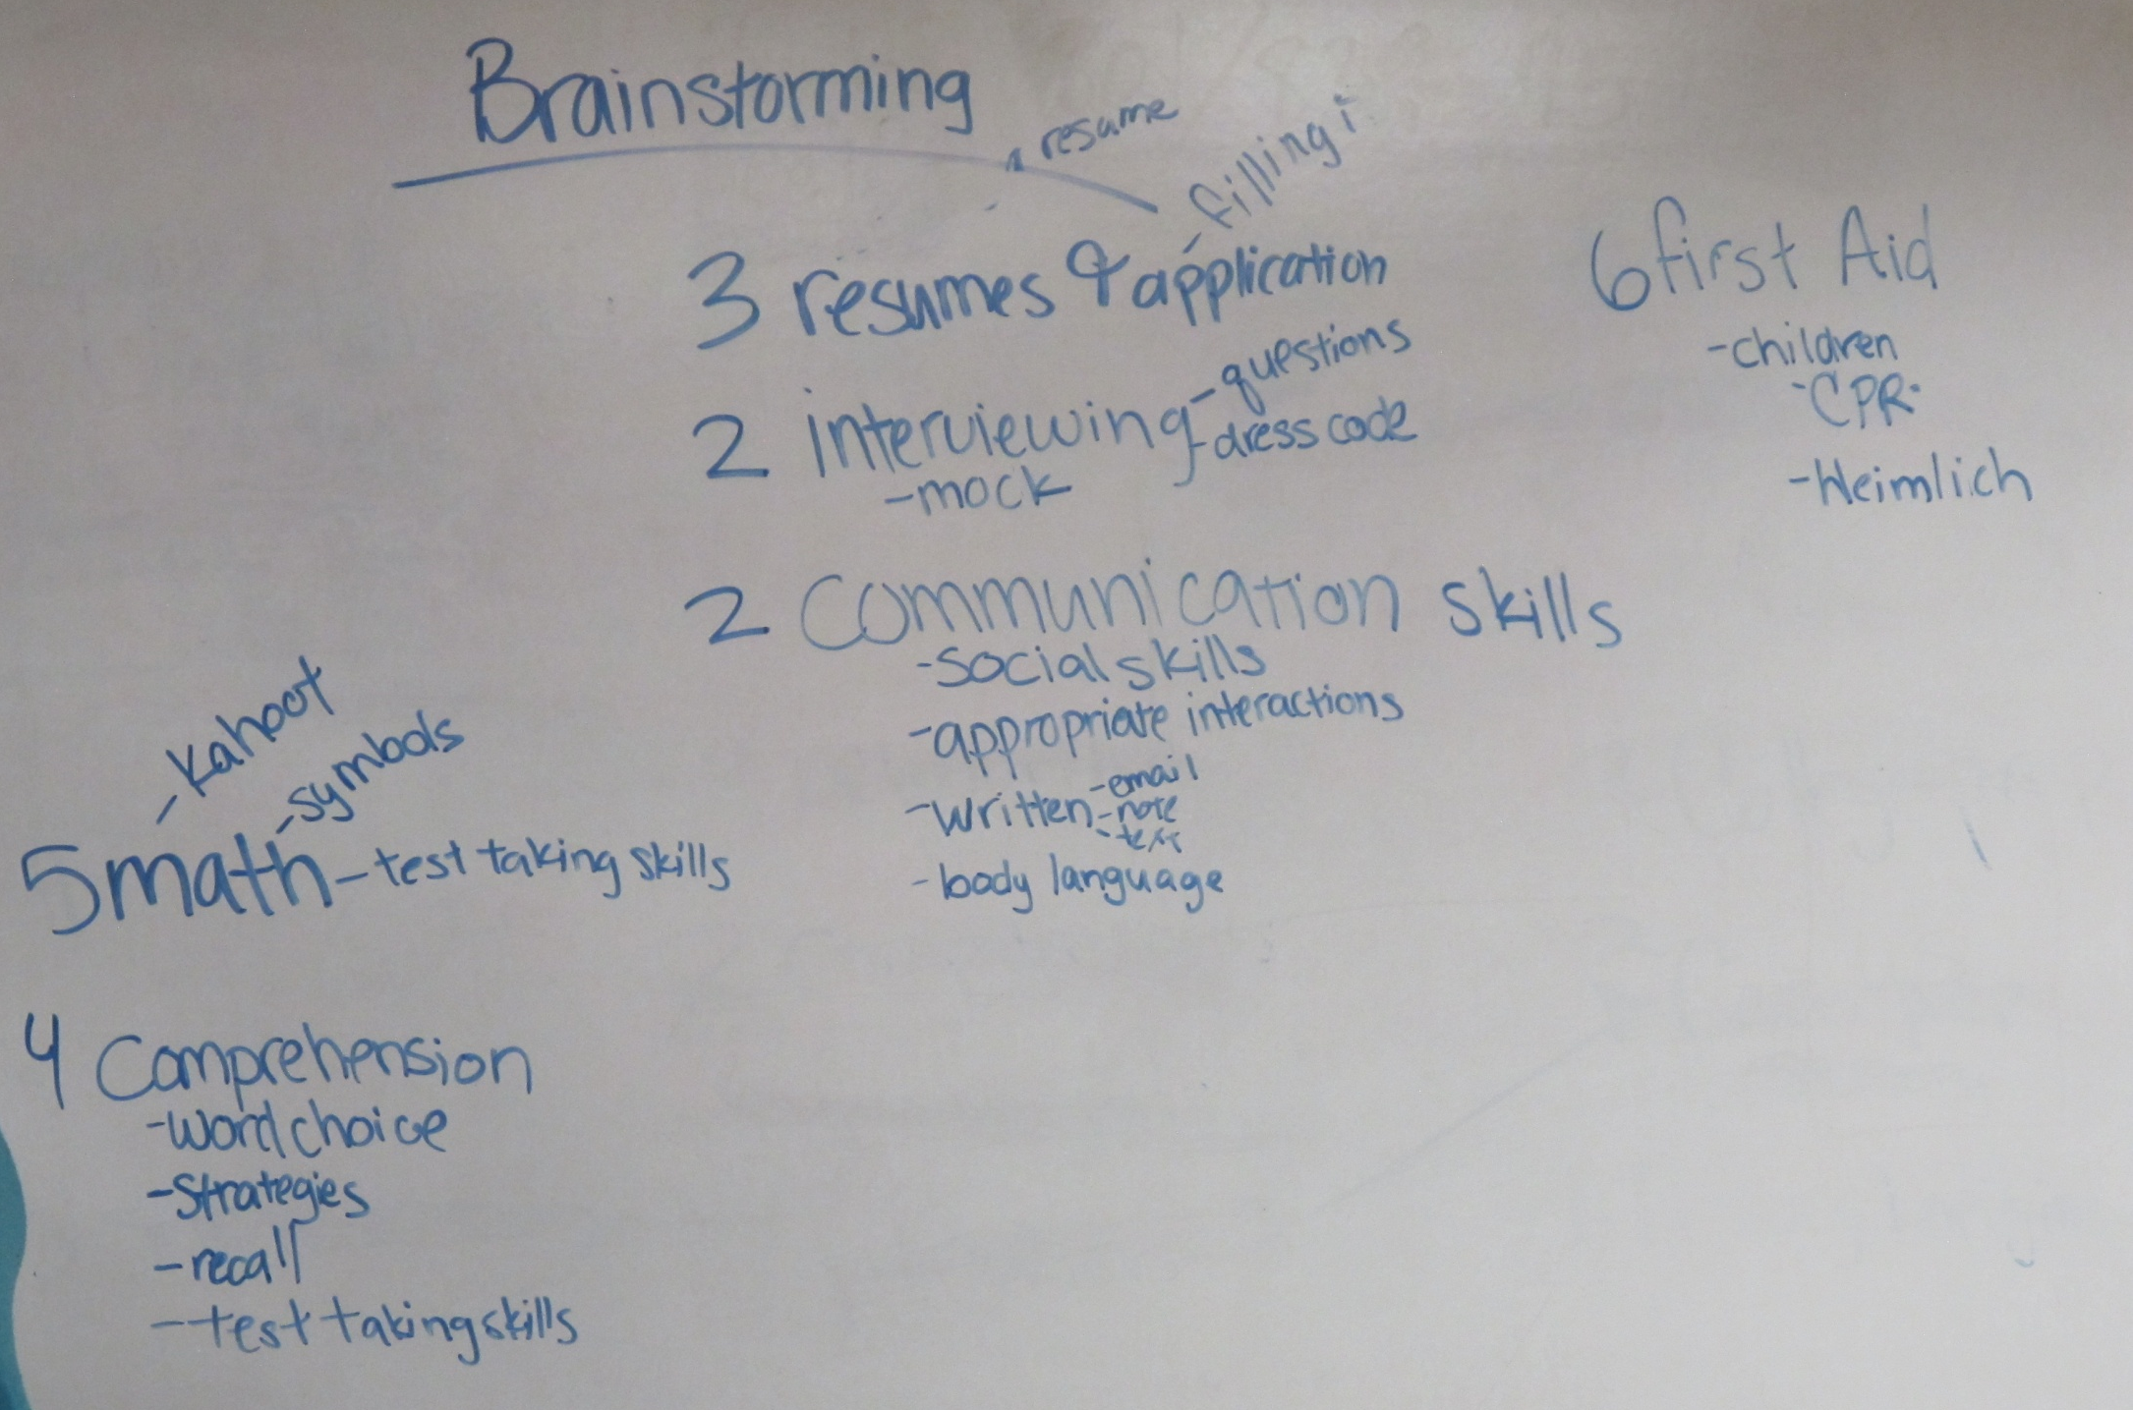
Brainstorming – defining some options
Notes:
Slide 5. Brainstorming (continued)

Slide 6
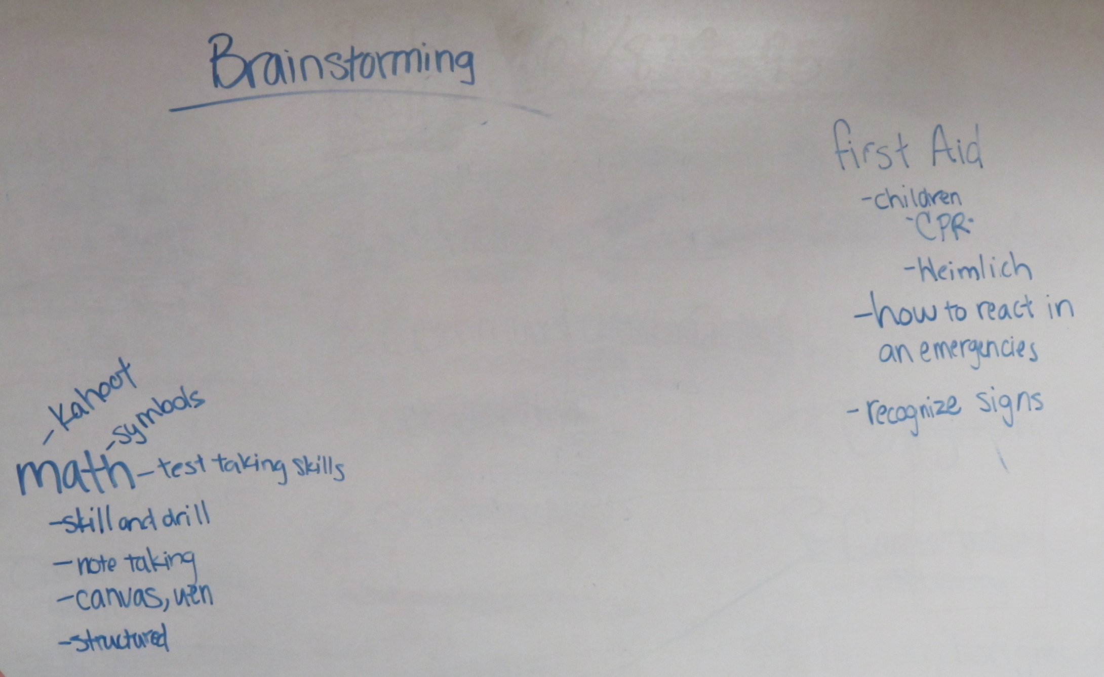
Brainstorming – narrowing the possibilities
Notes:
Slide 6. Brainstorming (continued)

Slide 7
We’ve got a winner!
Notes:
Slide 7. Brainstorming (end)

Slide 8
Some topics included:
>Nutrition >Spelling
>5-paragraph essay >Exercise
>Founding Fathers >Disability law
>Movie Making >Cooking
>Scientists >Spreadsheets
>Battle at Gettysburg >Note taking
>Landmark Supreme Court Cases >Salt
Notes:
Slide 8. (Don’t read this list aloud. Don’t leave on the wall very long. Don’t worry if everyone doesn’t finish reading it. )

Slide 9
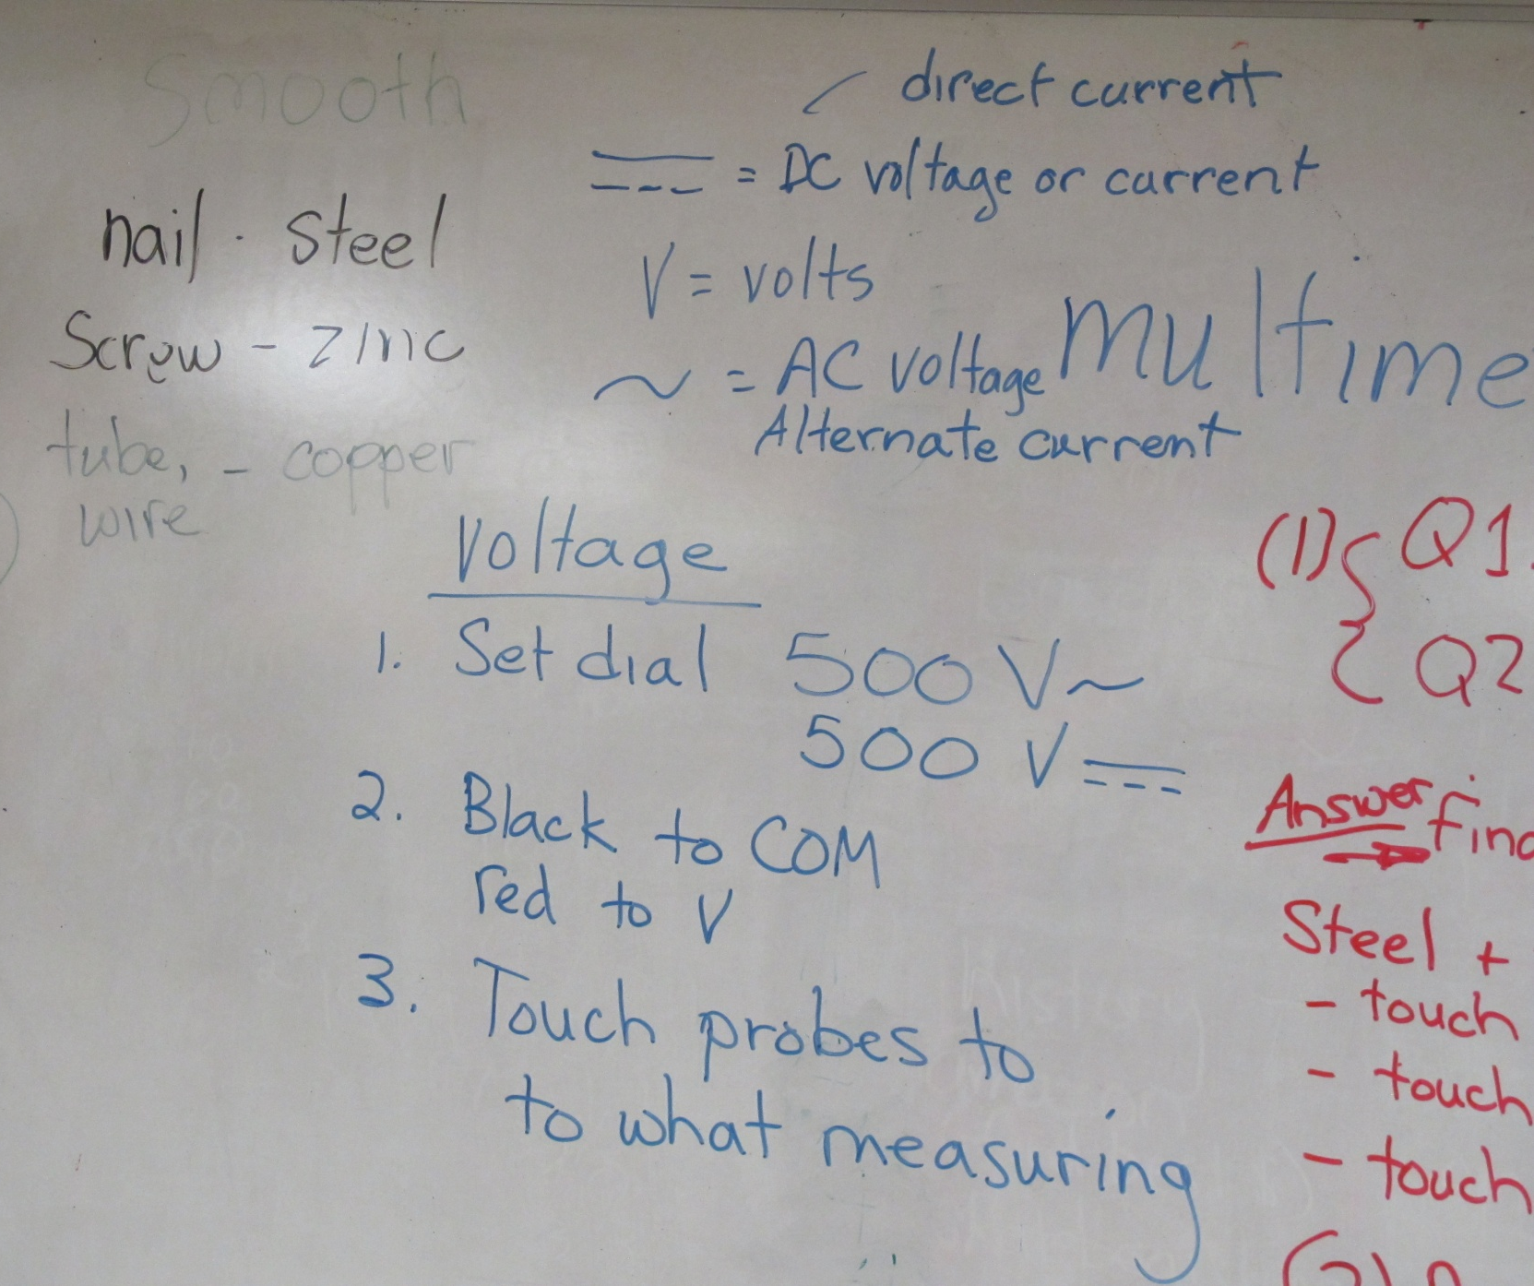
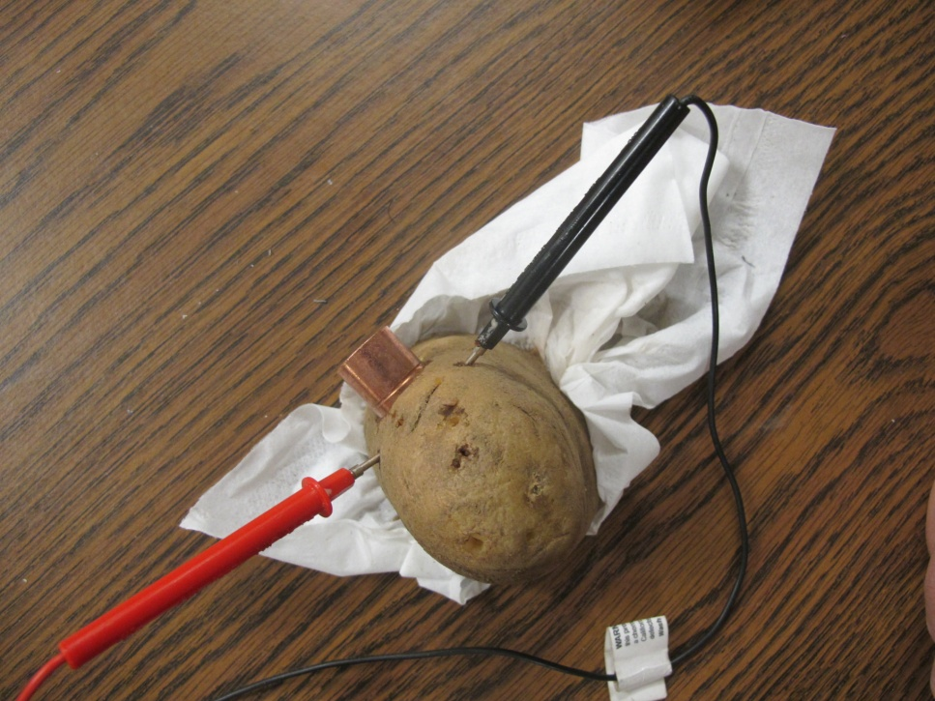
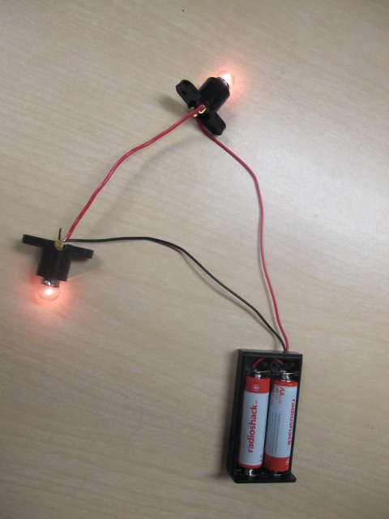
series or parallel?
See a lesson description for July 2015 at http://literacyactioncenter.blogspot.com
Notes:
Slide 9. Electricity

Slide 10
Your turn. (4 minutes)
What would you do with one of these topics?
1. Planets 2. Art Appreciation
3. Legislature 4. Culture
In your group: presentation: <2 minutes
Narrow the topic.
What will you learn? 2-3 goals or objectives.
Identify a final product that illustrates learning.
Connect to CCRS/Careers.
Notes:
Slide 10. Directions -- BRING TIMER

Slide 11
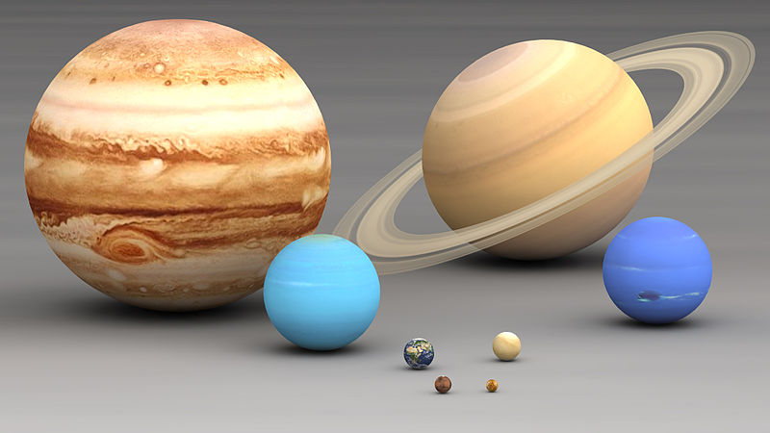
Planets
Planets What’s your plan?
Notes:
Slide 11. Planets – audience share

Slide 12
Planets
Planets - Here’s our plan:
Narrow: KWL – Know, Want to Know, Learn
Product: team presentation; open-note test
CCRS/Careers: Interpret/related NF; Presentation skills
Obj: Resource selection; team work; note taking; presentation – story boarding
Search for planets on https://sites.google.com/site/literacyactionclassroom/
Notes:
Slide 12. Planets – our plan

Slide 13
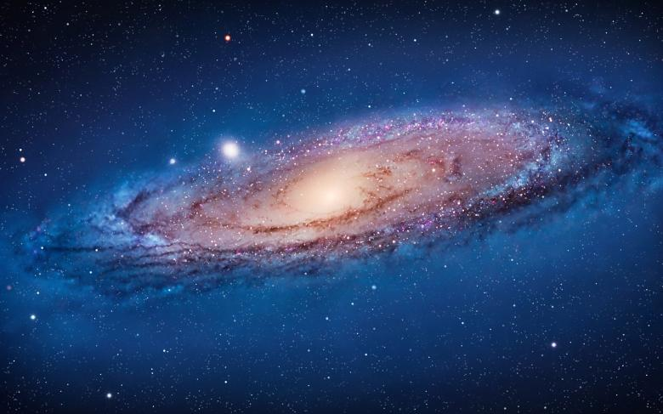
Planets
Galaxy
We live in the Milky Way galaxy.
Notes:
Slide 13.

Slide 14
Planets
Questions to ask
Web sites get data from somewhere. (Sometimes from each other.)
#1 Who owns the site?
#2 What are the owner’s credentials?
HINT: Look at the bottom of the page
for “About Us.”
Notes:
Slide 14.

Slide 15
Sample Questions
Life
Has this planet been explored? If yes, by whom?
What is the weather like on this planet?
What is the lifespan of this planet? (How old is it? How much older will it get?)
Does this planet have gravity? What is it?
Planets
Notes:
Slide 15.

Slide 16
Planets
Presentation Checklist
Slides
• >1 answer per slide (combine similar info on 1 slide)
• 4 - 5 slides for total presentation
• Use bullets (<8 words/bullet; <8 bullets/slide) & key words
Talk
• 4 – 5 minutes for total group presentation
• Each group member must say something about the planet
• Transition between each person talking planned and smooth
Content
• Answer questions
• Pictures must relate to the content
• Must include interesting fact
Notes:
Slide 16.

Slide 17
Planets
Mars has 62% < gravity than EARTH
Notes:
Slide 17.

Slide 18
Planets
Saturn |  |  |  |  |  |  |  |  |  |  |  |  |  |  |  |  | Mean | Median | Mode | Range
1.Smooth | 5 | 5 | 3 | 3 | 5 | 3 | 5 | 3 | 5 | 5 | 3 | 3 | 5 | 5 | 1 |  | 3.9 | 5 | 5 | 1-5 | 15 | 1 | 3 | 3 | 3 | 3 | 3 | 3 | 5 | 5 | 5 | 5 | 5 | 5 | 5 | 5
2.Timing | 5 | 5 | 3 | 3 | 3 | 1 | 5 | 5 | 5 | 5 | 3 | 5 | 1 | 5 | 5 |  | 3.9 | 5 | 5 | 1-5 |  | 1 | 1 | 3 | 3 | 3 | 3 | 5 | 5 | 5 | 5 | 5 | 5 | 5 | 5 | 5
3.Content | 5 | 3 | 5 | 5 | 1 | 5 | 5 | 3 | 5 | 5 | 5 | 5 | 5 | 5 | 5 |  | 4.5 | 5 | 5 | 1-5 |  | 1 | 3 | 3 | 5 | 5 | 5 | 5 | 5 | 5 | 5 | 5 | 5 | 5 | 5 | 5
Notes:
Slide 17.

Slide 19
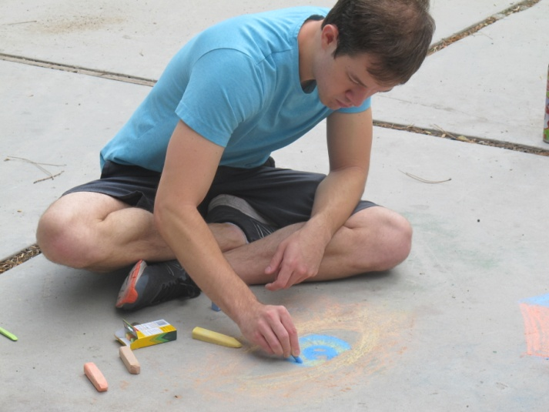
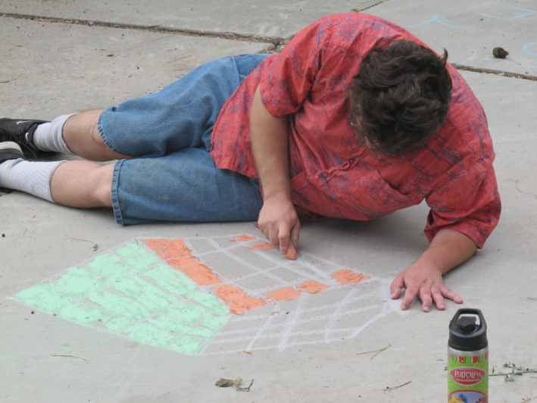
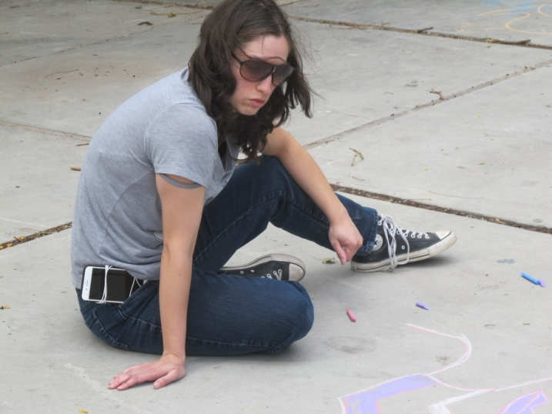
Art Appreciation
Art Appreciation What’s your plan?
Notes:
Slide 19. audience share

Slide 20
Art Appreciation
Art Appreciation - Here’s our plan:
Narrow: KWL – Know, Want to Know, Learn
Obj: Questioning & critical thinking skills; Using resources; Exploring art media
Product: artist presentations with Utah Arts Festival
CCRS/Careers: Interpreting visual/printed texts; Comparing texts; Delivering a product; graphic designer & game designer
Notes:
Slide 20.

Slide 21
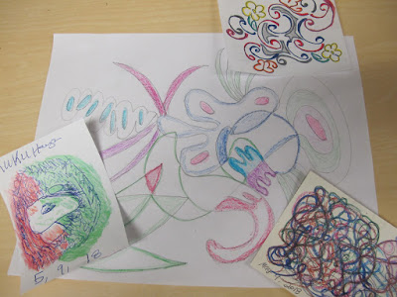
Art Appreciation
Doodle Art created to one of Billy Joel's tunes.
Notes:
Slide 21.

Slide 22
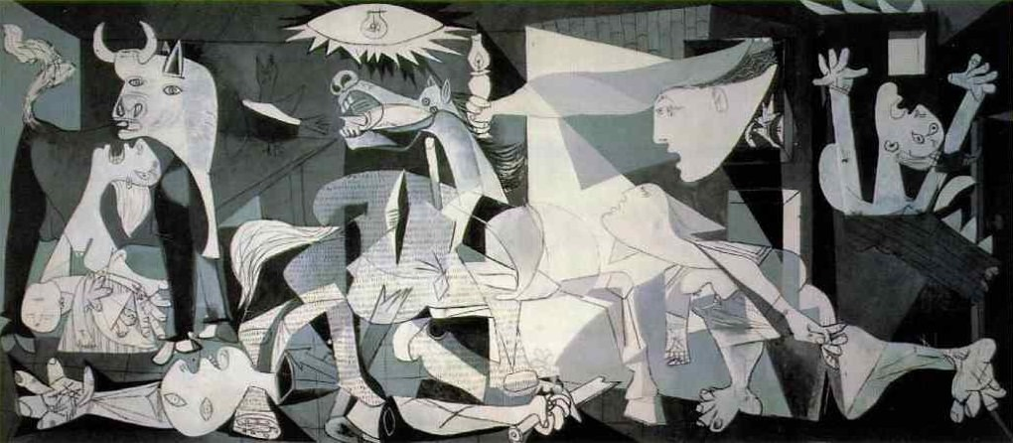
Art Appreciation
Examine works of art
Guernica by Picasso
Notes:
Slide 22.

Slide 23
Art Appreciation
Our 4 Questions –
What we wanted to know
Who is the artist? Brief bio.
What is the history behind the art piece?
What do you see in the art piece?
What was the artist’s style?
How did it show up in this piece?
See lesson description for May 2018 at http://literacyactioncenter.blogspot.com
Notes:
Slide 23.

Slide 24
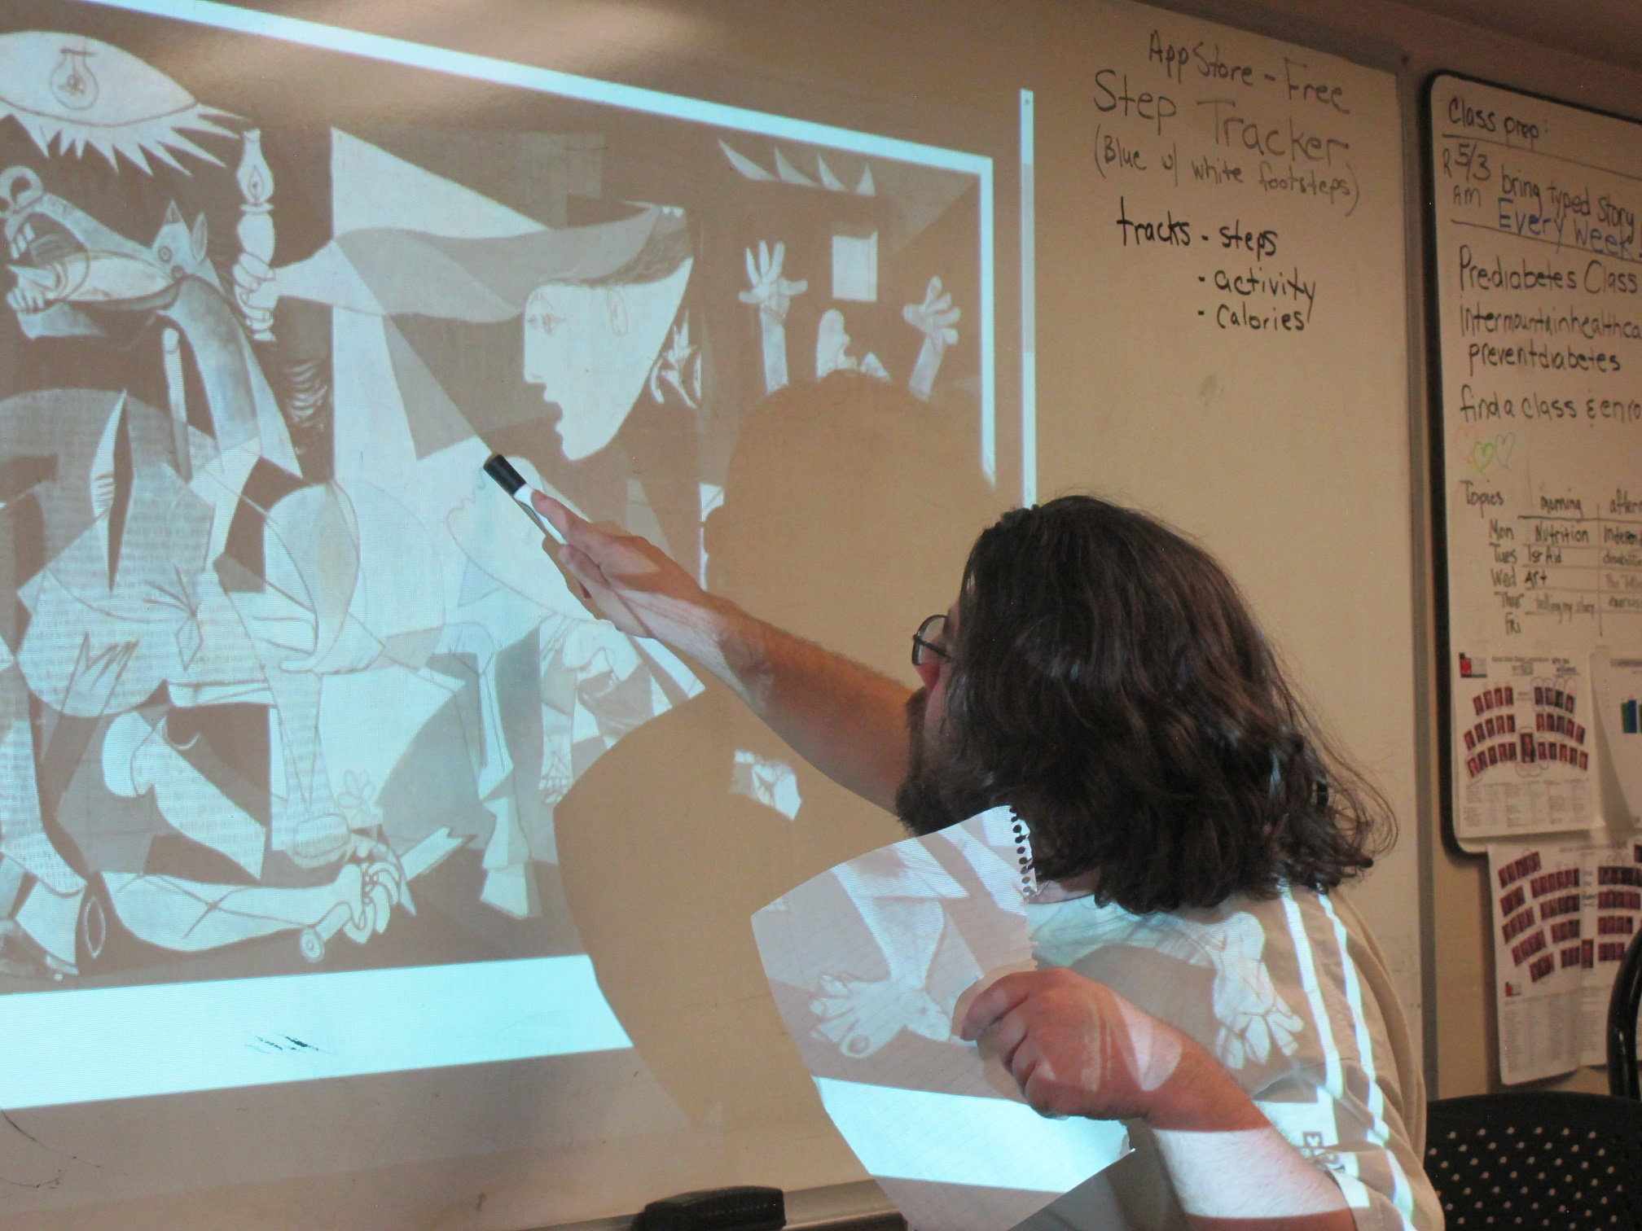
Art Appreciation
Notes:
Slide 24.

Slide 25
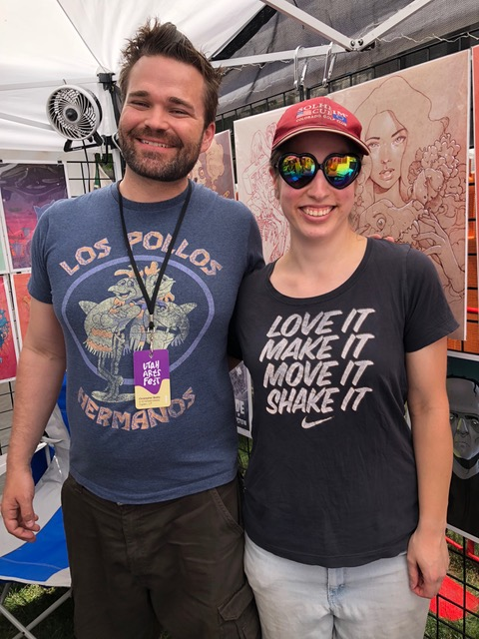
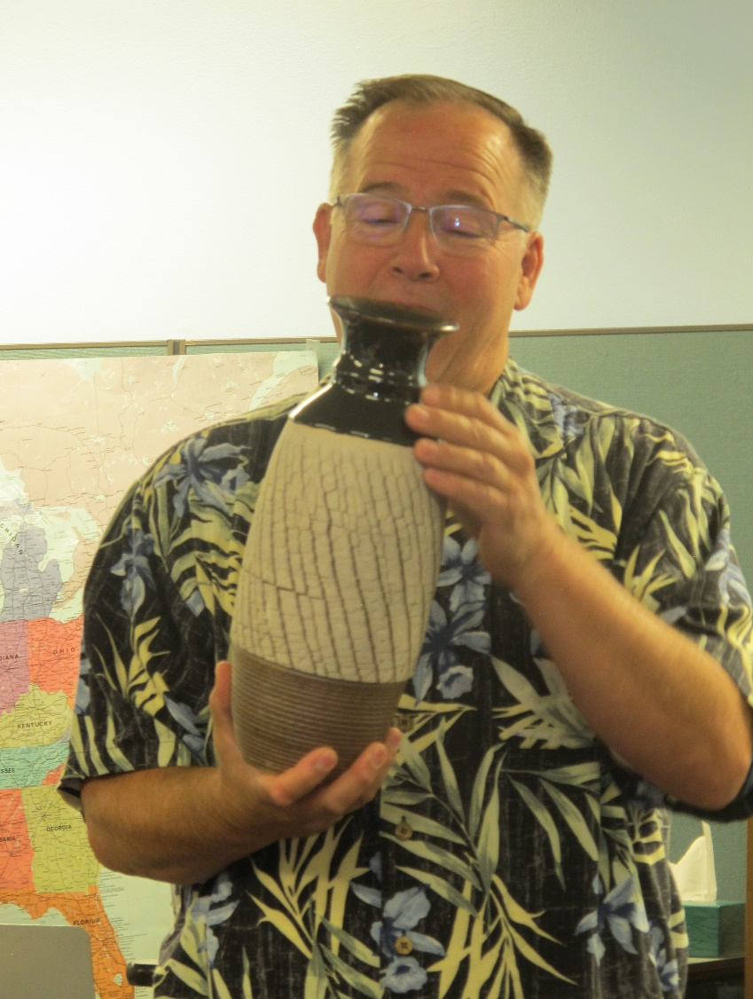
Art Appreciation
Ray presenting David statube
Teresa with artist Chris Bodily
Potter Joe Van Leeuwen
Notes:
Slide 25.

Slide 26
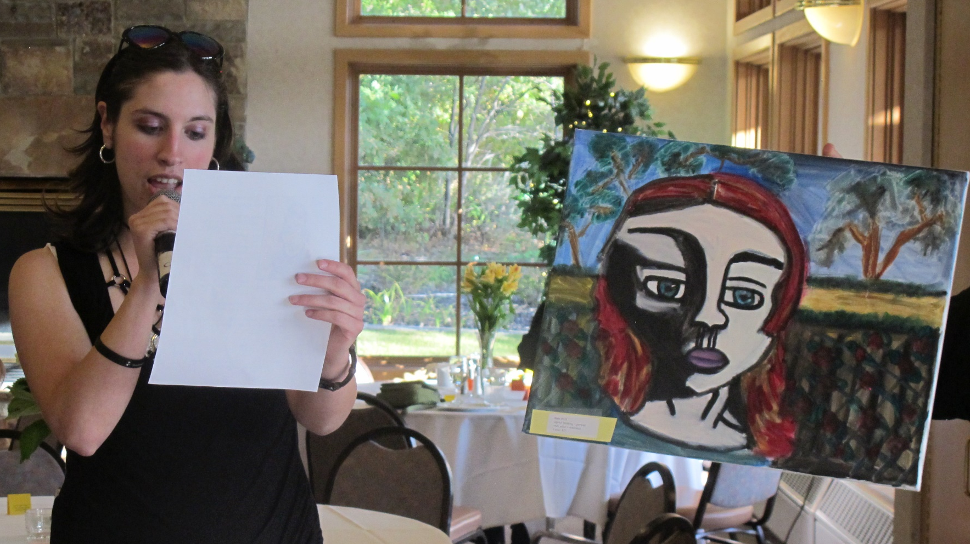
Art Appreciation
Notes:
Slide 26.

Slide 27
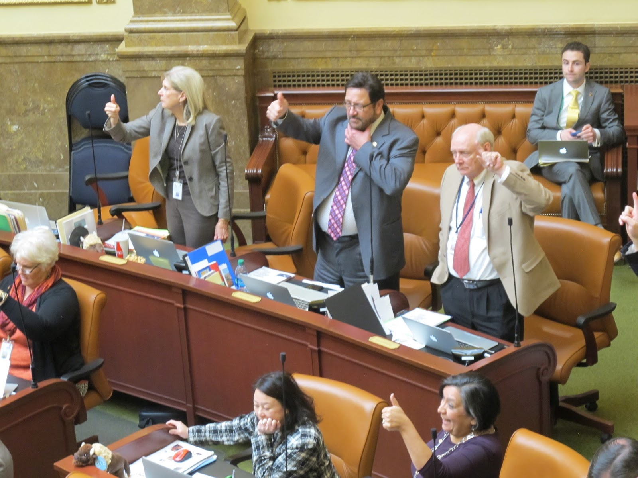
Legislature
Legislature What’s your plan?
2/22/17 HR without power.
Notes:
Slide 27. audience share

Slide 28
Legislature
Legislature - Here’s our plan:
Narrow: KWL – Know, Want to Know, Learn
Product: write to legislators (express opinion)
CCRS/Careers: Interpret/relate NF; write cohesive text; Argue point
Obj: Real people; Understand & follow bill
Notes:
Slide 28.

Slide 29
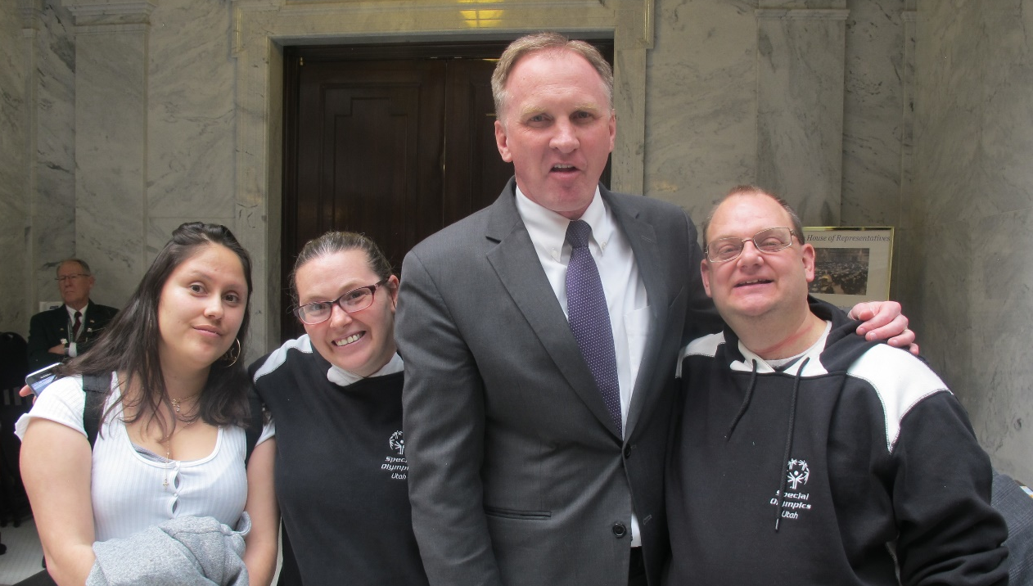
Legislature
Activities center around:
Who are our legislators?
Who do they represent?
What are the issues under fire on the hill? How did these ideas end up as law?
Search archives for March 2015, Feb 2017, March 2017, & June 2017 at https://literacyactioncenter.blogspot.com
Notes:
Slide 29.

Slide 30
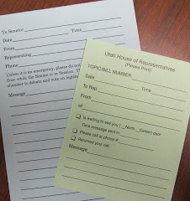
Legislature
Issues
Identify issues
Review newspapers & media
Follow bills –
Where do my legislators’
stand on these issues?
Voice my opinion
Notes:
Slide 30.

Slide 31
Legislature
Protecting People Crossing State Street
Called South Salt Lake Police. “Can’t do anything.”
Wrote letter to editors. No response.
Sent cc: of letter to SSL mayor. Invitation. Action taken.
Watch out for pedestrians.
Don’t talk or text as you drive.
Search archives for June 2017 at https://literacyactioncenter.blogspot.com
Notes:
Slide 31. Outcomes

Slide 32
Culture
Culture What’s your plan?
Pinmaps.net is an online map creator to pin multiple locations & share maps.
Notes:
Slide 32. audience share

Slide 33
Culture
Culture - Here’s our plan:
Narrow: KWL – Know, Want to Know, Learn
Obj: presentations - who we are; connect with each other
Product: comfort food stories & recipes
CCRS/Careers: Interpret/relate NF; investigative skills; write cohesive texts; speaking/listening skills
Notes:
Slide 33.

Slide 34
Culture
KWL: Culture (sharing backgrounds)
– collection of ideas, customs, skills, arts, etc. of people in a given period
Already KNOW
Archeologist dig up artifacts to understand cultures
Everyone has a different culture
Culture is dynamic
WANT to know
Languages Traditional foods Family tree
Where born Educational levels Music
Last name – origin, nationality Religious beliefs
#1 priority for me/for my family Family/my favorite past-times
Family traditions (handed down) Birthday/holiday traditions
Notes:
Slide 34.

Slide 35
Culture
Birthplaces
Pinmaps.net is an online map creator to pin multiple locations & share maps.
Notes:
Slide 35.

Slide 36
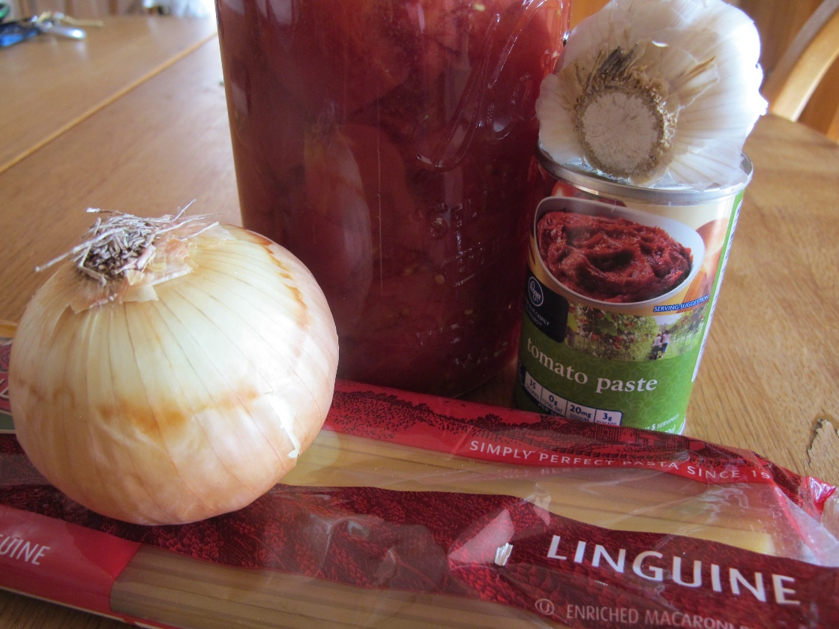
Culture
Other explorations included:
Last name origins
Religions
Comfort foods
Spaghetti with Meat Sauce
By Ken
My favorite dinner is spaghetti. I have good memories of my mom and dad cooking spaghetti. When I would get home from working at the Kroger Store in Dallas, Texas, they would be cooking. I could smell the spaghetti sauce cooking and the garlic bread warming in the oven. It smelled so good that I wanted to eat right away.
Notes:
Slide 36.

Slide 37
Key Elements
Decision-makers
Engaging & relevant
Accountability
Product – show how/what learned
Instructional designer
Notes:
Slide 37. Key elements

Slide 38
Cons
Takes time
Ongoing experiment
No prescriptive materials
Ambiguity
Pros
Interest – piqued, expanded, explored
Attendance
Trust (support & sharing)
Confidence
Synergy
Notes:
Slide 38.

Slide 39
Conclusions
Notes:
Slide 39.

Slide 40
Thank you for sharing.
Questions:
Deb Young or Betsy Folland
lac@LiteracyActionCenter.org
Notes:
Slide 40.

