Slide 1
Teach Investing in
Two Hours!

Slide 2
Investing in Two Hours
Key Principles
Focus on outcomes
Start early
Keep it simple
Reflects current trends
Make a decision

Slide 3
Investing in Two Hours
For an e-copy:
bit.ly/LGInvesting

Slide 4
Discussion Prompt
What do you know about investing and where have you learned about it?

Slide 5
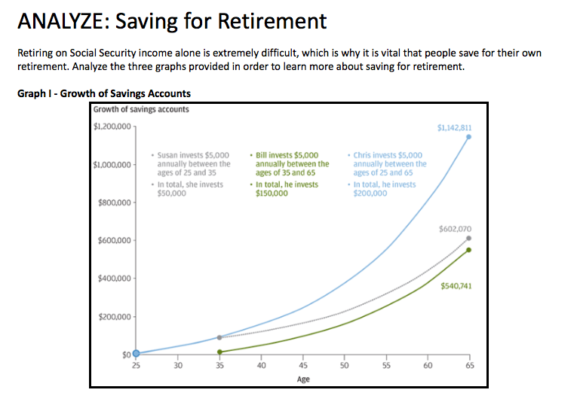
NGPF Activity
ANALYZE: Saving for Retirement

Slide 6
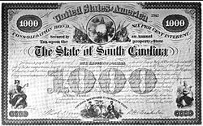
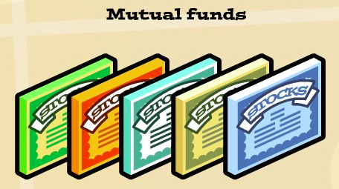
NGPF Reference & Game
Stocks, Bonds, & Mutual Funds

Slide 7
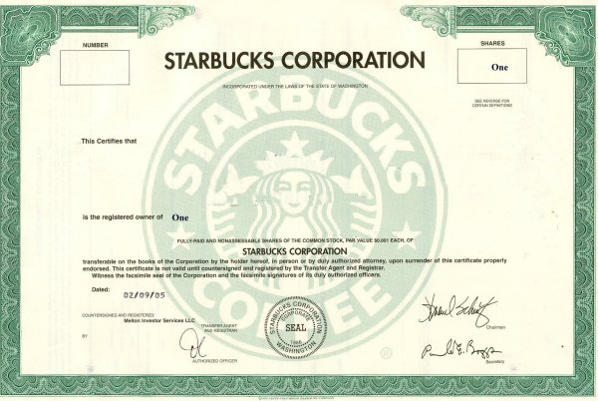
8-Hour Workshop
6. Crash Course in Investing
Stocks, Bonds, & Mutual Funds
Buying a Stock
You buy 1 share of 1.5 billion shares
Value of Your Shares
(Current stock price) X (# of shares you buy)
How You Make Money
Receive dividends of ~ $1.00 per share per year
Sell your share at a higher price than you bought it
Risk
Volatility of market
Price could plummet & not recover
Impossible to know when to sell to maximize earnings
www.ngpf.org Last updated: 3/2/17

Slide 8
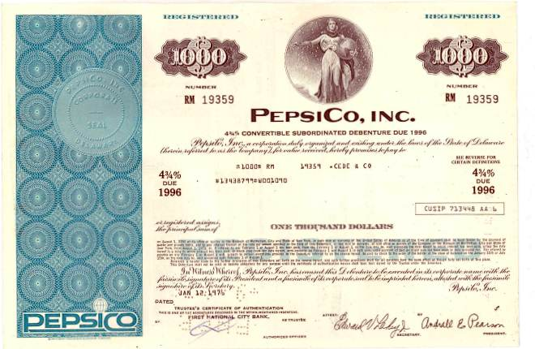
8-Hour Workshop
6. Crash Course in Investing
Stocks, Bonds, & Mutual Funds
Buying a Bond
You lend $1,000 to PepsiCo when they issue a bond
Terms of the Agreement
4.75% interest per year on the amount you lent to them
Repay your $1,000 at the end of the term (10 years)
How You Make Money
$47.50 per year for 10 years
$1,000 at end of term (this was your money in the first place)
Risk
Company/govt cannot repay you due to bankruptcy
www.ngpf.org Last updated: 3/2/17

Slide 9
8-Hour Workshop
6. Crash Course in Investing
Stocks, Bonds, & Mutual Funds
What do you think is riskier: the stock or the bond?
What are some ways you could minimize risk?
www.ngpf.org Last updated: 3/2/17

Slide 10
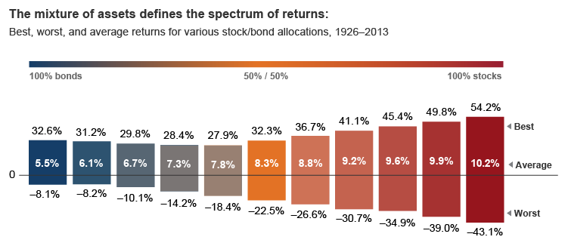
8-Hour Workshop
6. Crash Course in Investing
Stocks, Bonds, & Mutual Funds
Source: Vanguard, 2/28/17
www.ngpf.org Last updated: 3/2/17

Slide 11
8-Hour Workshop
6. Crash Course in Investing
Stocks, Bonds, & Mutual Funds
GAME: Let’s Make a Mutual Fund
You are being given a slip of paper with two pieces of information:
Name of a company and its ticker
The percentage change in the stock price over the past year (“performance”)
Await your teacher’s directions for your next steps
Teachers: Game support document here
www.ngpf.org Last updated: 3/2/17

Slide 12
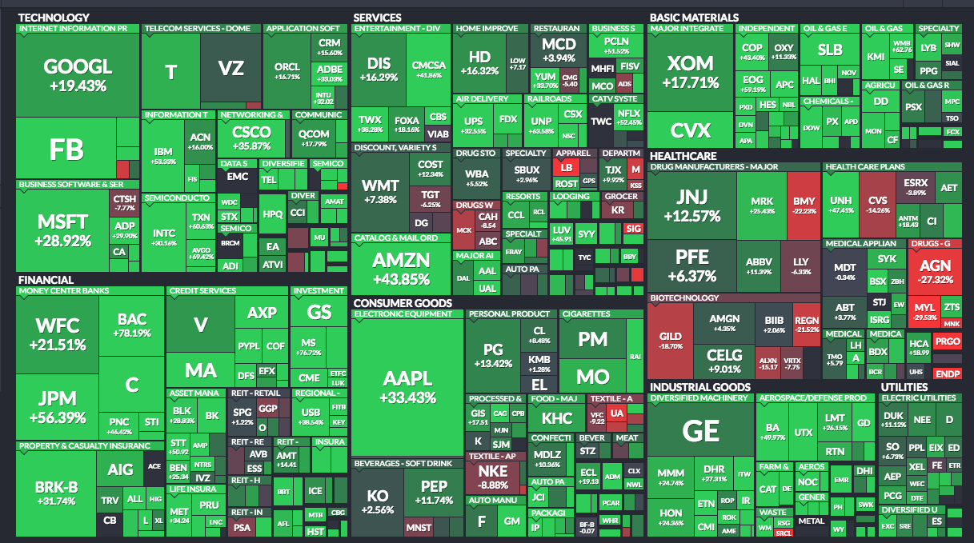
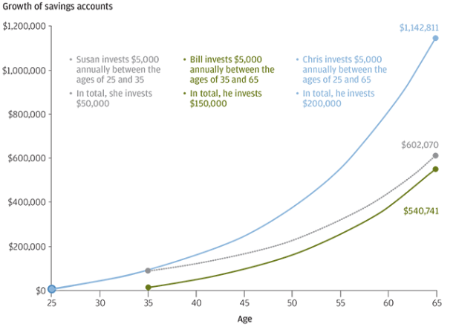
Investing
S&P500
Notes:
Live version of interactive, changing graphic is available here: http://finviz.com/map.ashx?t=sec
Return size is the % given there.
Bright green is the best and bright red is the worst
Box size is their market cap (shares x current stock price)
Fund manager tries to do better with their hand-selected fund than beating the S&P 500 -- infrequently do.

Slide 13
NGPF Game
Let’s Make a Mutual Fund
Round 1
Individual Round
Who had a positive performance?
Who had a negative performance?
Why would you invest in a company that did so poorly?

Slide 14
NGPF Game
Let’s Make a Mutual Fund
Round 2
Find 1 person who has a similar company to yours
What do you know about each company?
Better to own shares in TWO companies rather than one?

Slide 15
NGPF Game
Let’s Make a Mutual Fund
Round 3
Create a small mutual fund (group of 6 people)
What criteria did you use to form your group?
Estimate your return had you owned one share of each company
Would you describe this as a well diversified portfolio?

Slide 16
NGPF Game
Let’s Make a Mutual Fund
Round 4
Create an index fund (Dow Jones Industrials)
Why might it be better to own shares in Dow Jones Industrials, rather than one stock in Dow Jones?
How could an investor create MORE diversification in their portfolio?

Slide 17
NGPF Game
Let’s Make a Mutual Fund
What were your ahas/takeaways from this experience?
Why might this project be engaging for your students?
What modifications would you make and why?

Slide 18
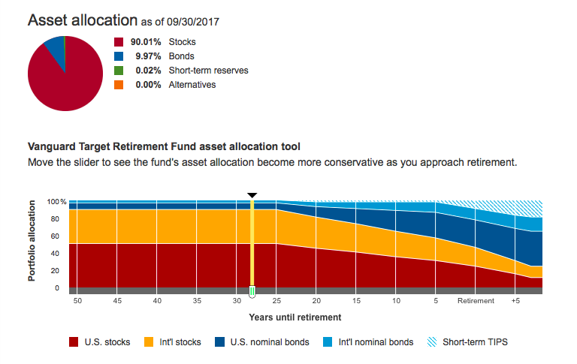
Interactive
Vanguard Target Retirement Fund Allocation Tool
For an e-copy:
bit.ly/VanguardTool

Slide 19
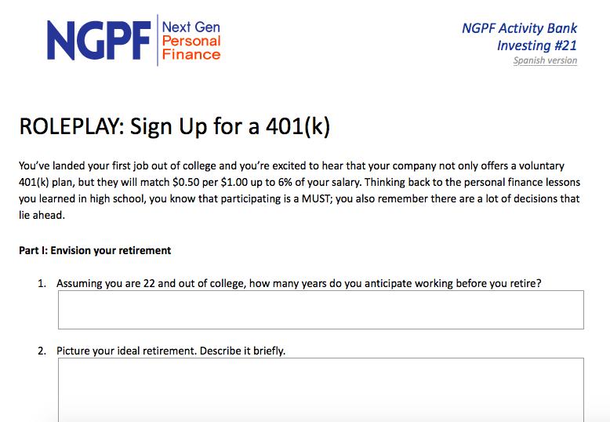
NGPF Activity
ROLEPLAY: Sign Up for a 401(k)

Slide 20
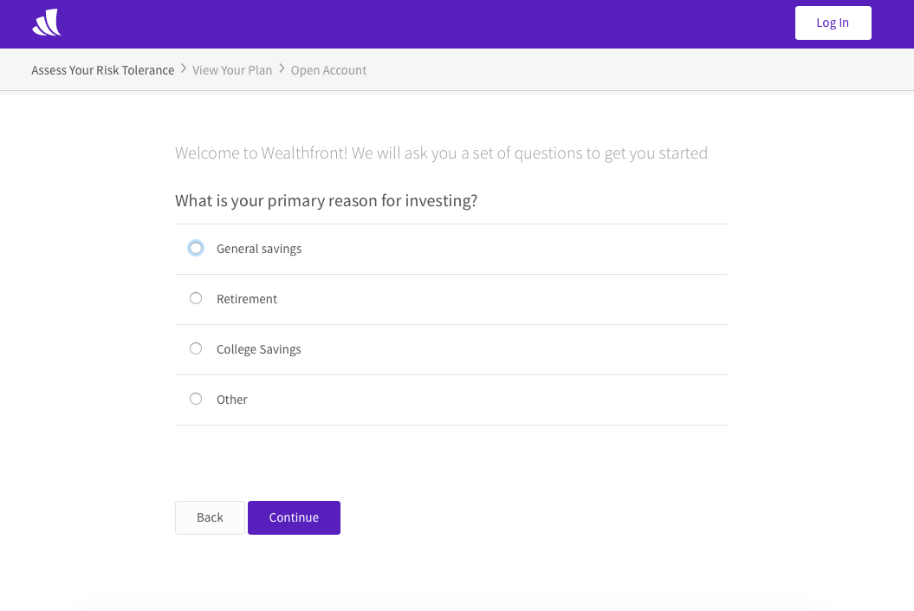
NGPF Activity
Wealthfront Risk Tolerance Assessment
For an e-copy:
wlth.fr/NGPFTool

Slide 21
Exit Ticket
Why is it important to start investing early for your retirement?
Explain 2 ways in which an actively managed mutual fund and an index fund differ.
What makes a target date fund an “easy” choice for a retirement investment?

Slide 22
Answer Keys?!
Sign Up For a Teacher Account
Access to Assessments
Answer Keys
How?
Home Page, upper right
Referral: STATE NAME!
Already have a Teacher Account?
bit.ly/NGPFDrawing
Notes:
– MENTION ASSESSMENTS & ANSWER KEYS IF NOT MENTIONED PREVIOUSLY
– How many got to the “Create a Teacher Account” section of the scavenger hunt?

Slide 23
Contact Us
www.ngpf.org
christian@ngpf.org
@NextGenPF
Next Gen Personal Finance
Private page: FinLit Fanatics
@NextGenPF

