Slide 1
Score Report Insights to Drive Instruction, Part 2: Focus on Mathematical Reasoning and Science
Debi Faucette September 2018

Slide 2
Session Objectives
Analyze real GED Ready® and Operational GED® Test Score Reports
Discuss the why and how of using score reports (as prescriptions) to drive instruction
Share ideas and resources

Slide 3
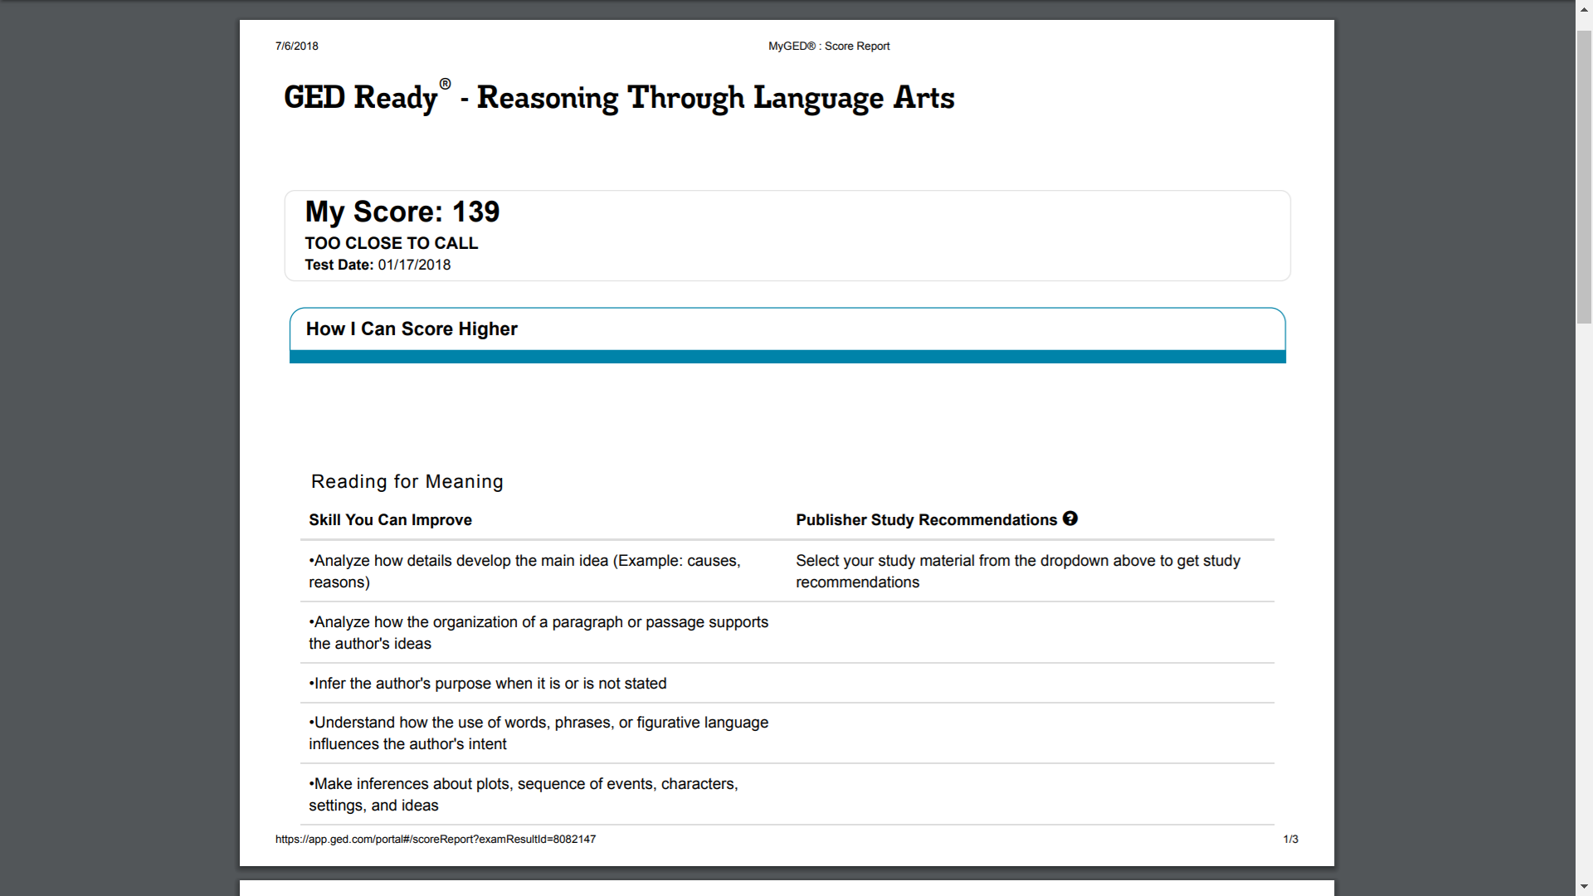
How Do YOU
Use Score Reports?

Slide 4
Common Score Report Uses
Look at the score only…to gauge how far from 145 the score is
Get a feel for what work needs to be done (in terms of skills and content)
Compare the GED Ready® and the GED® operational test scores for similarities and differences
Don’t really use the score report—consider the feedback too “generic”

Slide 5


So How Do You Take It
From This . . . …..……………………..To This?

Slide 6
How? Take Action!
Review
Diagnose
Prescribe

Slide 7
Features of the Enhanced Score Report
FEATURE | GED READY® PRACTICE TEST | GED® TEST
My Score | Indicates if a test-taker is likely to pass, too close to call, or not likely to pass the GED® test. | Indicates if a test-taker passed, passed with College Ready or College Ready plus credit scores, or scored below passing.
How I Can Score Higher | Shows the skills a test-taker needs to work on before taking the GED® test. Includes a personalized study plan with pages and chapters to review in popular study materials. | Shows the skills a test-taker needs to work on before trying again. Includes a personalized study plan with pages and chapters to review in popular study materials.
What My Score Means | Explains what skills the student successfully demonstrated on the GED Ready® practice test. | Explains what skills the student successfully demonstrated on the GED® test.
Review My Written Answers | Displays the test-taker’s written response to the extended response item. Educators can use the constructed response scoring tools to give test-takers feedback on their responses. | Available for the RLA test subject. Shows the students’ scores for their responses and the skills they need to work on to score higher. Not available for Science, Social Studies, or Math subjects.
Notes:
Key Points
Review the basic features of the score report and discuss that you will be showing them what these look like on the actual report.

Slide 8
What Instructors Need to Know
Resources for Success
.

Slide 9
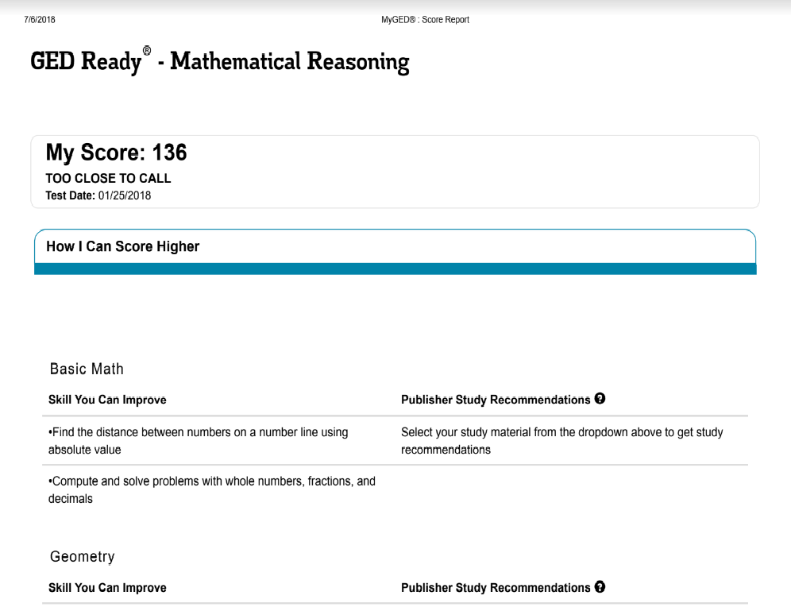
A GED Ready® Score Report: Yellow Zone

Slide 10
The GED Ready® Math Score: 136
Areas for Improvement (a sample)
Problem solving
Basic Math (e.g. Number lines and problem solving with whole numbers, fractions, and decimals)
Geometry (e.g. construct and interpret data from various types
of graphs; volume and surface area of three dimensional figures; find side
lengths, radius or diameter when given the volume or surface area; basic probability;
finding side lengths when given area or perimeter
Basic Algebra (e.g. multiplying polynomials; solve inequalities; and create basic algebraic expressions to solve problems
Graphs and functions
Geometric reasoning
Algebraic reasoning

Slide 11
What About the Additional Skills?
These represent skills that the test-taker was NOT consistent with:
  Solve problems involving rational numbers
  Solve two-step, arithmetic, real world problems that involve percents
  Compute the area and perimeter of triangles and rectangles
  Find side lengths of triangles and rectangles, when given area or perimeter
  Calculate the mean, median, mode, range, and weighted average, and calculate a missing data value, given the average and all the missing data values but one

Slide 12
Diagnosis
An “incidental” math student whose math reasoning abilities stalled after learning the basics.
Use the Performance Level Descriptors (PLDs) to determine where the student is on the math continuum—as you already know, you can’t add the more complex topics until the foundation is in place.
Students who are confused by a number line, more likely than not, are not going to be able to plot points on a coordinate plane.
As you determine how to sequence math content, keep in mind what foundational skills are necessary.

Slide 13
But…the Feedback Doesn’t Cover What Specific Questions Were Missed
No, the feedback summarizes the skills that are needed to earn a higher score
And yes, we are inferring what’s needed based on what was not demonstrated (and here we are talking about consistency)

Slide 14
Ideally, What Happens Next?
How do we get the biggest bang for the buck with the available time?
High Impact Indicators (HIIs)
Performance Level Descriptors (PLDs for Level 1- Not Passing and Level 2 – High School Equivalency)
PLDs = Stuff to Teach!
And, remember to have students review the Study Guide

Slide 15
How to Use PLDs in the Classroom
Use PLDs to:
  Tip 1: Assess student’s current skill level
  Tip 2: Determine when students are ready to test
  Tip 3: Shape learning activities
  Tip 4: Add perspective to lesson plans
Notes:
Key Points
There are many different ways that we can use PLDs to assist us in developing an effective curriculum. Here are four tips to get started.
Tip 1: Use PLDs to assess a student’s current skill level
Identify where to focus in order to develop the skills students need to move to the next performance level
Tip 2: Use PLDs to determine when students are ready to test
Determine if a student should take GED Ready® or the GED® test
Use with the Enhanced Score Report's personalized study plan to create a plan for developing student skills
Tip 3: Use PLDs to shape learning activities
Set learning objectives in your classroom based on the PLDs
Determine if you need to adjust how you're approaching the content
Work one-on-one with students to help develop needed skills
Tip 4: Use PLDs to add perspective to lesson plans
Determine how prepared your students are and create lesson plans accordingly
Identify the gaps in your students’ skills and develop focused lesson plans to address those gaps

Slide 16
Mathematical Reasoning
Mathematical reasoning is the critical skill that enables a student to make use of all other mathematical skills. With the development of mathematical reasoning, students recognize that mathematics makes sense and can be understood.
Notes:
Key Points
We know that the test is called Mathematical Reasoning, but what is it?
Share statement on the slide.

Slide 17
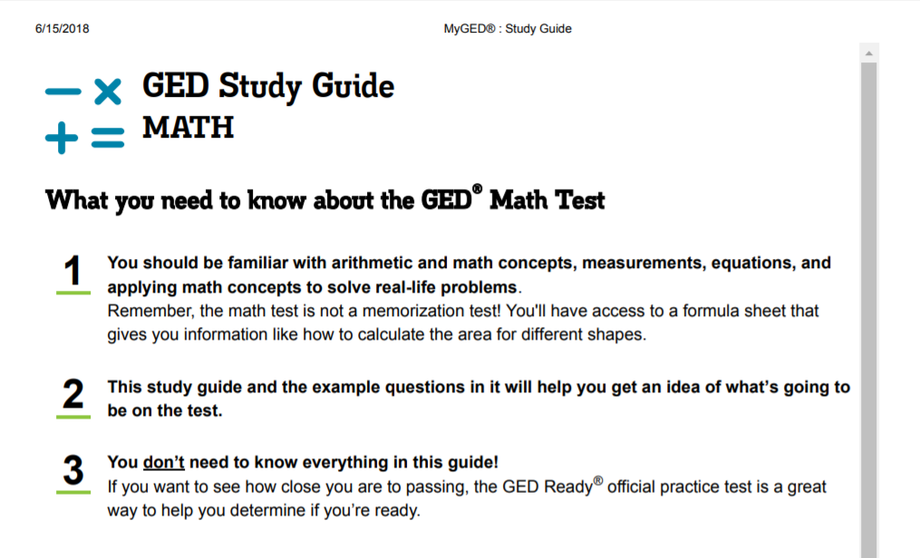

Slide 18

Analysis of Math Challenges
In Mathematical Reasoning, items require:
Application and development of quantitative and algebraic reasoning skills
  Grounded in real-world examples
  Beyond rote application of formulas and/or procedural steps
  The “why” and “how” of math
Strong critical reading and thinking skills
  What is the question asking?
  What heuristics can I use?
  Is the answer reasonable?
Notes:
As we look at questions on the GED Practice test/Item Sampler, think about how the questions require that our students apply and develop quantitative and algebraic reasoning skills that go beyond rote memorization and application of formulas and/or procedural steps. Instead, they require that our students are able to think and reason about math as they solve real-world problems. They need to be able to answer questions such as:
What is the question asking?
What heuristics can I use to solve the problem?
Is my answer reasonable and does it answer the question?
These are important skills in both real-world situations, as well as in the workplace and postsecondary education.

Slide 19
Productive vs. Non-Productive Beliefs
Unproductive Beliefs | Productive Beliefs
Students can learn to apply mathematics only after they have mastered the basic skills. | Students can learn mathematics through exploring and solving contextual and mathematical problems.
The role of the student is to memorize information that is presented and then use it to solve routine problems on homework, quizzes, and tests. | The role of the student is to be actively involved in making sense of mathematics tasks by using varied strategies and representations, justifying solutions, making connections to prior knowledge or familiar contexts and experiences, and considering the reasoning of others.
An effective teacher makes the mathematics easy for students by guiding them step by step through problem solving to ensure that they are not frustrated or confused. | An effective teacher provides students with appropriate challenges, encourages perseverance in solving problems, and supports productive struggle in learning mathematics.
Effective Teaching and Learning. (2014). In Principles to Actions : Ensuring mathematical success for all (p. 11). Reston, VA: NCTM.
Notes:
Key Points
Research has also provided us with support for effective teaching and learning. Let’s take a few moments to look at what the research says.
Review this slide and the next.

Slide 20
Productive vs. Non-Productive Beliefs
Unproductive Beliefs | Productive Beliefs
Mathematics learning should focus on practicing procedures and memorizing basic number combinations. | Mathematics learning should focus on developing understanding of concepts and procedures through problem solving, reasoning, and discourse.
Students need only to learn and use the same standard computational algorithms and the same prescribed methods to solve algebraic problems. | All students need to have a range of strategies and approaches from which to choose in solving problems, including, but not limited to, general methods, standard algorithms, and procedures.
The role of the teacher is to tell students exactly what definitions, formulas, and rules they should know and demonstrate how to use this information to solve mathematics problems. | The role of the teacher is to engage students in tasks that promote reasoning and problem solving and facilitate discourse that moves students toward shared understanding of mathematics.
Effective Teaching and Learning. (2014). In Principles to Actions : Ensuring mathematical success for all (p. 11). Reston, VA: NCTM.
Notes:
Effective Teaching and Learning. (2014). In Principles to Actions : Ensuring mathematical success for all (p. 11). Reston, VA: NCTM.

Slide 21
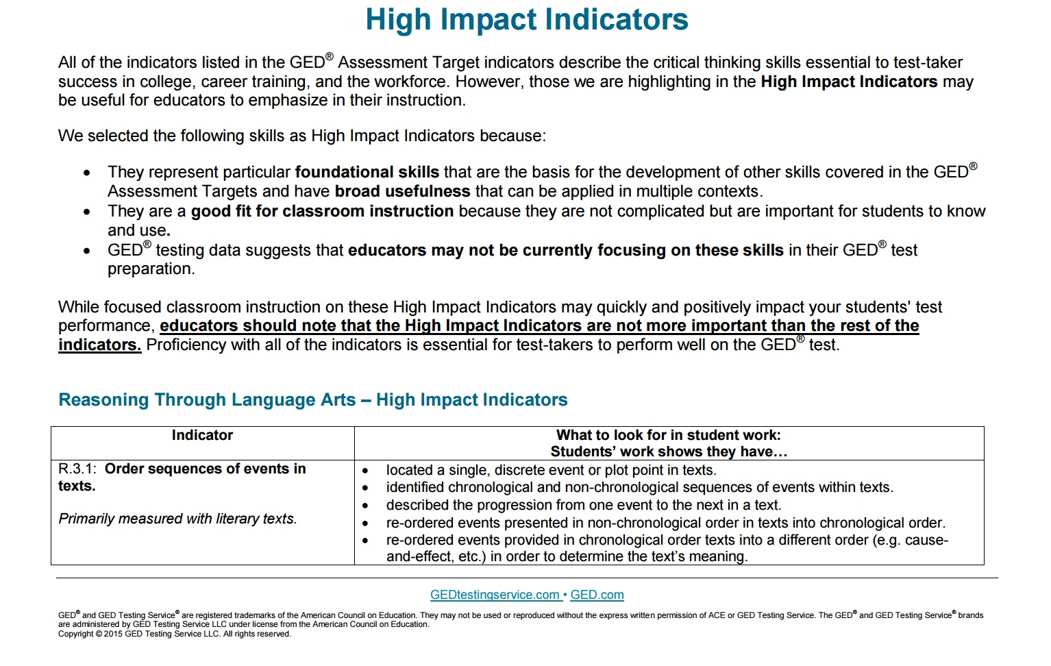
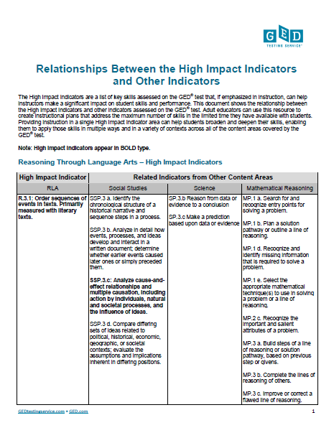
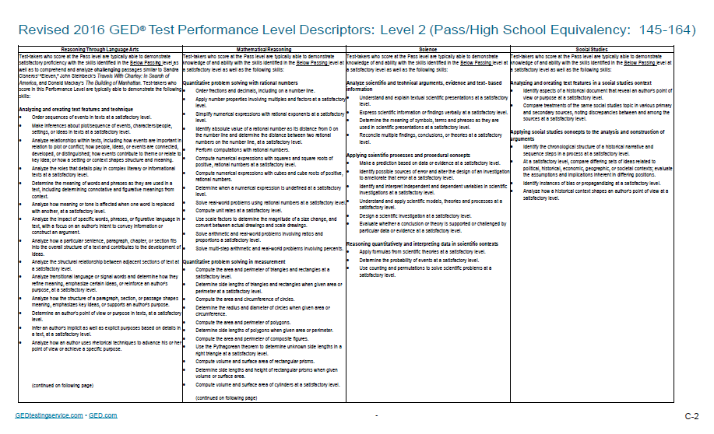
Getting Started with Content
Notes:
Key Points
You will want to spend time reviewing the Relationships Between the High Impact Indicators and Other Indicators chart, as well as the High Impact Indicators chart, and the Performance Level Descriptors. Remember, indicators not identified as high impact continue to be assessed on the GED® test and are very important to include in a GED® Preparation program.

Slide 22
Just a Couple of Strategies for the Classroom
Teach a simple approach to solving word problems by using real world examples
Teach multiple ways to solve problems
Focus on the WHY to give reasoning skills a boost

Slide 23
Reading and Reasoning Process
First Read: Read for Understanding
Second Read: Identify a Problem-Solving Process
Third Read: Solve the Problem and Check for Reasonableness
Miller, P. and Koesling, D. “Mathematics Teaching for Understanding: Reasoning, Reading, and Formative Assessment. Danvers, MA
Notes:
Key Points
The Three Read Process is an important close reading routine that can be used in all content areas. As you model your own visual thinking, you will want to make sure that each time you read the problem, you use the questions necessary for a first read, second read, and third read.

Slide 24
And What About Our “Too Close to Call” Test-Taker?
The Math test score was 135—completely in line with the feedback from the GED Ready® exam
The operational exam feedback identified overlapped with the areas needing improvement on the GED Ready ®—Basic Math, Geometry, Basic Algebra, Graphs & Functions…
Sound familiar?

Slide 25
What Instructors Need to Know: Science
Same Skills…Different Context

Slide 26

Overview of Science Test
Content
  Life Science – 40%
  Physical Science – 40%
  Earth and Space Science – 20%
Themes
  Human Health and Living Systems
  Energy and Related Systems
Science Practices – reasoning and thinking scientifically
Question types – Technology-enhanced items
Notes:
Key Points
This slide provides a short overview of the content and context of the Science Test. Review the information on the slide. For additional information, access the Assessment Guide for Educators Science section.
In 2018, the Science Test will include only technology-enhanced items. However, in subsequent years short answer items may be included. Notification will be provided if any changes are made to the types of items included on specific versions of the test.
The Assessment Guide for Educators Science is located at: https://ged.com/wp-content/uploads/assessment_guide_for_educators_science.pdf

Slide 27
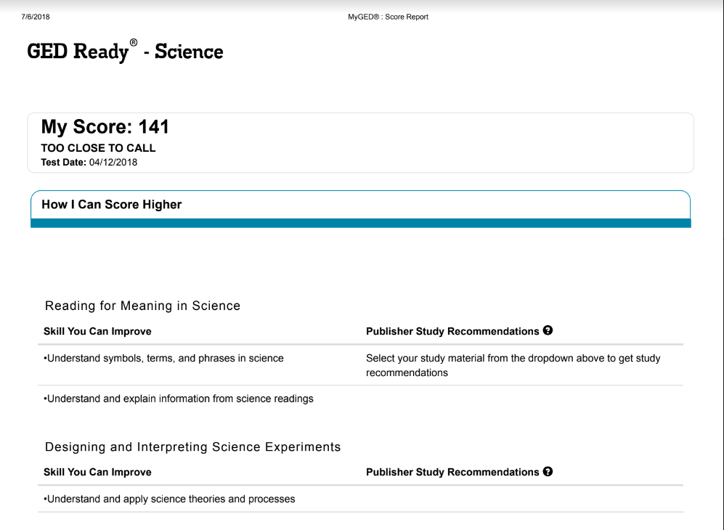

Slide 28
Additional Skills (Selected)
Identify and refine hypotheses for scientific investigations
Pull specific evidence from a written source to support a finding or conclusion
Make a prediction based on data or evidence
Make judgments about whether theories or conclusions are supported or challenged by data or evidence
Express scientific information or findings using numbers or symbols
Understand and explain written scientific presentations

Slide 29
GED Ready® Science Score: 141
Areas for Improvement
Close Reading
Reading for Meaning in Science
Designing and Interpreting Science Experiments
Using Numbers and Graphics in Science
Scientific Method
Math in Science

Slide 30
Diagnosis
Transform into a proficient reader—being able to sort through the structure of text to extract important details, evidence, and facts
Develop close reading skills (an essential)
Practice engaging with Science texts (noticing, wondering, questioning, relating, thinking, and on occasion, arguing)
Practice “reading between the lines” (aka inference)

Slide 31
Explore the Relationships
R.8.6: Identify an underlying premise or assumption in an argument and evaluate the logical support and evidence provided. Primarily measured with informational texts.
AS.1.a: Cite specific textual evidence to support inferences, conclusions, or analyses of technical texts.
SSP.1 a. Determine the details of what is explicitly stated in primary and secondary sources and make logical inferences or valid claims based on evidence.
Notes:
Key Points
Review another HII for RLA that deals with inferences. Sometimes the question requires that test-takers look at what is provided explicitly in a source text and then must make inferences as to why something occurs.

Slide 32
How Did Our Test-Taker Fare with Operational Testing?
GED® Science test score: 143
The operational exam feedback identified the following areas as needing improvement
  Reading for Meaning in Science
  Designing and Interpreting Science Experiments
  Using Numbers and Graphics in Science
Sound familiar? It should…the same feedback from the GED Ready®!

Slide 33
Questions for Reflection
What Can YOU Take Away from this Session?

Slide 34
Questions to Ask Yourself…and Your Colleagues
What are the key ingredients in skill development?
What are some of the most effective ways to prompt persistence especially in students who struggle with reading, writing, or mathematical reasoning?
How can I bring these elements to the classroom?

Slide 35
A Few Takeaways…

Slide 36
Key Takeaways
Please unlearn the notion that there is ONLY one right way—whether it is writing, problem-solving, or thinking critically.
Once is not enough—if that were true, we would have legions of experts!
Flow with the plateaus—learning and skill development are not linear.
Remember that learning is both iterative and integrative. This will enable you to expect the best and have your students deliver their best.

Slide 37

https://ged.com
Notes:
Key Points
[Review url and how to access information. Discuss that there are additional websites for their review in the workbook.]

Slide 38
Questions?
Debi Faucette, Senior Director
Debi.Faucette@ged.com
202.302.6658
communications@ged.com

Slide 39
Thank you!
Communicate with GED Testing Service® communications@ged.com

